Slide 1
PGS Introduction
Why PGS?
What is PGS?
How PGS works?

Slide 2
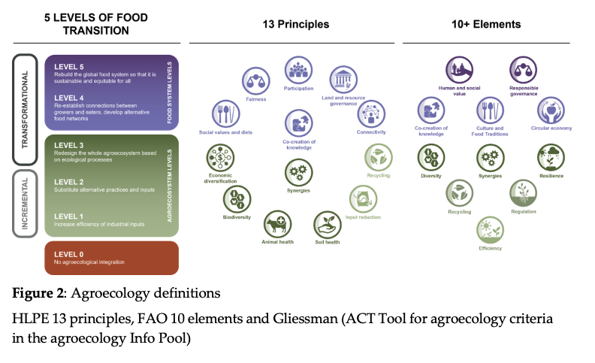

Slide 3


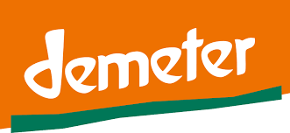
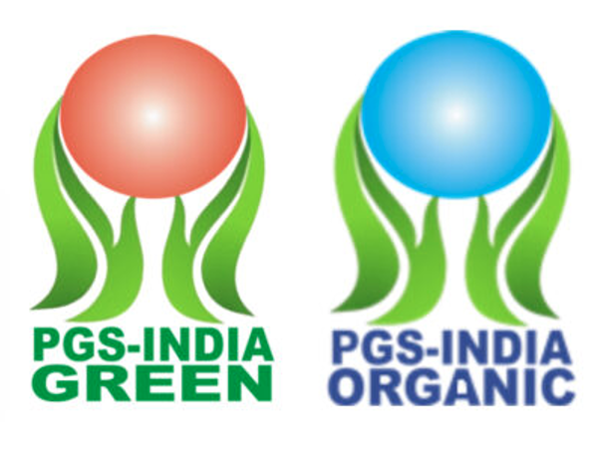



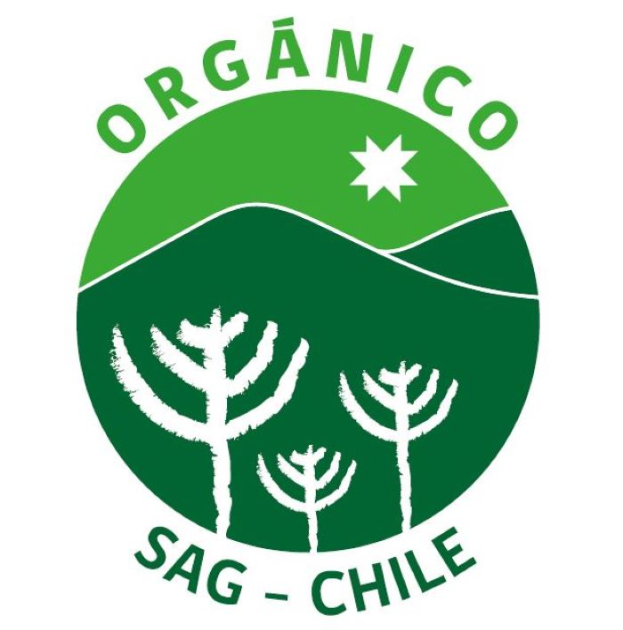
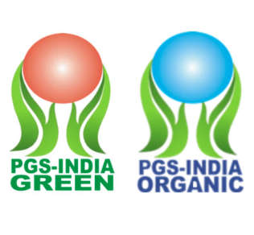
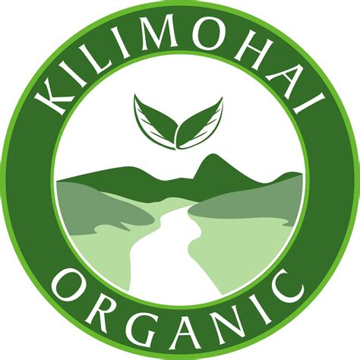


Slide 4
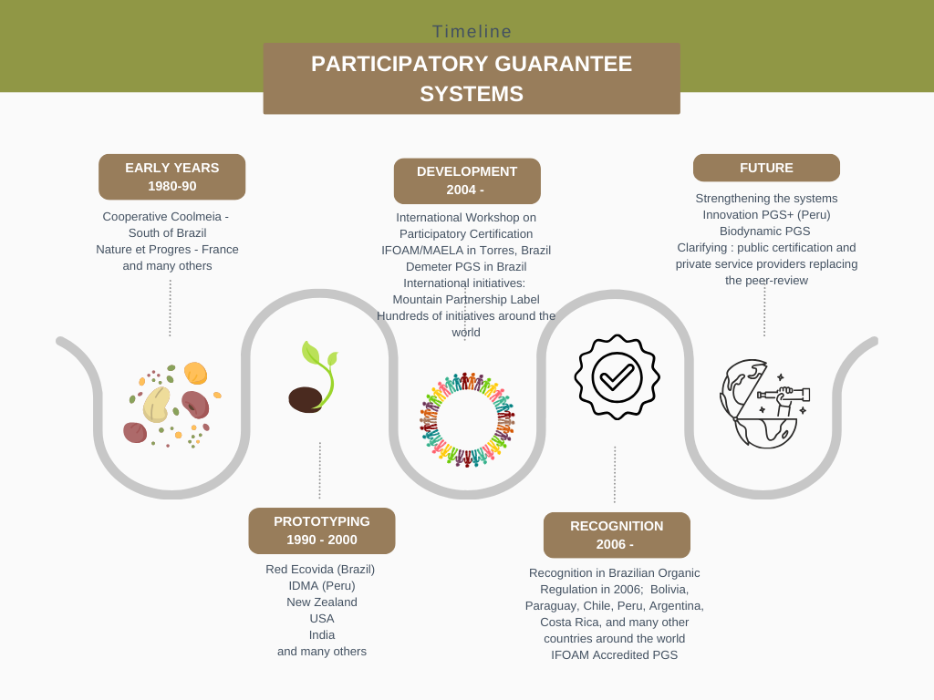
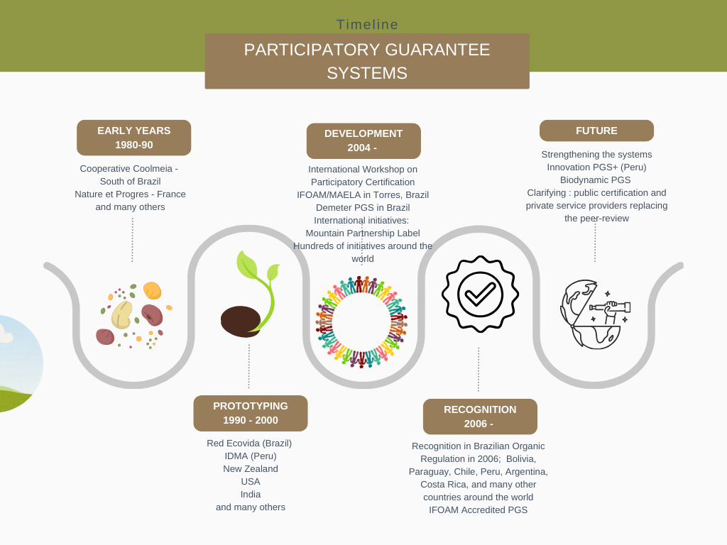

Slide 5
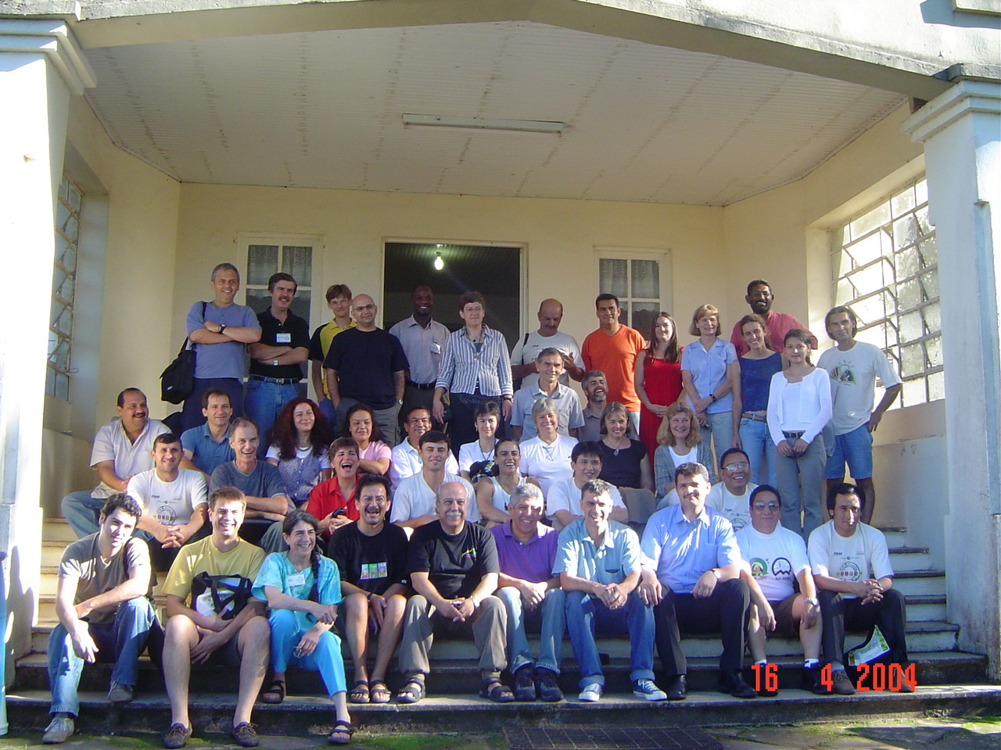
Why PGS?
Need for a guarantee system for a local organic market.
High third party certification costs
Disagreement with the paradigm for ensuring credibility
Ambition to strengthen and empower farmers
Creation of opportunities for technical exchange and learning
Notes:
IFOAM observed that that some groups of farmers and consumers in different countries had developed less formal methods for guaranteeing the organic status of their production.
In 2004 IFOAM has decided that the time was ripen enough to assess the status of alternative certification schemes around the planet.
In 2004 in Brazil IFOAM and MAELA, at a workshop now referred to as Torres 1 representatives from many of these alternative ‘schemes’ came together to share their experiences in how they help smallholders gain recognition in their markets as organic producers.
The reasons behind alternative certification: The reasons for these “alternative” methods of certification vary, but often result from certification costs, disagreement with the paradigm for ensuring credibility, or a political ambition to strengthen the farmers. In some cases ISO 65 type certification is seen as unnecessary.
A key out put from Torres 1 was the synthesis and documentation of the common themes that underpinned many of the different approaches. This helped to define PGS as described in the IFOAM PGS Guidelines Doc and create the term Participatory Guarantee Systems.

Slide 6
What is PGS?
What is PGS?
Participatory Guarantee Systems (PGS) are locally focused quality assurance systems. They certify producers based on active participation of stakeholders and are built on a foundation of trust, social networks and knowledge exchange.
(Definition IFOAM – Organics International 2008)
To understand – be clear first:
What is Organic Agriculture?
What is an Organic Guarantee System and why is it needed?

Slide 7




PGS key elements
Notes:
1. Building a Shared Vision is the starting point of a PGS. This is where the key stakeholders (producers, consumers, NGOs, traders, institutions, governments, etc.) collectively agree to support the principles guiding what the PGS is trying to achieve.
The shared vision can embrace organic production goals, as well as goals relating to standards, social justice, fair trade, respect for ecosystems, the autonomy of local communities, cultural differences, and so on. These principles are used to guide both production standards and the rules of how the PGS will operate.
Shaping the vision in a participatory process is an essential step in the PGS development.
How the stakeholders collectively share their vision will vary, depending on the local circumstances and the ways in which stakeholder groups are engaged.
2. Participation is an essential and dynamic part of PGS and is reflected through the active engagement of stakeholders who share a common vision, including producers and consumers, retailers and traders and NGOs among others. All stages of the planning, the development and the operation of PGS are facilitated by these stakeholders, in various capacities. The concept of participation embodies the principle of a collective responsibility to ensure the organic integrity of the PGS.
3. Transparency is created by making all stakeholders, including producers and consumers, aware how exactly the guarantee system works. This includes the standards, the organic guarantee process (norms) and the decision-making processes. This does not mean that every detail is known by everyone but rather they have at least a basic understanding of how the system functions or have a way to find out. As far as Standards are concerned, most PGS initiatives develop summary version of the standards adopted, as away to make it easier for producers to understand what they are agreeing to comply with.
4. Trust: The integrity base upon which PGS are built is rooted in the idea that producers can be trusted and that the organic guarantee system can be an expression and verification of this trust. Trust is built through the collective development of the shared vision by the key stakeholders and maintained through the continuation to collectively shape and reinforce the vision through the PGS. This idea of ‘trust’ assumes that the individual producer has a commitment to protect nature and the health of consumers through organic production. The ways trust is reflected in the PGS may vary and will depend entirely on factors that are culturally specific to the PGS group.
5. Learning Process: Through the exchange of ideas and experiences a learning process unfolds and becomes an ongoing dynamic of a PGS. This can include technical aspects, for example to build knowledge on organic standards and organic practices. A social learning process happens when different stakeholder groups get to know each other and gain awareness of each other’s situations through the participation in the PGS. The obtained knowledge is fundamental for the PGS and contributes to how the components are designed. It is key in the development of trust between stakeholders and in the PGS process itself.
6. Horizontality: PGS are intended to be non-hierarchical. This is reflected in the overall democratic structure of PGS, where producers are able and encourage to take different roles in specific committees, elections are held in order to appoint people to decision making bodies, and there is alternation/rotation of roles and tasks (not control by one single facilitator, for example).

Slide 8
The growth of PGS

Slide 9
India:
64,475 PGS
1’805,141 producers
1’035,847 has.
Global:
64,805 PGS
2’012,234 producers
1’131,933 has.

Slide 10
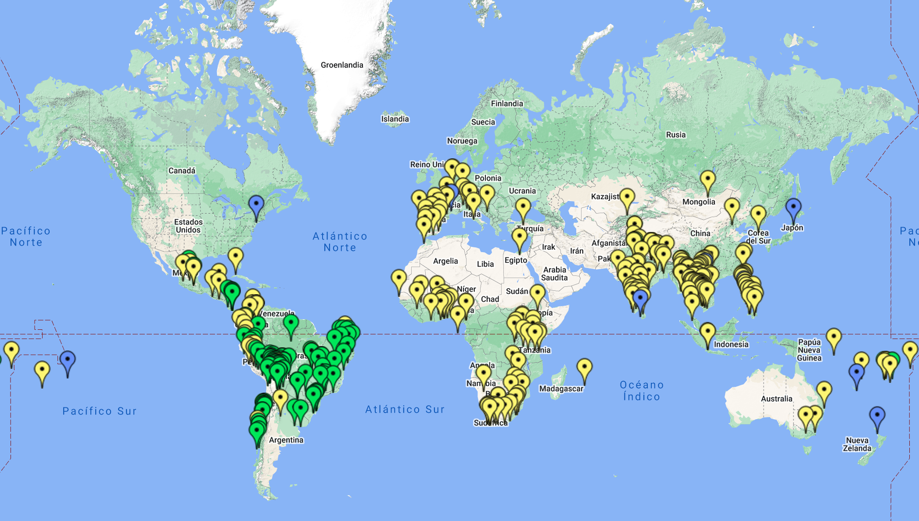
PGS MAP: https://pgs.ifoam.bio/

Slide 11
Participatory Guarantee Systems (PGS)
PGS aim to
… provide a credible organic guarantee to consumers seeking organic produce
… at a reasonable cost for the farmer
… in a way that is managed by the farmers and stakeholders themselves.
Active participation on the part of the stakeholders results in greater empowerment but also greater (and shared) responsibility.
Replacing external professional work by volunteer internal work means less expenses, but more time input.

Slide 12
Challenges of PGS
Requires high degree of dedication from stakeholders
Long term process for capacity building
Not everywhere recognized
Complex social organization (collective)
A lot of voluntary work
Limitation in the oversight of anonymous, long distance market channels
Notes:
With this slide we end our presentation for today.
We still have some homework to do:

Slide 13
Why PGS – and when/when not
PGS a lot of work and long-time effort:
Will only work if there is a clear need for it and clear benefits for stakeholders involved
PGS alternative to third party certification. There are situations where third party certification is more suitable. There are situations where PGS is more suitable. There are situations where neither is needed.
→ understand your situation and the needs and conditions well!

Slide 14
Why do we want a PGS?
PGS develops where the need has been identified:
Local market for organic products exists or is developing.
Local suppliers of organic products exist or are developing.
Smallholders need access to a guarantee.
Customers need assurance.
Short supply chains.
-> From a shared need comes a shared vision

Slide 15
PGS and 3rd party
Third party certification | PGS
Certifies the product | Certifies the farm / each farmer has a certificate
Independent from stakeholders | Participatory (stakeholder involvement)
In accordance with international norms | Following general PGS international principles but locally adapted Normally complying the national norms if exists, hence, also international norms.
Gives access to international markets (with right channels) | Priority given to domestic markets, exceptionally intra-regional/international
Normal guarantee system in government organic regulations | Often not recognized by governments
Deals only with certification | Combines with other functions, e.g. capacity building, marketing, etc.

