Slide 1
Basic concepts and fundamentals of organic production
Patricia Flores,
Senior Global Academy Manager
IFOAM – Organics International
Notes:
Ask

Slide 2
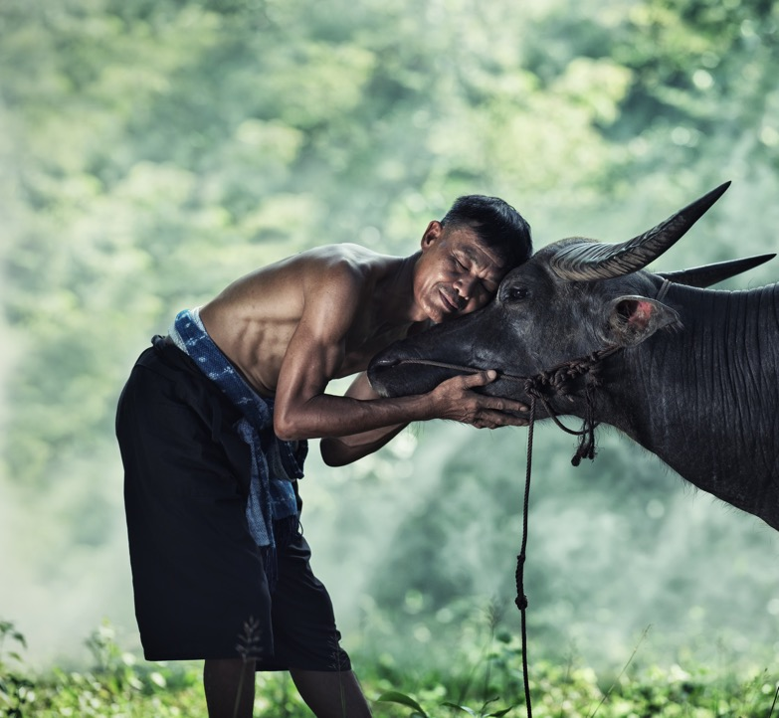





The principles
of organic agriculture
are the roots from which our community grows and develops. They are the base of our shared vision.
Health
Ecology
Fairness
Care
3
3
*Read more about the four principles of organic agriculture here.

Slide 3

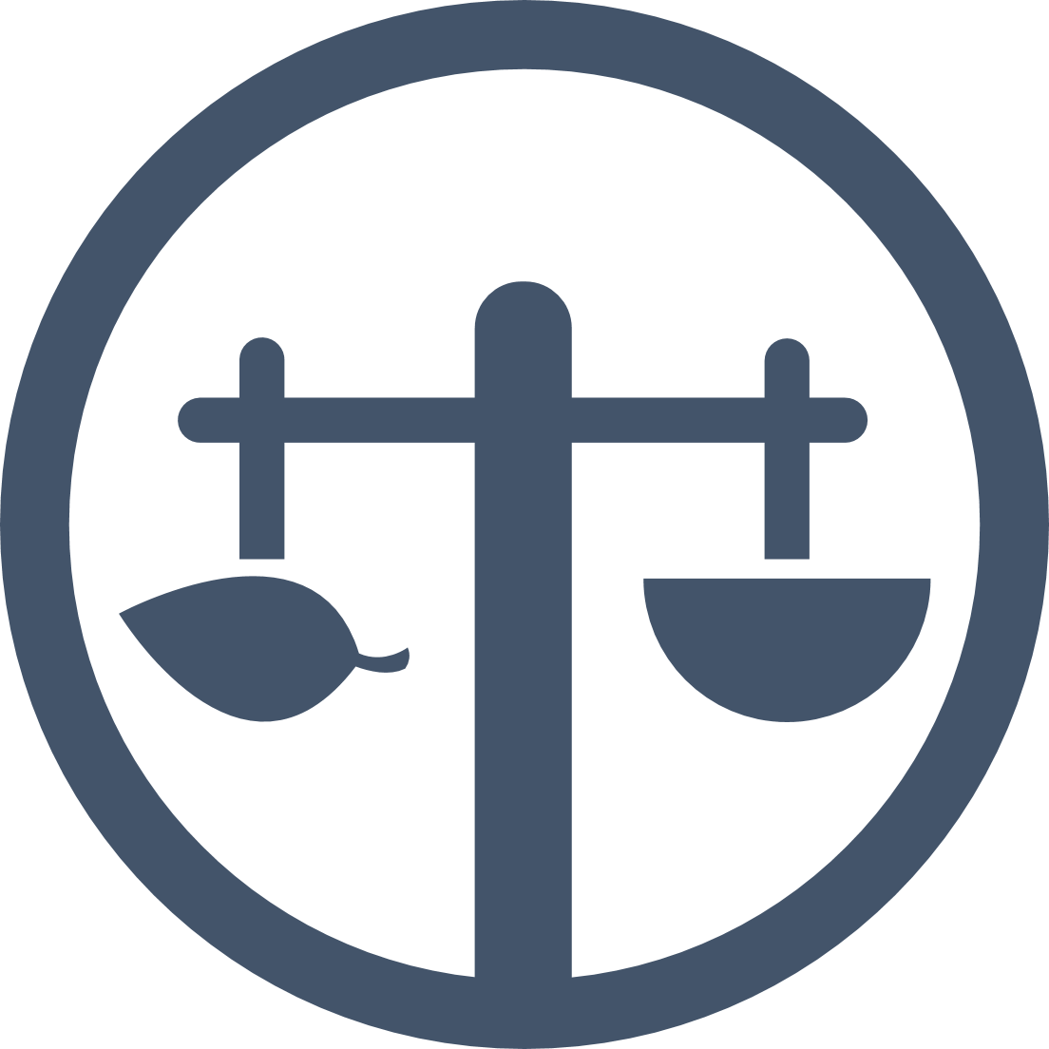


Inspired by the principles!
Organic agriculture...
Sustains and enhances
the health of soils, plants, animals, humans and our planet.
Builds on relationships
that ensure equity for our environment, and our communities.
Health
Fairness
Safeguards
living ecological systems and
cycles, by working with them
not against them.
Protects the wellbeing
of current and future
generations and ecosystems.
Ecology
Care
*Read more about the four principles of organic agriculture here.

Slide 4
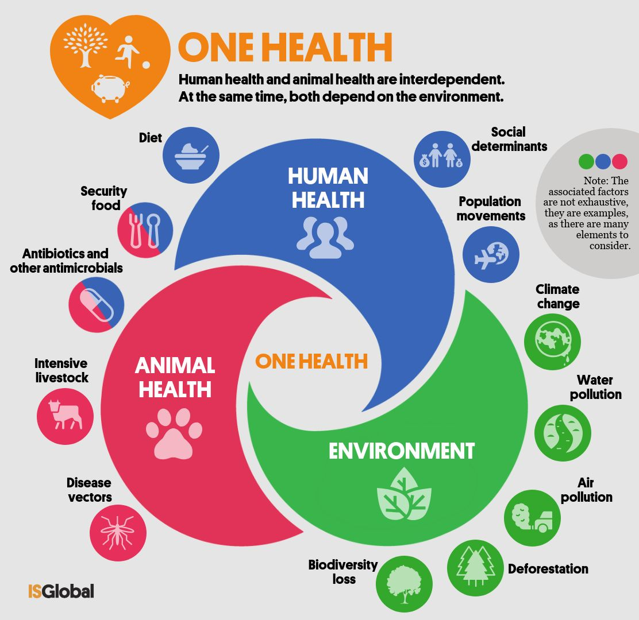

Slide 5
This is why organic is part of the solution!
It’s time to take action...
From Problems
To Solutions
Using our principles
Greenhouse gas emissions
Soil erosion
Water crisis
Biodiversity loss
Poverty
Lack of information
Inequity
Inefficient Policies
Carbon sequestration
Soil fertility
Water retention
Agro-biodiversity
Rural incomes
Access to information
Equity
Sustainable policies
Health
Ecology
Ecology
Care
Fairness
Care
Ecology
Fairness

Slide 6
What is Organic Agriculture?
Exercise: Organic practices – what are they?
Time: 5 minutes

Slide 7
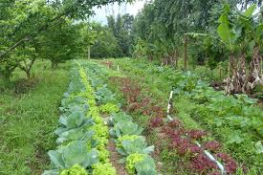
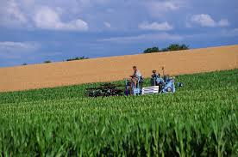
Definition of Organic Agriculture
"Organic Agriculture is a production system that sustains the health of soils, ecosystems, and people.
It relies on ecological processes, biodiversity and cycles adapted to local conditions, rather than the use of inputs with adverse effects.
Organic Agriculture combines tradition, innovation, and science to benefit the shared environment and promote fair relationships and good quality of life for all involved.”
IFOAM General Assembly 2008

Slide 8
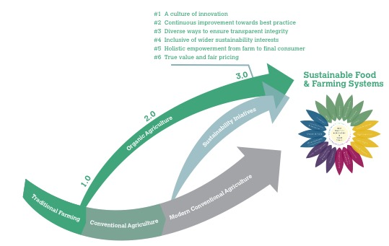
Towards Organic 3.0
In order to fully utilize its potential, organic agriculture needs to grow, continuously improve its performance and inspire mainstream agriculture. Organic 3.0 provides a roadmap for innovative, inclusive, fair and impactful organic development from farm to final consumer.
All stakeholders and policymakers are invited to participate in the formulation of local and international strategies that advance the implementation of Organic 3.0

Slide 9
The Organic Guarantee System

Slide 10
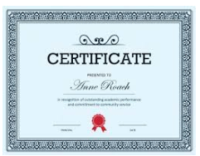
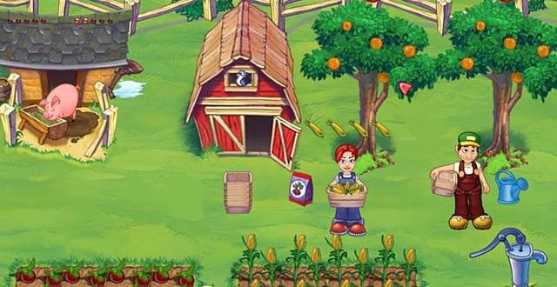
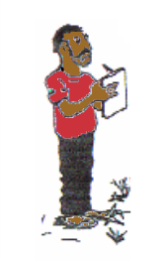
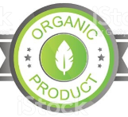

What is an organic guarantee system?
Components of organic guarantee systems
The producer follows an organic standard.
A certificate proofs that the farmer passed the verification process.
A verification system confirms that the producer complies with the organic standard.
A label allows consumers to identify the organic products in the market.
Notes:
Q? Ask to put in chat or say orally.
What are the components?
How does it work – give an example?

Slide 11
Why do we need a guarantee system for Organic Agriculture?
Why do we need a guarantee system for organic products?
The consumer requests assurance that products are healthy and environmentally sound Organic products and is often willing to pay a higher price for them.
Trust
The farmer produces according to defined organic standards and can serve this consumer’s needs and sell her products often at a higher price.
Notes:
This is how the need for a guarantee systems emerges: the need to define standards for organic agriculture (the first element of a GS) and procedures to verify that these standards are being followed (second element of a GS).
A GS serves this purpose: to build trust.

Slide 12
Can a producer be called organic without guarantee/certification?
Organic agriculture is practiced for many reasons:
Food and Nutrition Security
Health
Climate change
Biodiversity
Soils
Sustainable development and strengthening livelihoods
None of these require organic assurance!
Only when we get to the market, does verification of organic integrity become an issue.
No market - no organic guarantee needed
Notes:
How does organic agriculture (and these principles) relate to guarantee systems?
If we look at the reasons why people adopt organic agriculture, we can see that in most cases there is virtually no relation.
But when it comes to trade and the market: this is where integrity becomes an issue.

Slide 13


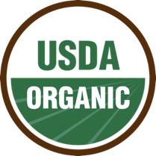
1980s - now: Value Chain and certification
1990: organic markets growing at 20 per cent per year
1991: EU adopts a legislative framework for HE
2002: USA adopts the National Organic Programme (NOP)
2014: 84 countries with organic regulation
2018: Global organic retail sales reached $90bn.

Slide 14
The Uncomplicated Picture 2023
More than 76 countries have fully operational organic legislation
A total of 20 countries have organic legislation that has not been fully implemented,
Some 13 countries are drafting legislation
Approximately 100 private organic standards.
More than 700 CBs participating in organic certification

Slide 15
Question
How Kazakhstan regulate its organic market:
Does the legislation include exports, domestic trade, control and surveillance systems?
Do you have private standards?

Slide 16
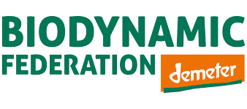
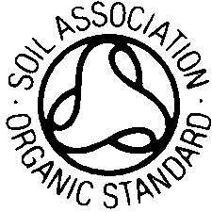

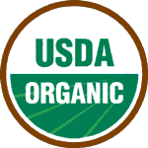
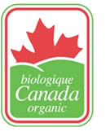

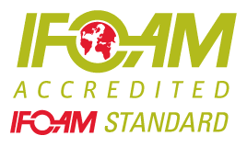

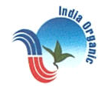
Types of standards
Private standards
National legislation
Voluntary regional organic standards
International Organic Standards
  IFOAM Standard
  Codex Alimentarius

Slide 17
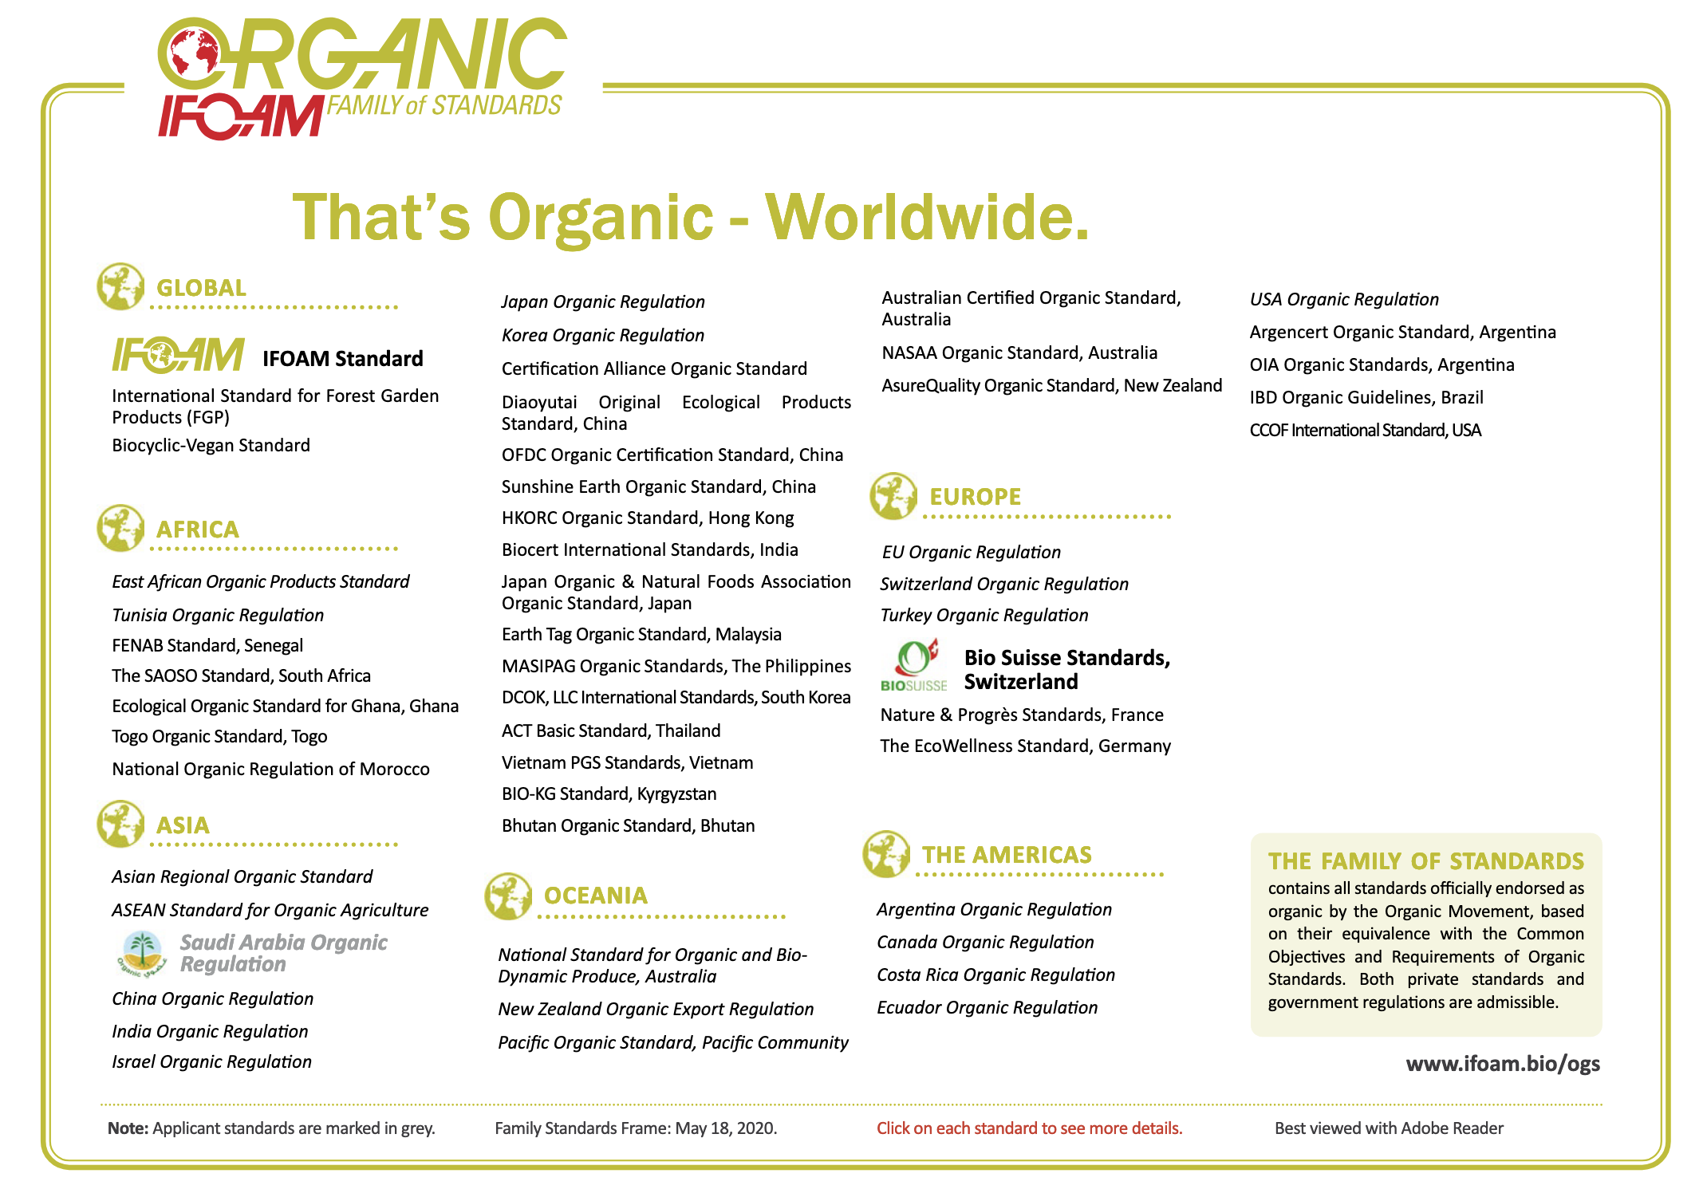
IFOAM family of standards

Slide 18
The standard must pass COROS in order to enter the family
Common Objectives and Requirements of Organic Standards (COROS)
Organic farming is long-term, ecological and systemic.
Soil fertility is long-term and based on biological factors.
The use of synthetic materials and exposure of people and the environment to persistent, potentially harmful chemicals are avoided/minimised throughout the organic production chain.
Pollution and degradation of the production/processing facility and the environment as a result of production/processing activities are minimised.
Some unproven, unnatural and harmful technologies are excluded from the system.
Responsible treatment of animals.
The natural health of the animals is maintained and preserved.
Compliance with the standard is maintained throughout the supply chain.
Employees and workers are ensured honesty, respect and fairness, equal opportunity and non-discrimination.

Slide 19
Advantages of FoS and COROS passage
FoS is recognised by many private standards and some countries
Textiles (Private)
  Global Textile Standard (GOTS)
  Textile Exchange
  Öko Tex Organic
  Cotton made in Africa Organic
Cosmetics (Private)
  COSMOS Belgium
  Nature Label, Belgium
  EcoWellness labelling programme
Food (Private)
  Labelling requirements of the East African Organic Standard
Exhibitions (Private)
  Requirements for exhibitors/products accepted at BioFach
  Middle East Natural & Organic Product Expo's technical criteria for organic products
State programmes
  Australian requirements for imported organic or biodynamic products and ingredients
  Procedures and conditions for importing organic products into Saudi Arabia

Slide 20
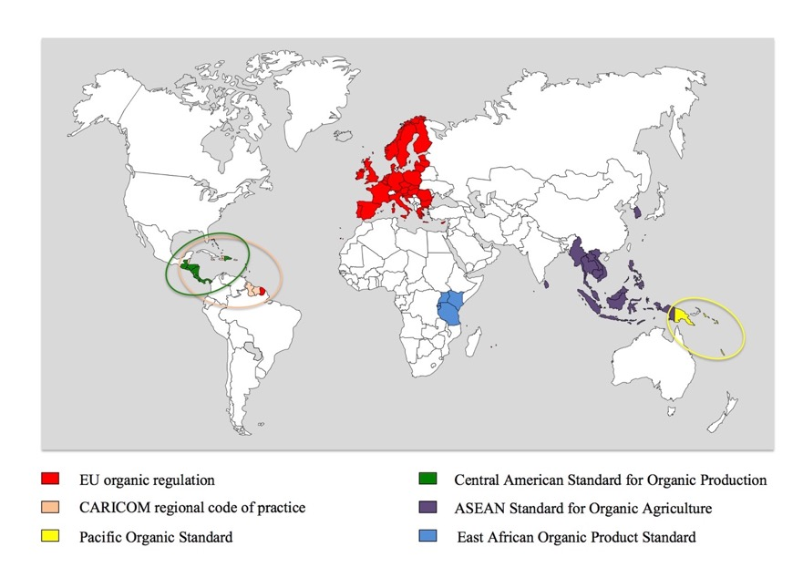
Regional Organic Standards - 2015-2023.

Slide 21
Organic Origin Guarantee Scheme in the EU
1 regulation for 27 countries (standard + control measures). "Bio", "Eco", "Organic" are regulated by law.
General labelling of organic products
CBs should be accredited by the national accreditation body + approved by the competent authority (except for state CBs).
Free trade in organic products within the EU, with 1 certificate.
Equivalence with the main organic markets (USA, Canada...). From 2025, equivalence agreements will become trade agreements
PGS is not accepted
Some countries have private standards (e.g. Germany), others do not.

Slide 22
Questions for the audience
There are 3.7 million organic farmers in the world. How many of them are certified under the group certification scheme?

Slide 23
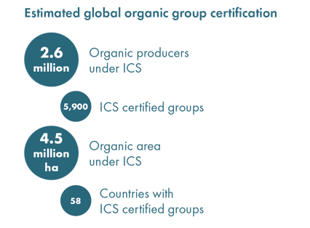
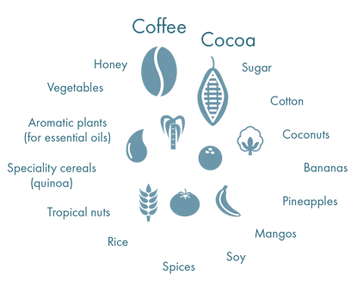

Response
Approximate data on group certification
Coffee
Cocoa
Organic producers
honey
Sugar
Vegetables
Cotton
Farmers' groups
Aromatic plants
Coconuts
Niche cereals
Bananas
Organic land
Pineapples
Tropical nuts
Rice
Mango
Countries
Spices
soya
76% of the world's organic farmers confirm organic status through group certification.
Notes:
The largest groups in Ethiopia are 6-8 k. Need to be divided into smaller groups.

Slide 24
ORGANIC SYSTEM OF INTERNAL CONTROL
definition
An internal control system (ICS) is part of a documented quality assurance system that allows an external certification body to delegate the periodic inspection of individual team members to a specific body or unit of the certified operator.

Slide 25
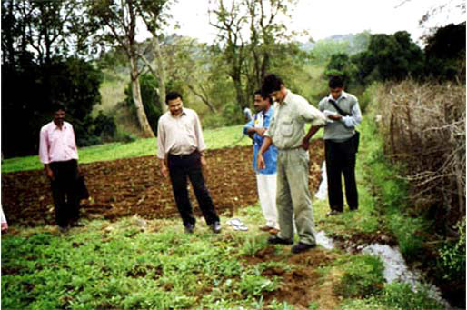
ORGANIC SYSTEM OF INTERNAL CONTROL
The certifying bodies only verify
Smooth operation of the system
And its reliability/integrity

Slide 26
ORGANIC SYSTEM OF INTERNAL CONTROL
Prerequisites for certification of the Small Farmers' Group
The cost of individual certification is disproportionately high relative to the cost of sale.
Homogeneity of members (location, production system, size of land holdings).
Generally only suitable for small farmers
Usually have a common distribution system

Slide 27

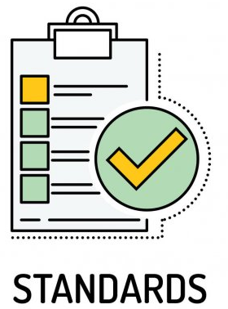
Standards – who decides about them?
Governments/authorities?
The private sector?
Experts or specialists?
Standards authorities?
Anyone can set standards,
and everyone does…
Notes:
Take a break after this slide!
Goverenment regulations lead to specific requirements that affect the production practices in other countries as well: the importing country is the one setting the rules for organic productions in international trade.
Regional standards can contribute to trade in areas where there are no governmental regulation on organic agriculture.
Voluntary standards are common around the world and that is how the first standards were born.
IFOAM has also developed standards that are available as a reference to be used by anyone, for free, as long as the references to IFOAM are approapriately used.
There is actually a multiplicity of Standards that creates some confusion within the sector, but we will not address this in this course.
Farmers and producers have been further excluded from the development of standards, becoming more and more passive recipients of rules developed “outside”.
For now it is enough to say that anyone can set standards, everyone does, and those who are more directly affected by these rules should be more involved in their deveopment as well.

Slide 28
Organic Guarantee Systems
Why so many organic standards?
Differences in culture, climate, practices, economic stage, natural resources, …
Specific concerns of organic consumers & movement
Overall legal framework
Stage of development of organic agriculture in the country
Notes:
Examples of differences Climate and agricultural practices: max 170 kg Nitrogen/ha/year under EU ha but not the same in the East African standard because this amount of fertilization is calculated based on 1 crop per year under the EU climate and not for 3 crops per year under tropical (equatorial) climate.
Specific concerns of the country: example of the antibiotics prohibition in the USA, whereas 3 treatments per year/animal (with due withdrawal period) are allowed in the EU.
Legal framework: social justice and deforestation (clearing of primary forest) are not included in the EU organic regulation because this is covered by other (so-called “horizontal” legislation). Same for the drinking quality of water used in processing. However they are included in many standards of “developing countries” for example in Africa and Asia because there the countries do not have (or they do not properly enforce) such general legislation.
Stage of development of organic agriculture: for example the minimum percentage of animal feed that must be organic. The EU now requires organic farmers to feed almost 100% of certified organic feed, but in some countries this percentage is only 60% because there is not yet a wide supply of certified organic feed for animals. Same issue for organic seeds, which are not widely available in many countries.

Slide 29
How many types of organic guarantee systems are there?

Slide 30
Organic Guarantee Systems
How - by whom - can the guarantee be provided?
1st party → the producer himself
2nd party → other farmers or the buyer
3rd party → an independent certification body
3rd party certification:
Currently dominant system for organic guarantee. Access to export markets.
Professional service. Inspectors are professionals, Certification Body (CB) is a specialized organization
Independence/impartiality (ISO 17065). No producer organization, no advisory service
Individual or group certification (group certification with ICS)
CBs must be overseen by a competent authority

