Slide 1
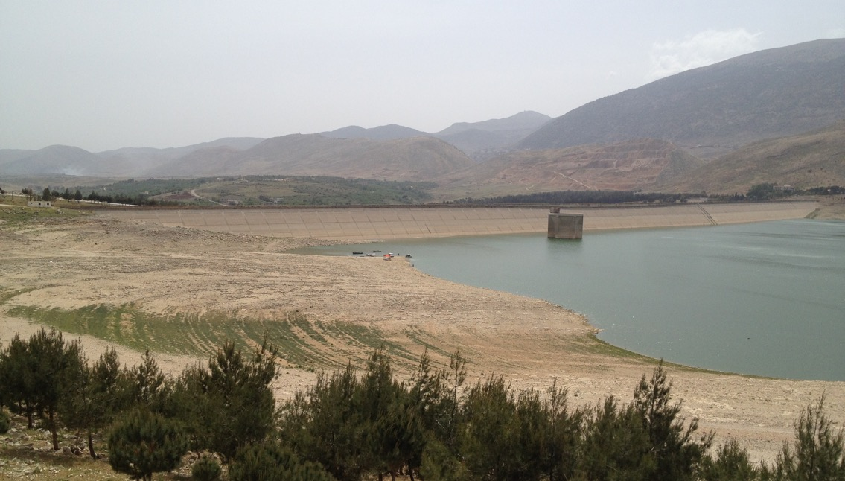


Improving Irrigation System Management:
Global Experience
with Emphasis on Europe

Slide 2
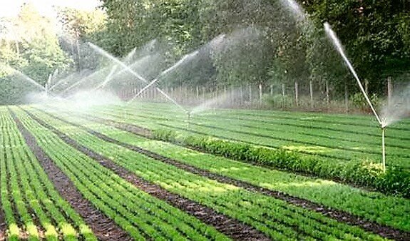
Why this is important – eight statements
Irrigation is the largest water user globally – it holds the key to sustainable water resource management
Yet water use in many irrigation systems is still increasing – at the cost of strategic water reserves, or other uses such as environmental flows
Irrigation is hugely important for food and fibre production, yet crop water productivity and water efficiency is still far below optimum
Irrigation systems serve many other function which are not optimized
Water quality (such as salinity) is an increasing risk but it is not addressed
Governance of large irrigation systems is outdated, not change-oriented
Underfunding in typical, leading to the collapse of newly built infrastructure
Opportunities for optimization are not used

Slide 3
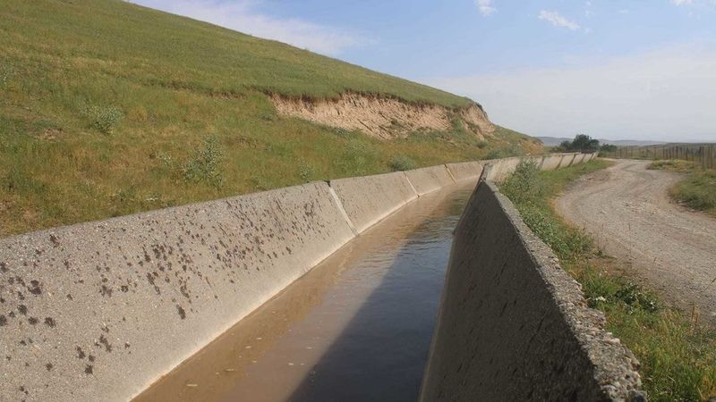
Modernization of irrigation infrastructure
  Efficient field irrigation
  Irrigation system management
  Water allocation
Water management
  Use non-conventional sources
  Reduce water logging and salinity, address scarcity
  Salt tolerant crops
Policy frameworks and regulations for irrigation infrastructure
  Good governance
  Operate as public business
  Secure financing
  Adressing multiple functions
Framework to Improve Irrigation System Management

Slide 4
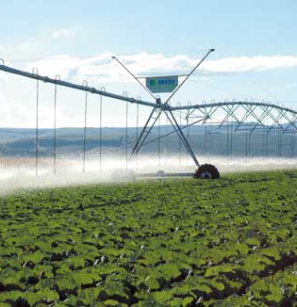
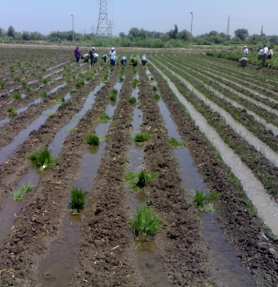
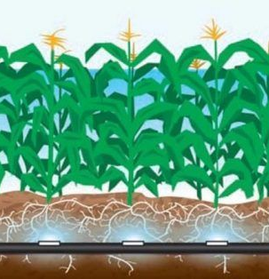
1. Modernization of irrigation infrastructure
Water saving: use a range of improved field techniques
- but be aware of evaporative losses (= look at net losses)
Centre-pivot (high evaporative losses!)
Ridges (losses can be reused)
Sub-irrigation (no gross/net losses)

Slide 5
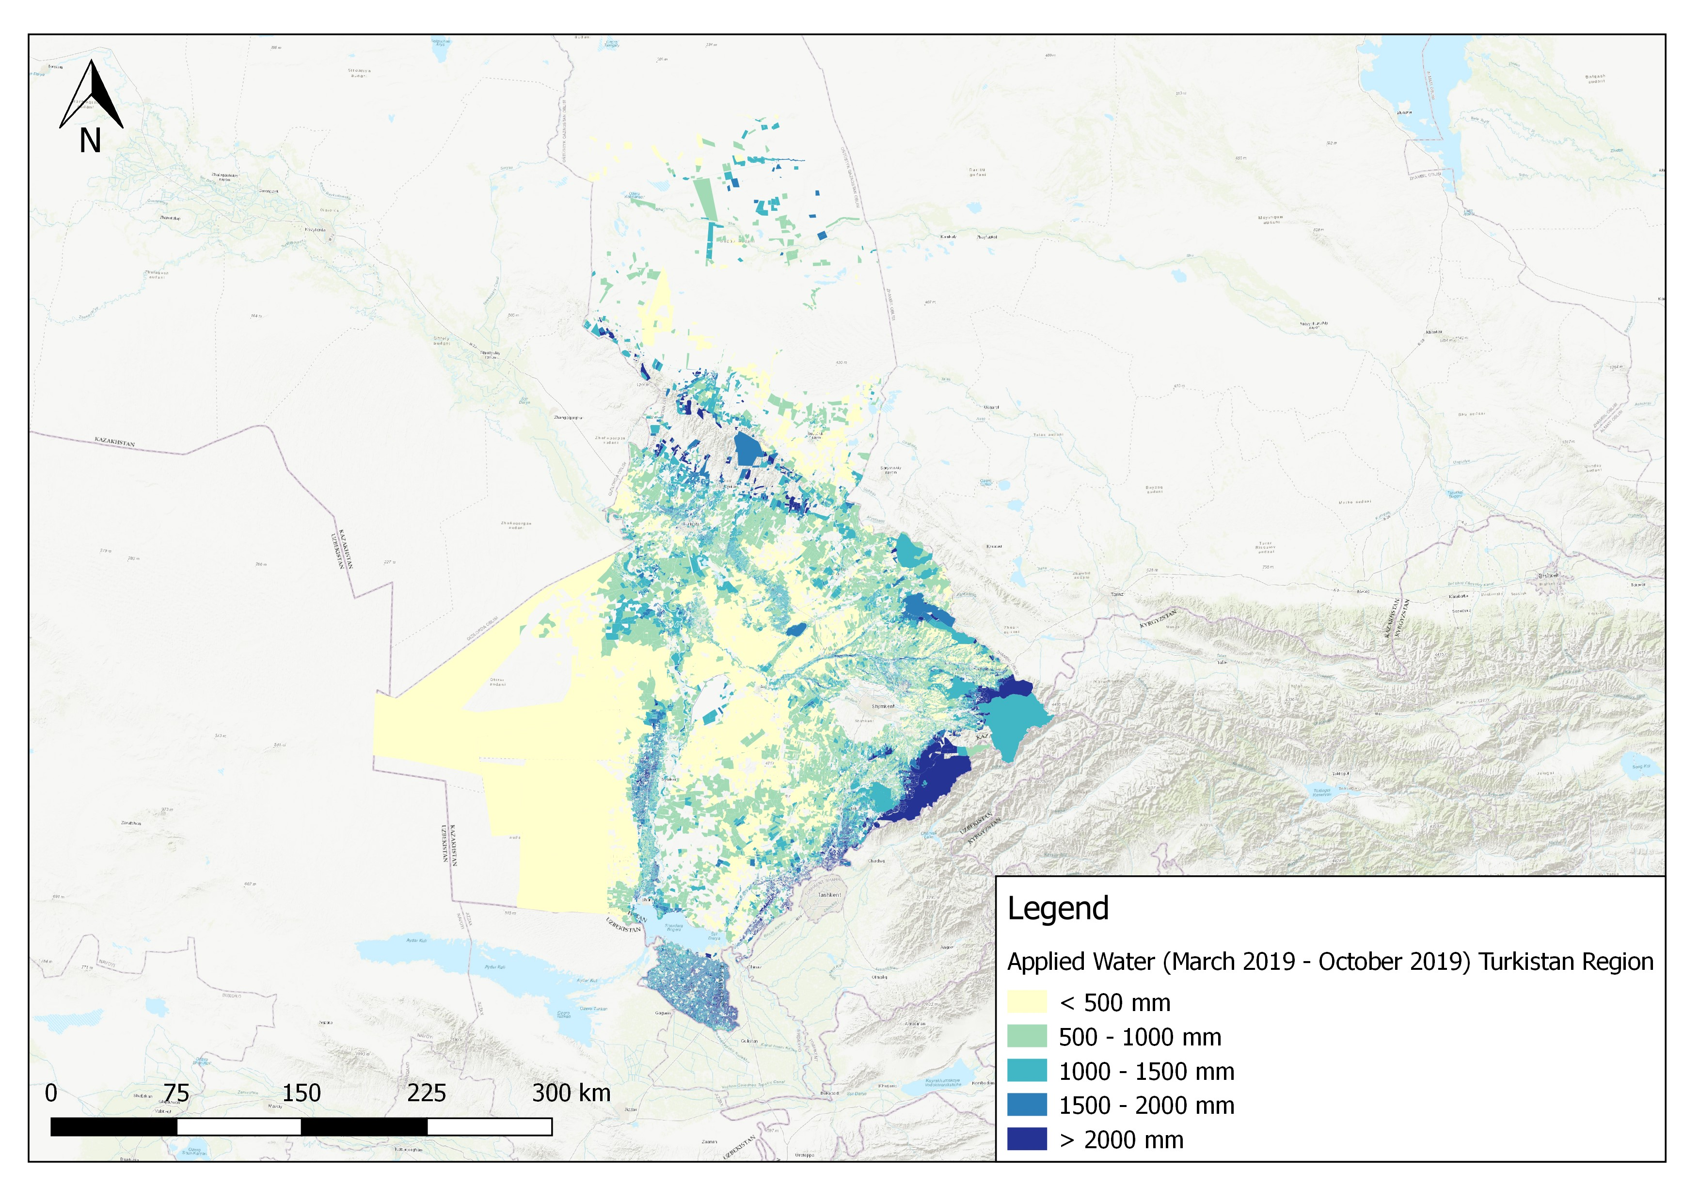
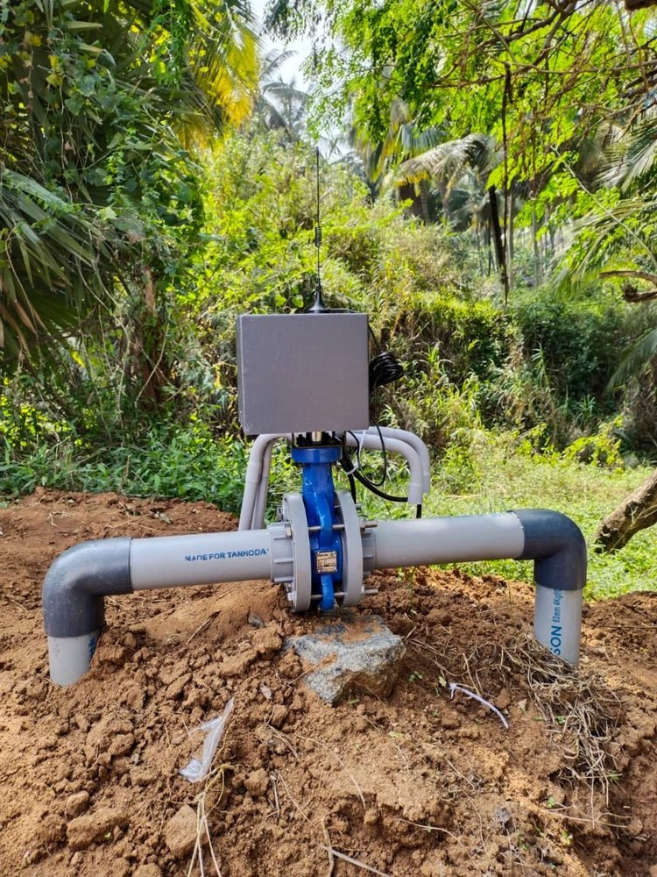
1. Modernization of irrigation infrastructure
System management: combine fully automated precision systems with remote sensing and IT
Remote sensing measuring
evapotranspiration and moisture stress
Automated system
responding to signals
in moisture stress

Slide 6
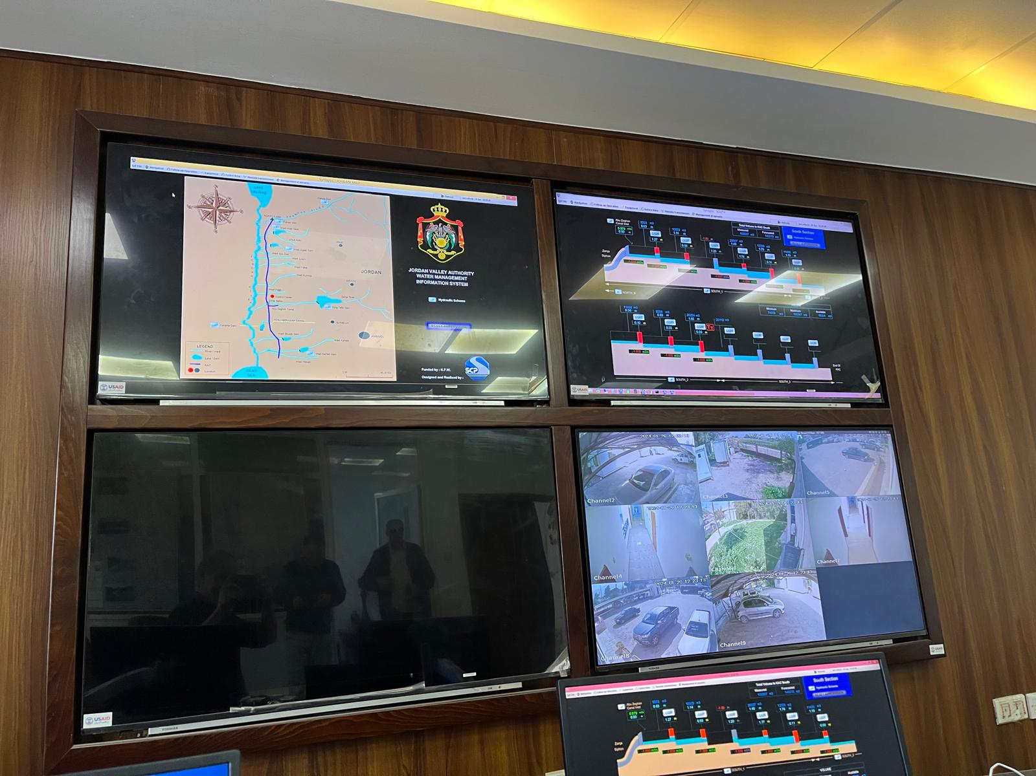
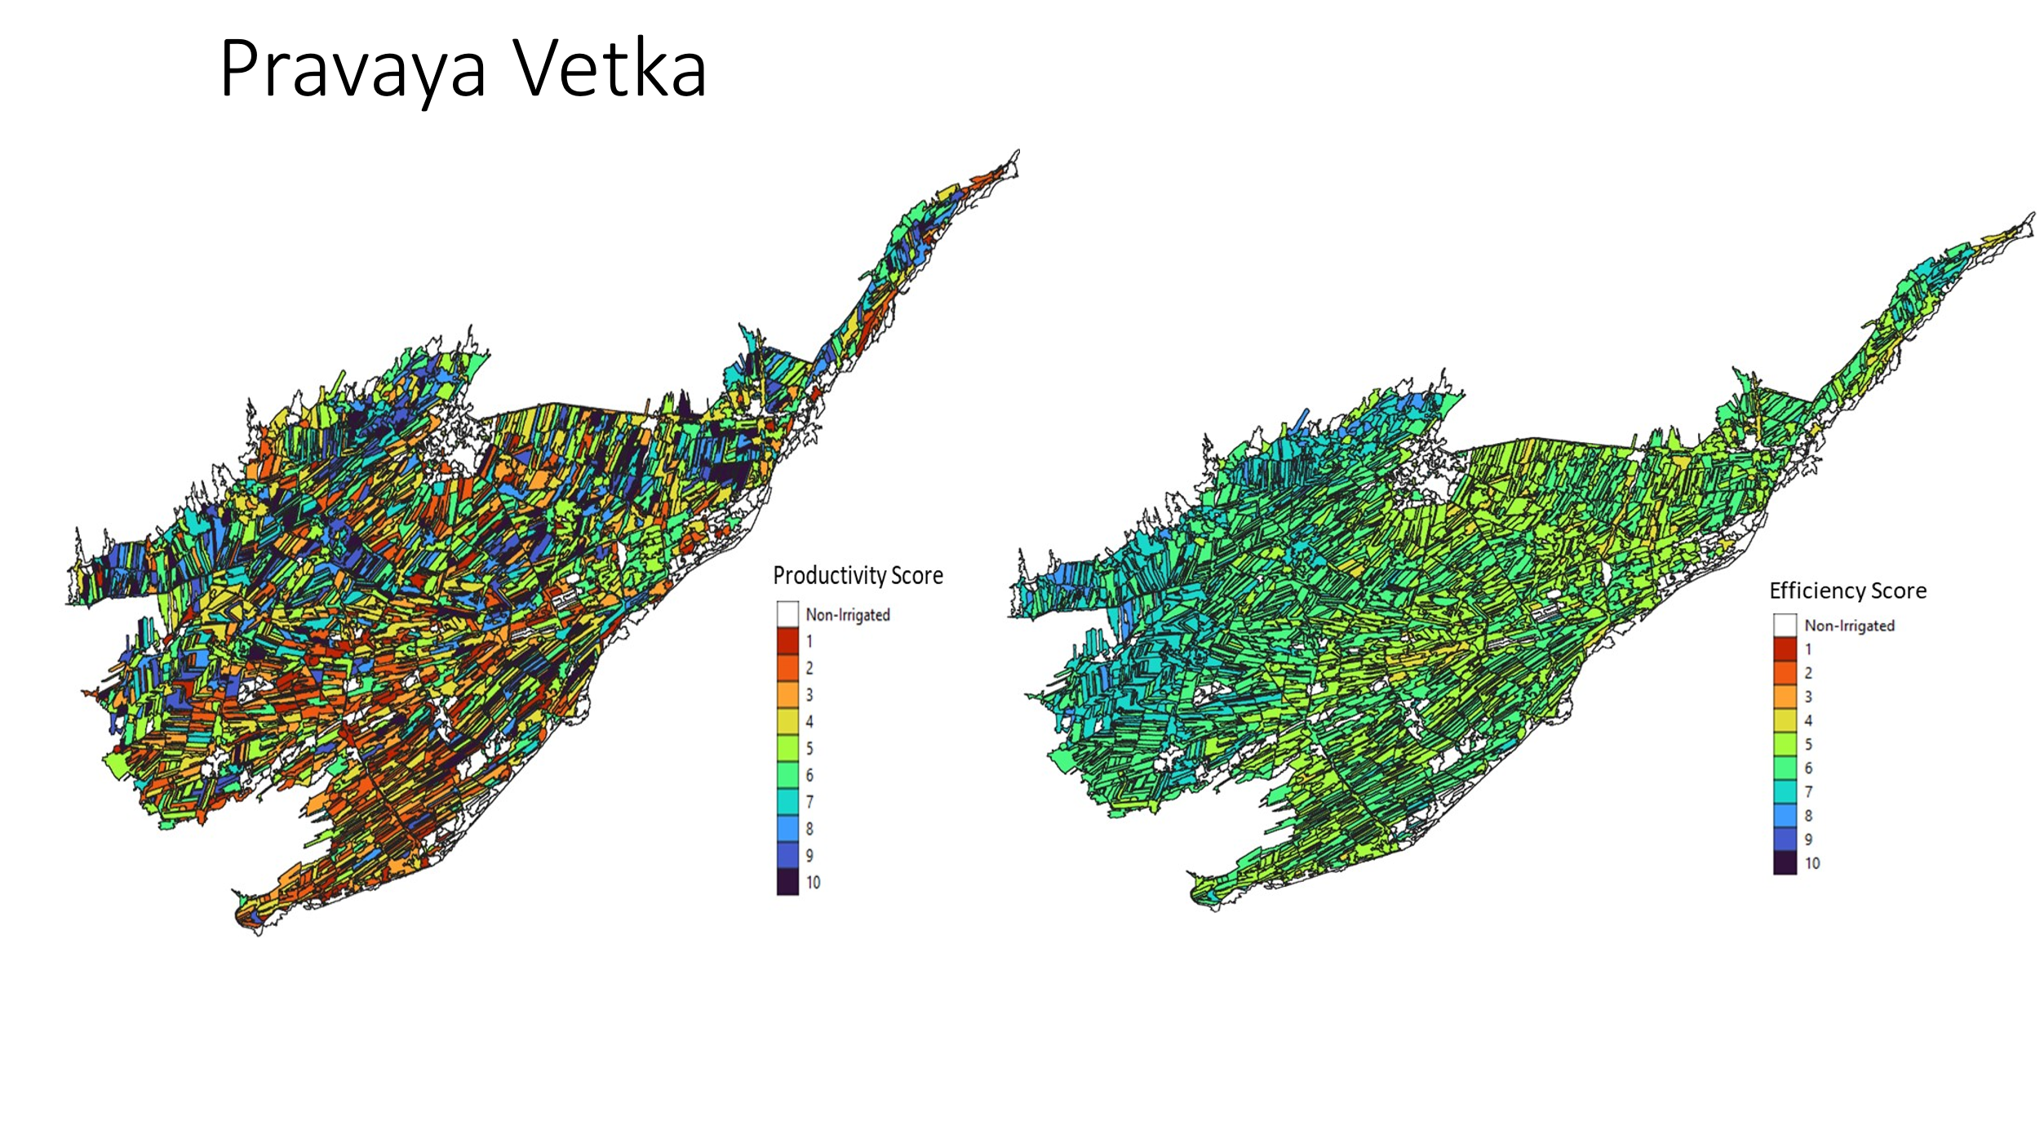
1. 1. Modernization of irrigation infrastructure
This needs to be matched with improved water allocation at system level
- hardware (control room) and software (regulations)
‘Who gets what, how, when and where’ is at the heart of water governance and economies and societies at large

Slide 7
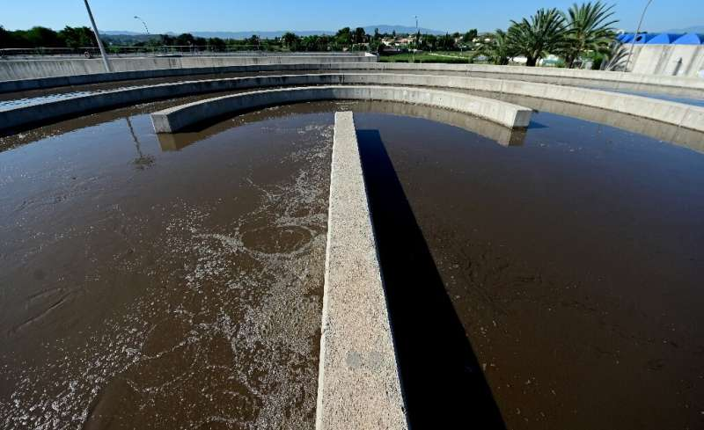
2. Water management within irrigation systems
  Use of unconventional water sources to address water scarcity
  Reduce water logging and salinity & save water
    Conjunctive use of surface and groundwater
    Controlled drainage
  Use salt tolerant crops

Slide 8
Unconventional water resources can address water scarcity
Utilization of unconventional water resources includes:
  Reuse of urban and industrial water
  Desalination of saline water
  Rainwater harvesting
Reclaimed water in Spain is extensively utilized in agriculture, constituting 61.9% of its usage. It serves as a crucial irrigation source, especially in arid and semi-arid regions.Increase in the supply of the water resource
This utilization leads to:
  An increase in the supply of water resources
  Preservation of freshwater resources such as wetlands, rivers, and aquifers
Consequently, farmers gain access to a more predictable and clean water supply

Slide 9
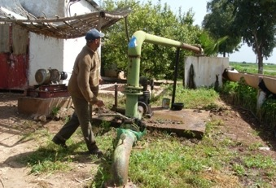
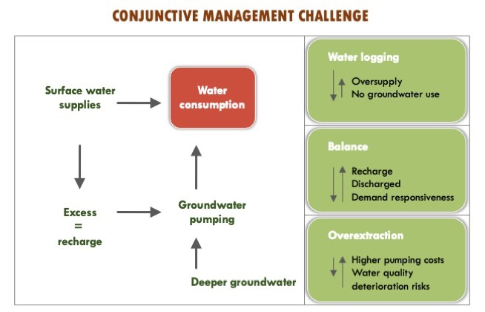
Conjunctive management of both surface and groundwater within irrigation systems to reduce water logging and salinity
Reusing shallow groundwater in irrigation systems
Finding balance of ‘optimum seepage and reuse’
  No wastage, no shortage
  Demand orientation
  Buffer
Water quality factor

Slide 10
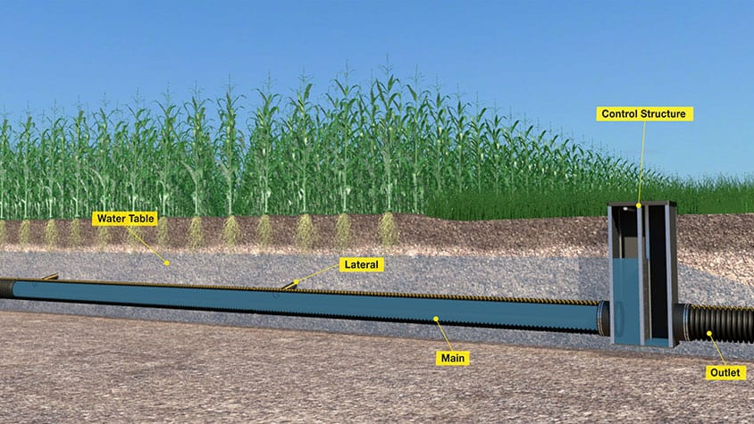
Controlled drainage to adapt soil water tables over the growing season:
combining reduced salinity with the water conservation for optimized crop production
The water table can be managed according to crop water needs

Slide 11
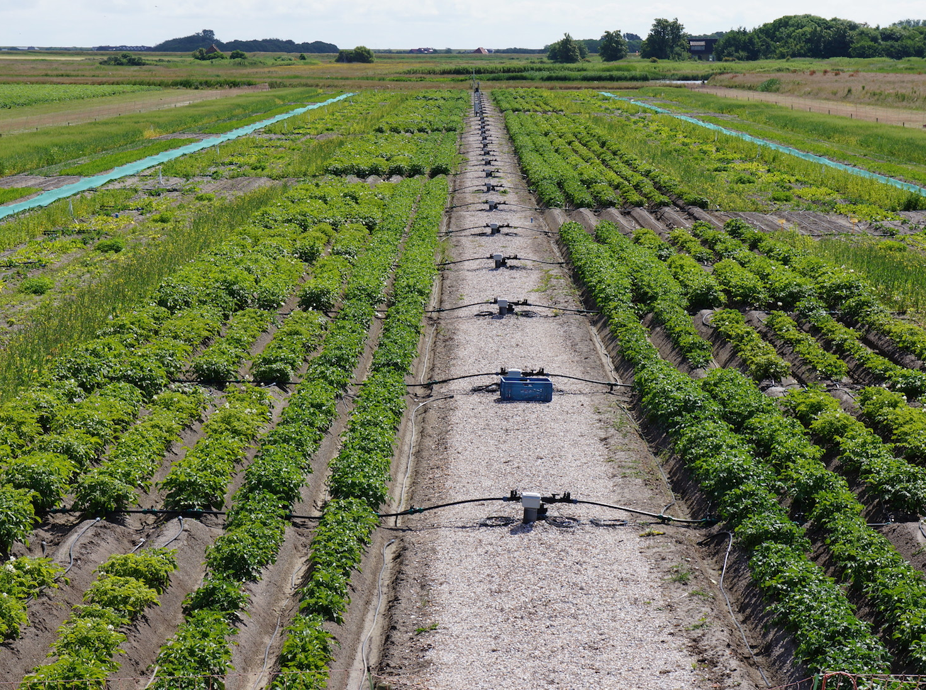
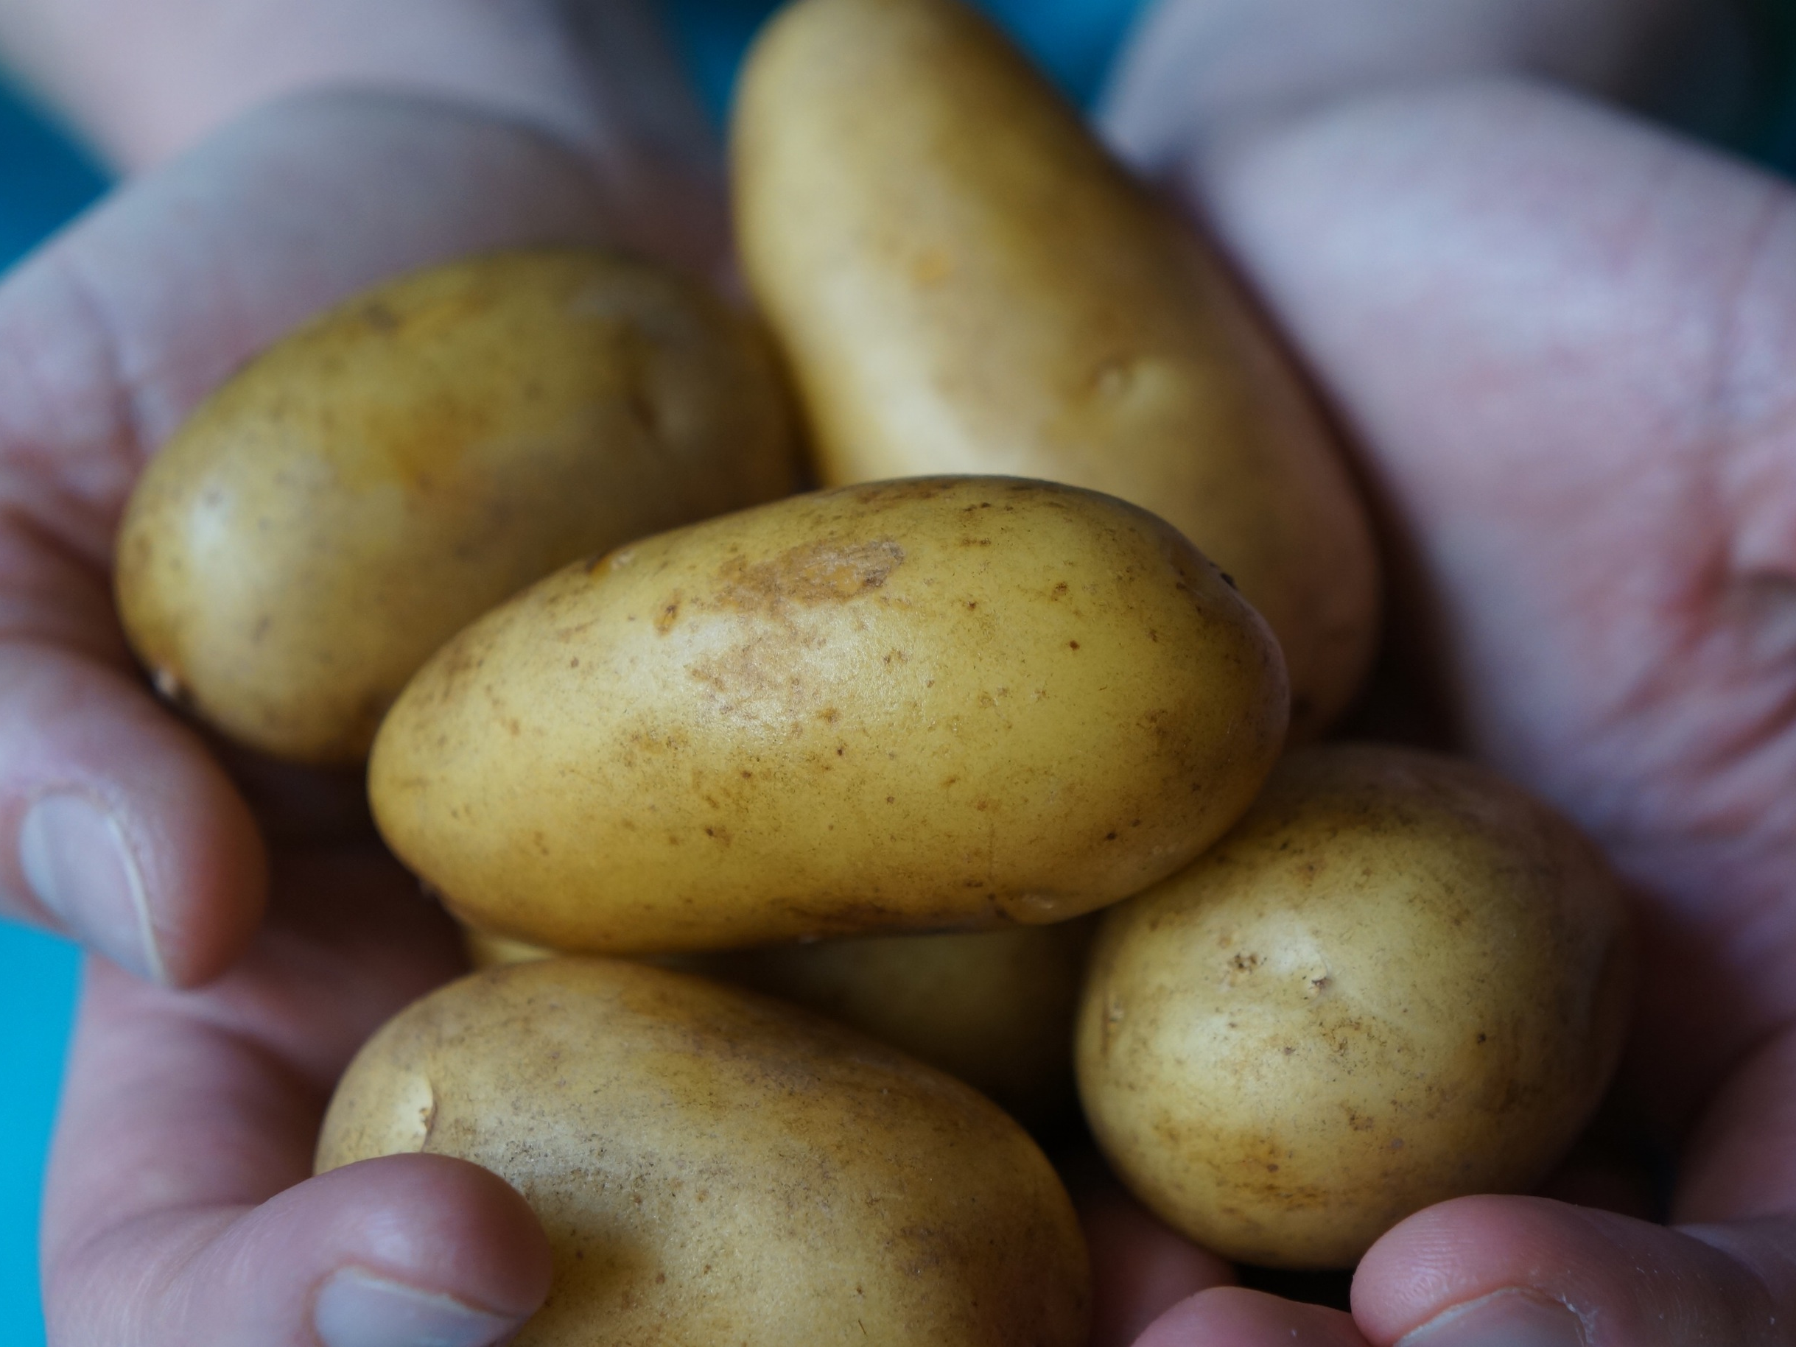
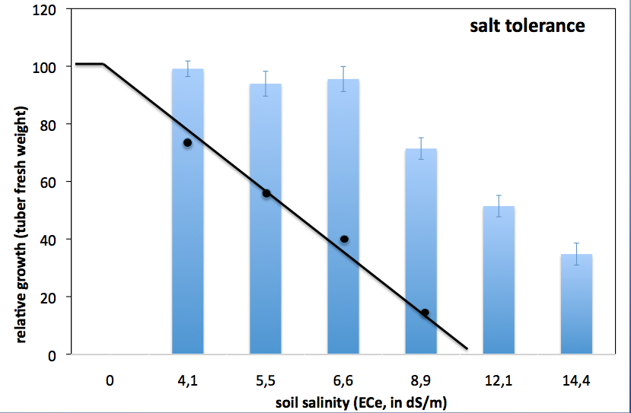
Using salt tolerant varieties
- Testing existing varieties for salt tolerance
Testing salt tolerance of
different crop varieties by different mixes
of fresh and salt water at the island of Texel
-
Many varieties have previously unknow
ability to deal with salt, especially in
sandy areas

Slide 12
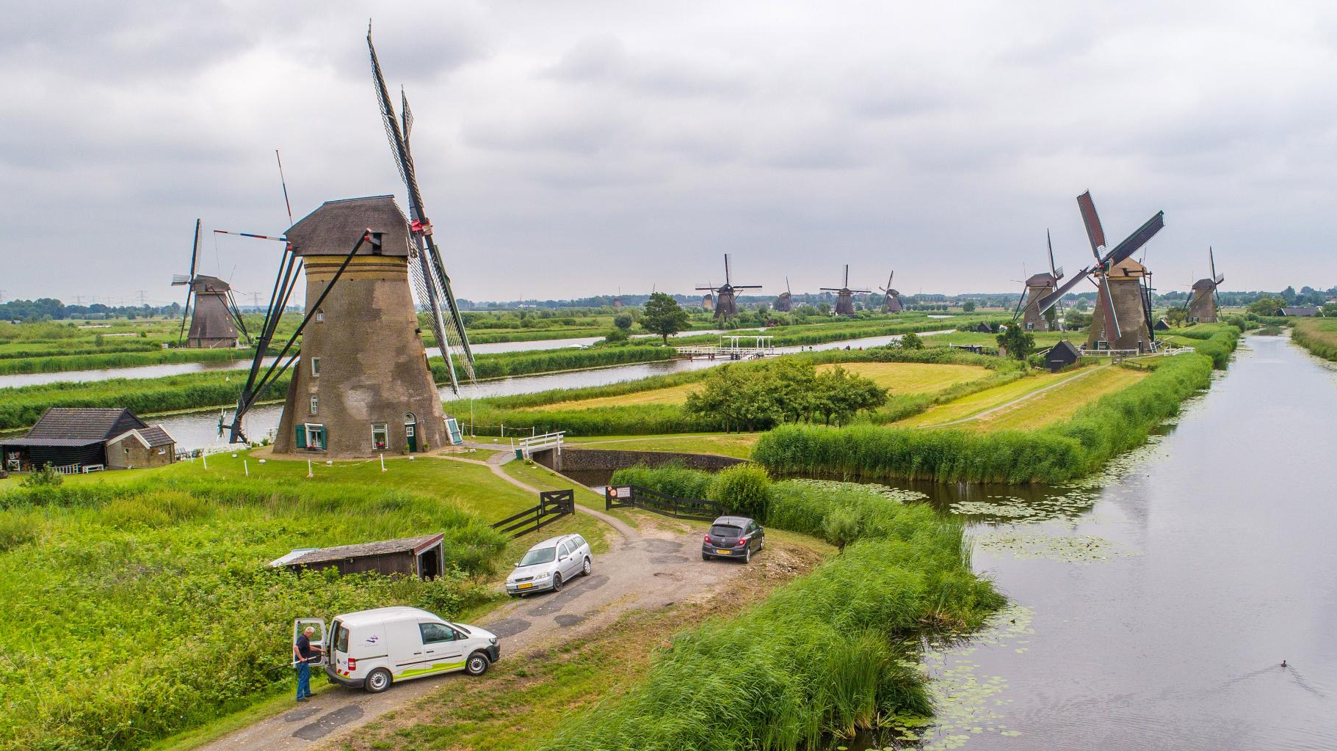
3. Work on policy frameworks and regulations for irrigation infrastructure management
  Good governance
  Operate irrigation as public business
  Secure financing
  Manage multifunctionality

Slide 13

Good governance in Spain: irrigator associations and tribunals
Representative: safeguard multiple interests in irrigation and water management
Autonomous: operate as professional organization, limit bureaucracy and interference
Decentralized: delegate to lower levels (WUAs) what can be best done locally
Self-correcting: build in redressal mechanisms to address conflicts and violations

Slide 14
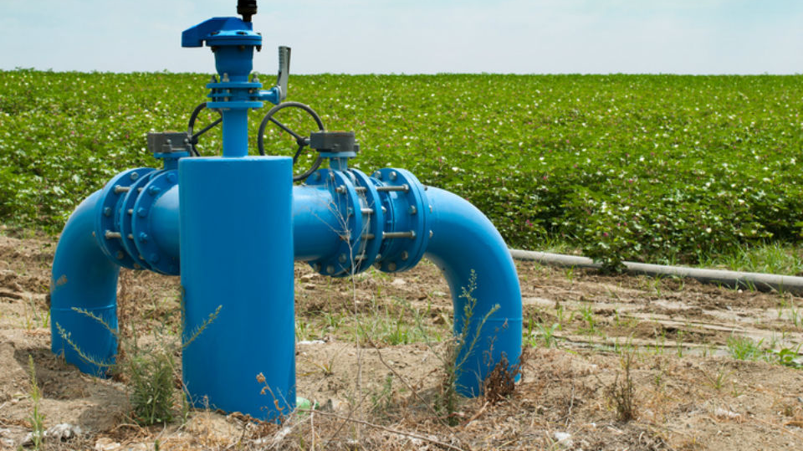
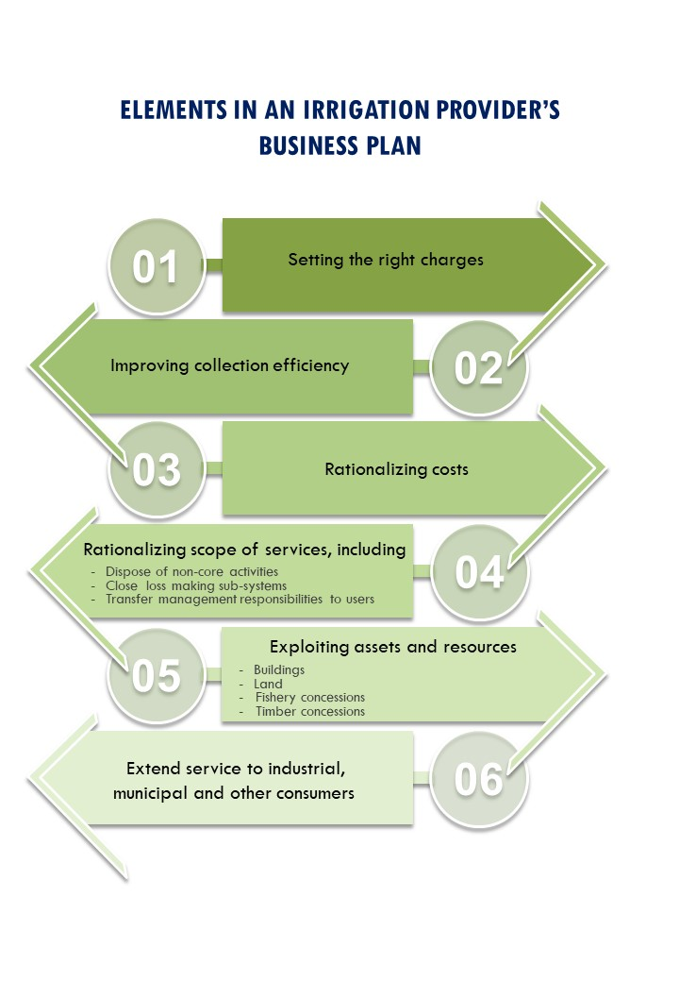
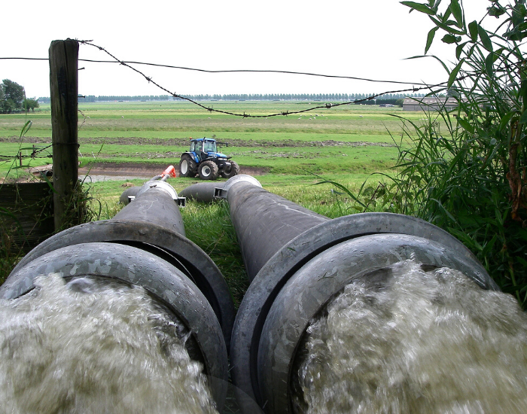
Operate irrigation systems
as a public business
Rely on private
service providers:
various services and contract forms
Private contractors
running emergency pumps

Slide 15
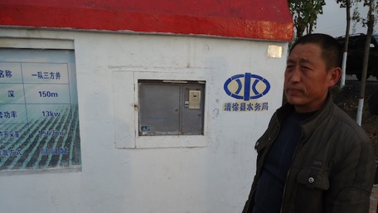
Example using ATM cards
to release irrigation supplies
Simplified system of water charging
Charges related to water consumption for fairness
Also develop other revenue streams
Ensure infrastructure O&M and emergency work is covered
Built in incentive systems

Slide 16
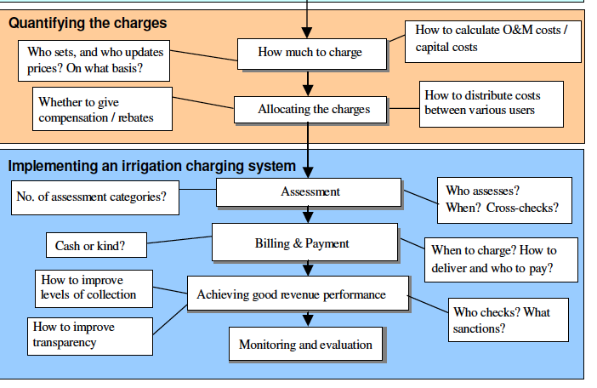

Slide 17
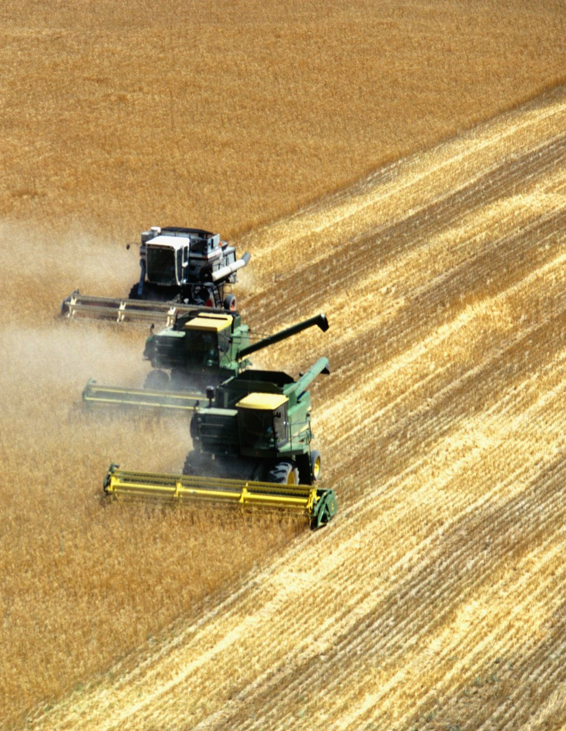
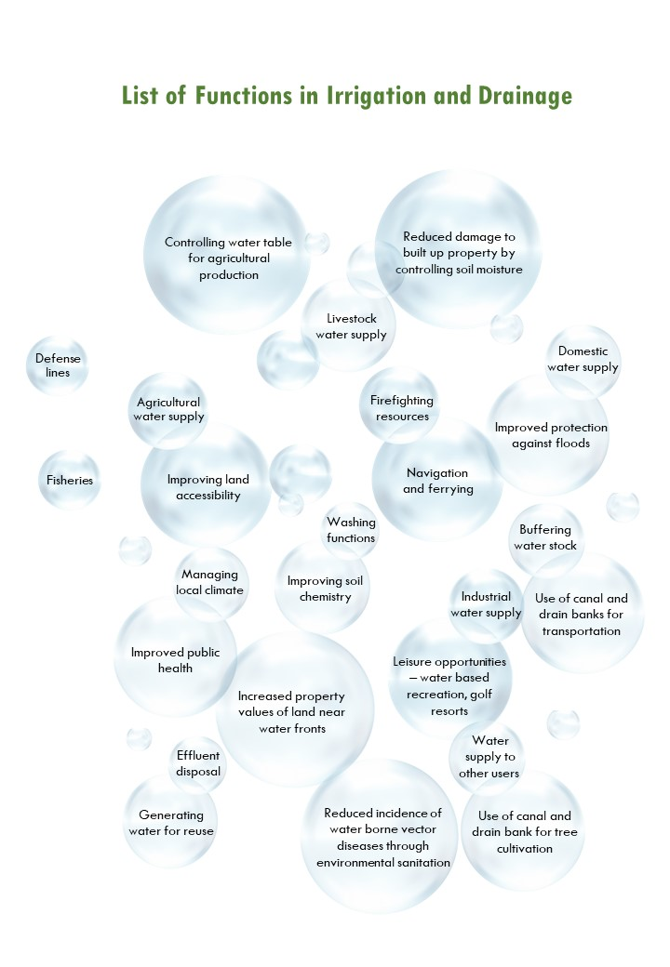
Irrigation systems provide
more services than
agricultural water supply
This needs to be
accommodated in
infrastructure and
policy frameworks

Slide 18
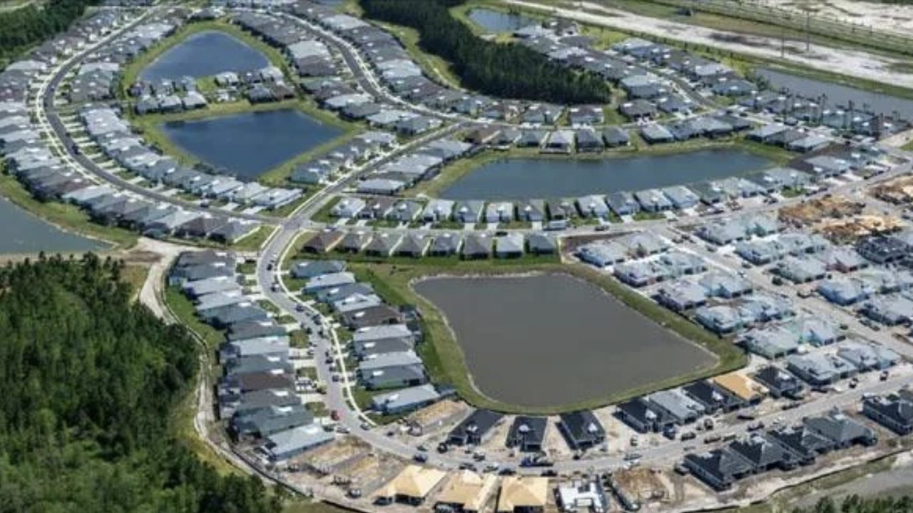
MANAGE MULTIFUNCTIONALITY
MULTIPLE FUNCTIONS, MULTIPLE SOURCES OF INCOME
EXAMPLE:
WATER STORAGE PONDS AS POPULAR WATER FRONT PROPERTY

Slide 19
Thanks

