Slide 1
Impact of food production and family farming
It is estimated that agriculture globally uses up to 40% of global land and 70% of freshwater
FAO 2017
Food systems contribute for one third of the total emissions of anthropogenic greenhouse gas emissions
FAO 2021
Family farming, feeding up to 80% of the world population, is considered responsible of a resource intake of 25% of the total resources (land, water, fossil fuel) consumed in food production; whilst the so-called industrial food chains use at least 75% of the world’s agricultural resources, but producing food for less than 30% of the world population
ETC 2017
Family farming represents 90% of the farms in the world and manages around 70-80% of farmland worldwide
Lowder 2021
Notes:
RIVEDERE

Slide 2
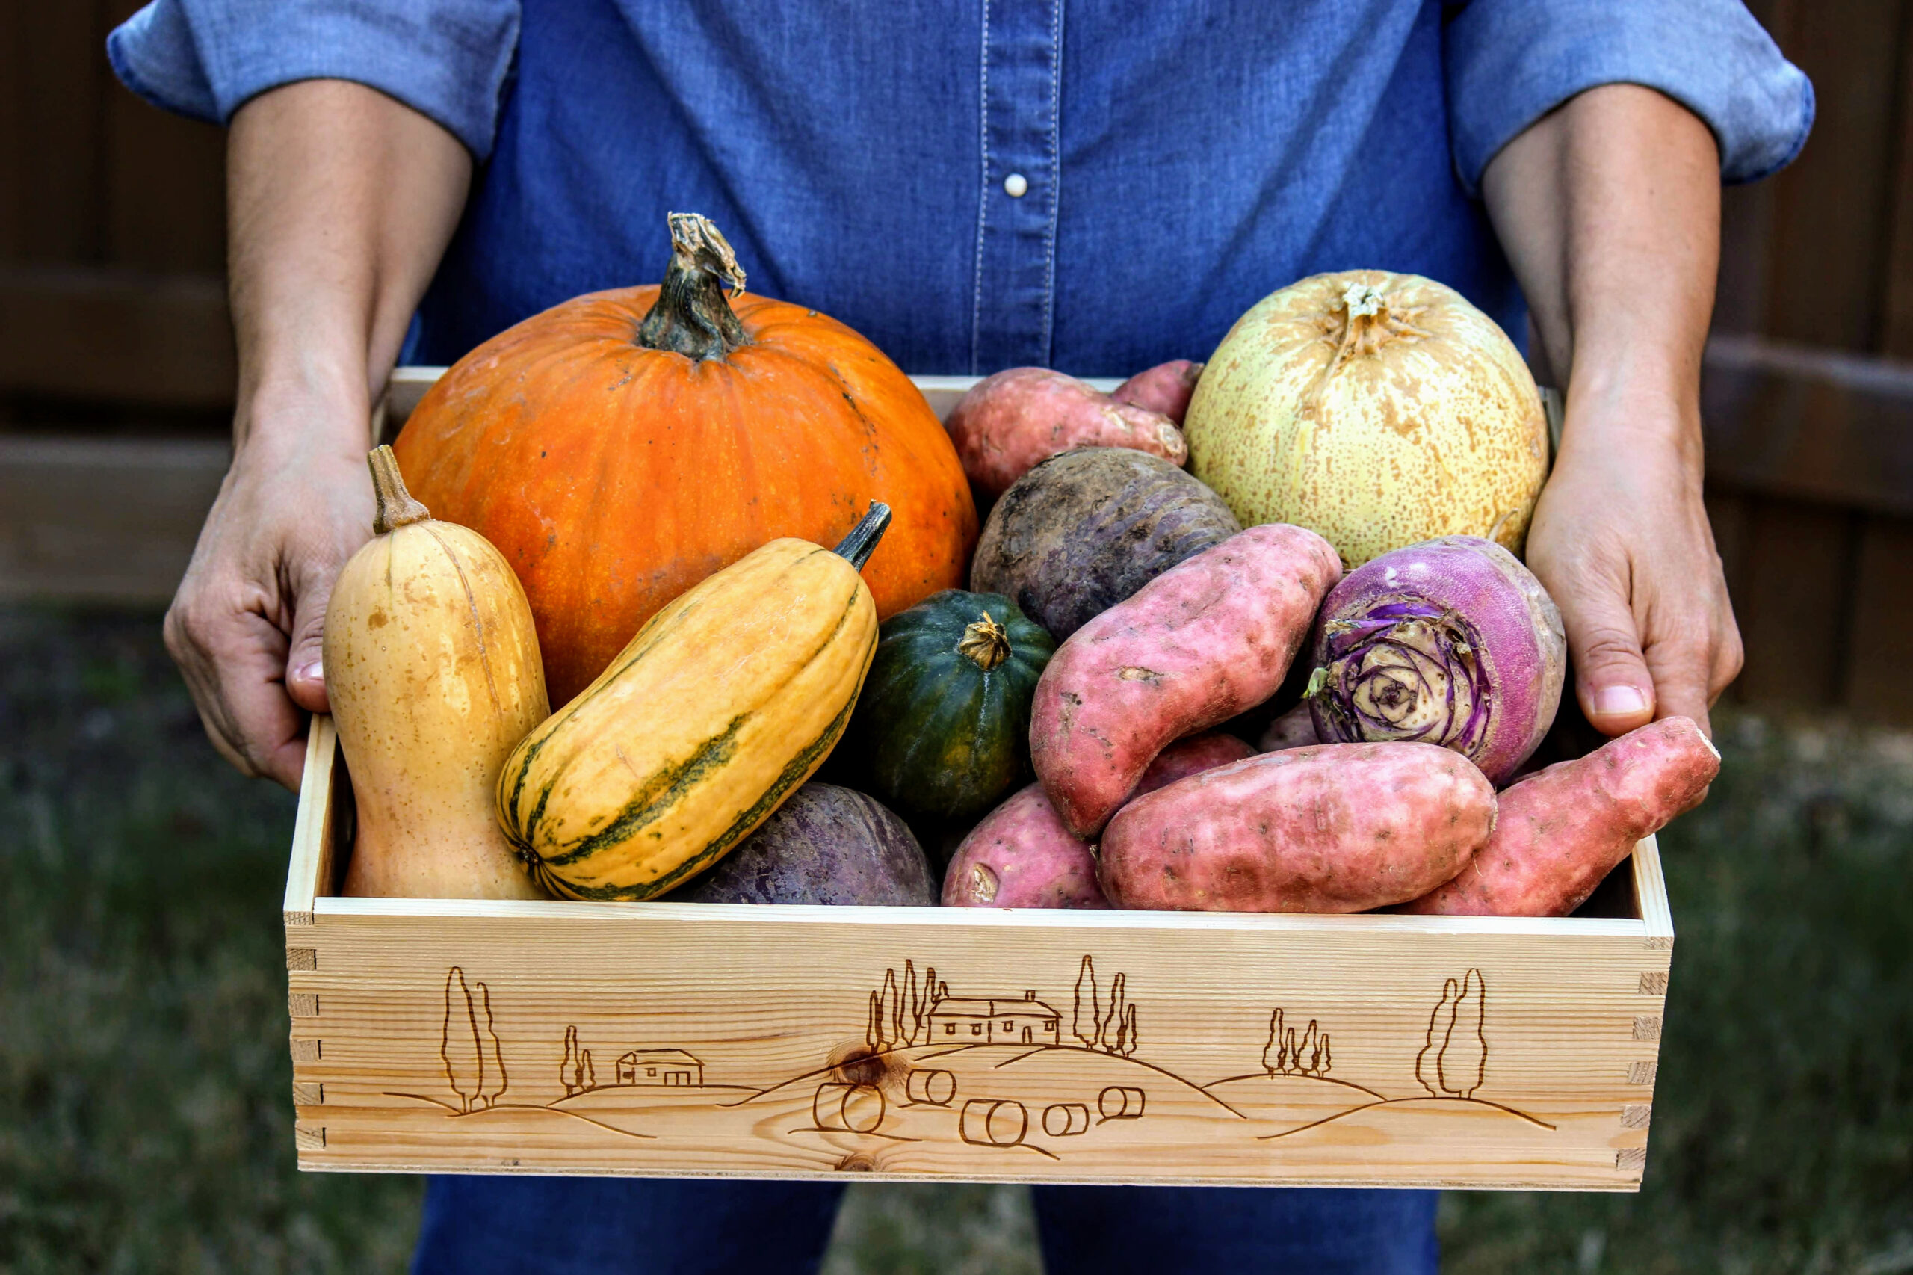
Who will feed us?
Peasants (not food corporations) feed the world: 70% of the world’s population is fed by the Peasant Food Web, using only 25% of resources.
Industrial food production fails to feed: Only 24% of the food produced by the Industrial Food Chain actually reaches people – the rest is wasted in meat production inefficiencies; lost in transport, storage and at the household; and diverted to non-food products.
Industrial food costs us more: For every dollar spent on industrial food, it costs another 2 dollars to clean up the mess
ETC 2017

Slide 3
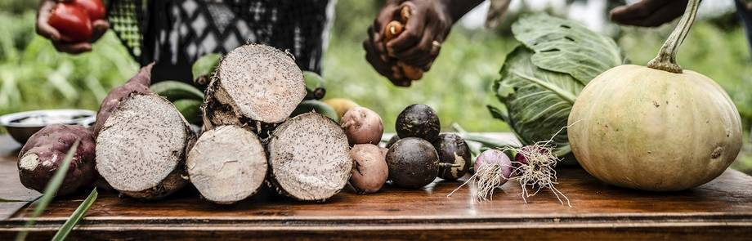
The Emergence of the 'Food Systems' Discourse and Corporate Solutions to Hunger and Malnutrition
…the main­stream narrative of the UN on food systems fails to address the structural drivers that shape agro-industrial food systems such as trade, financialization, patriarchy and neo-colonialism. And it equally fails to sufficiently define the new food para­digm required for more just, sustainable and healthy societies.
Recine E. et al 2021
Food system is a matter of public interest
Food must be understood as a commons and as a human right, not as a commodity
Trade and investments are the determinants of food injustice

Slide 4
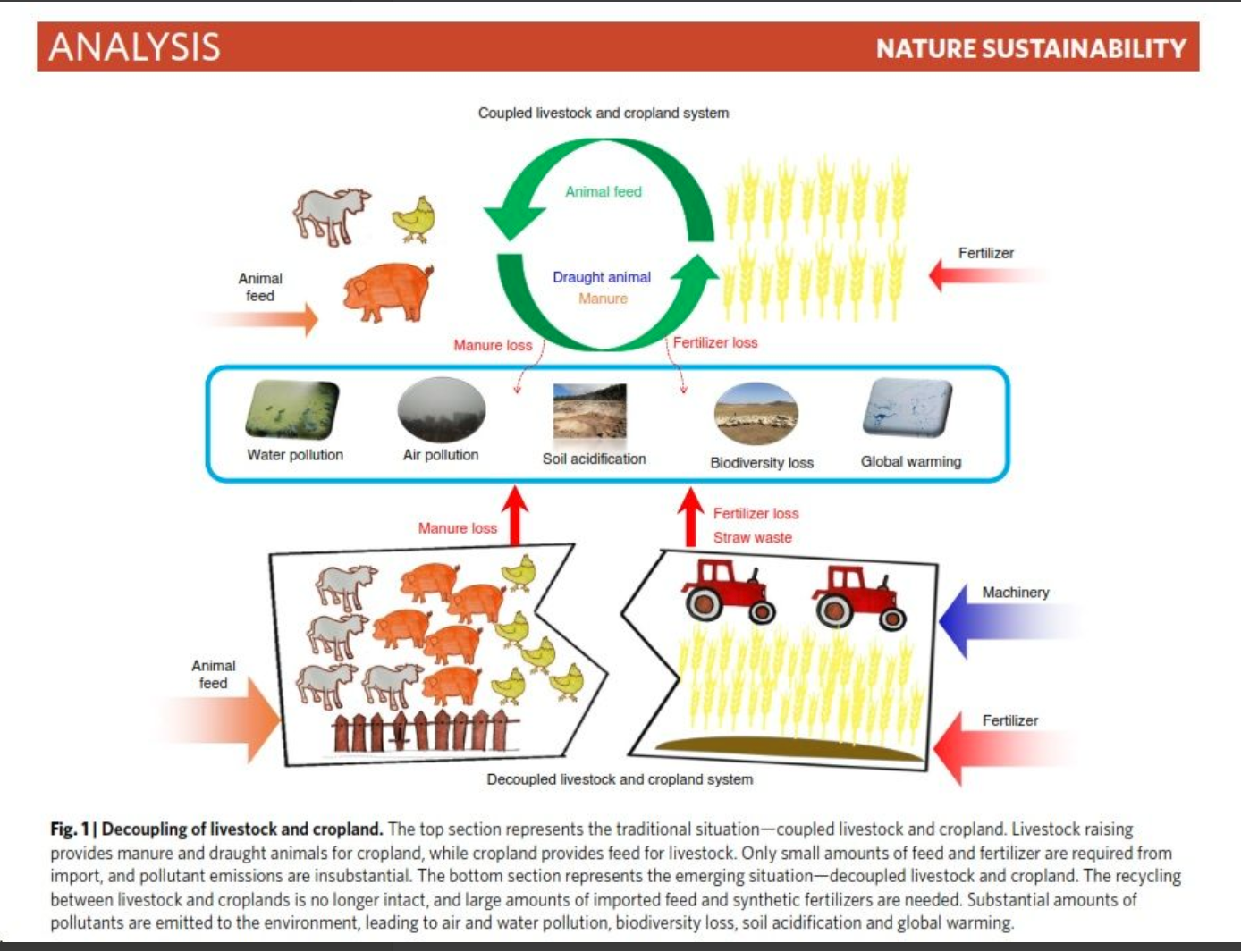
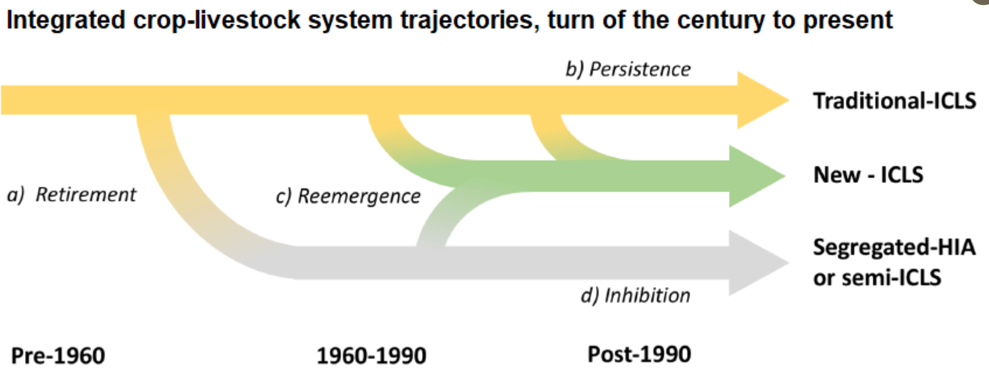

Slide 5
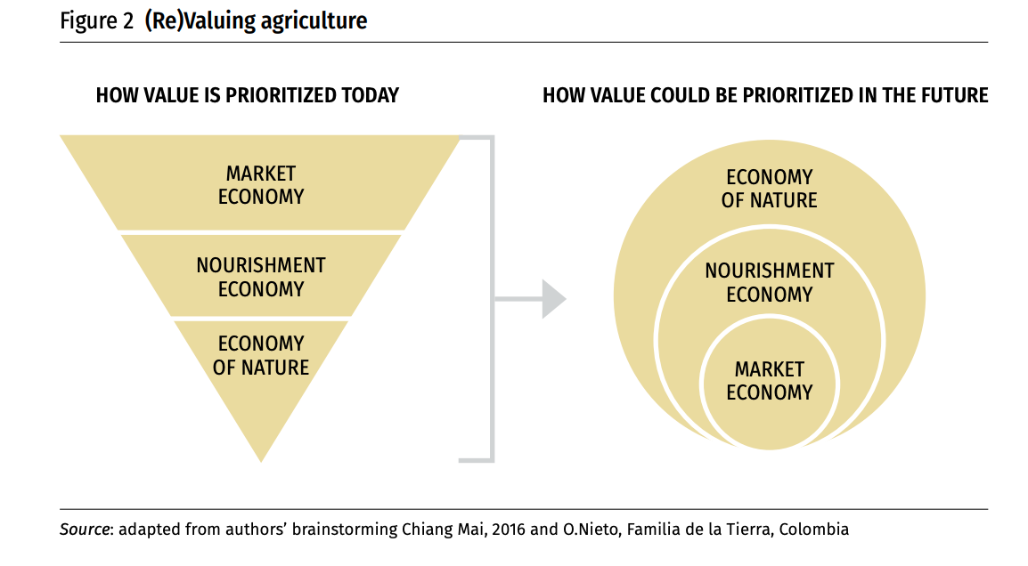
David Strelneck Strelneck@NourishN.com

Slide 6
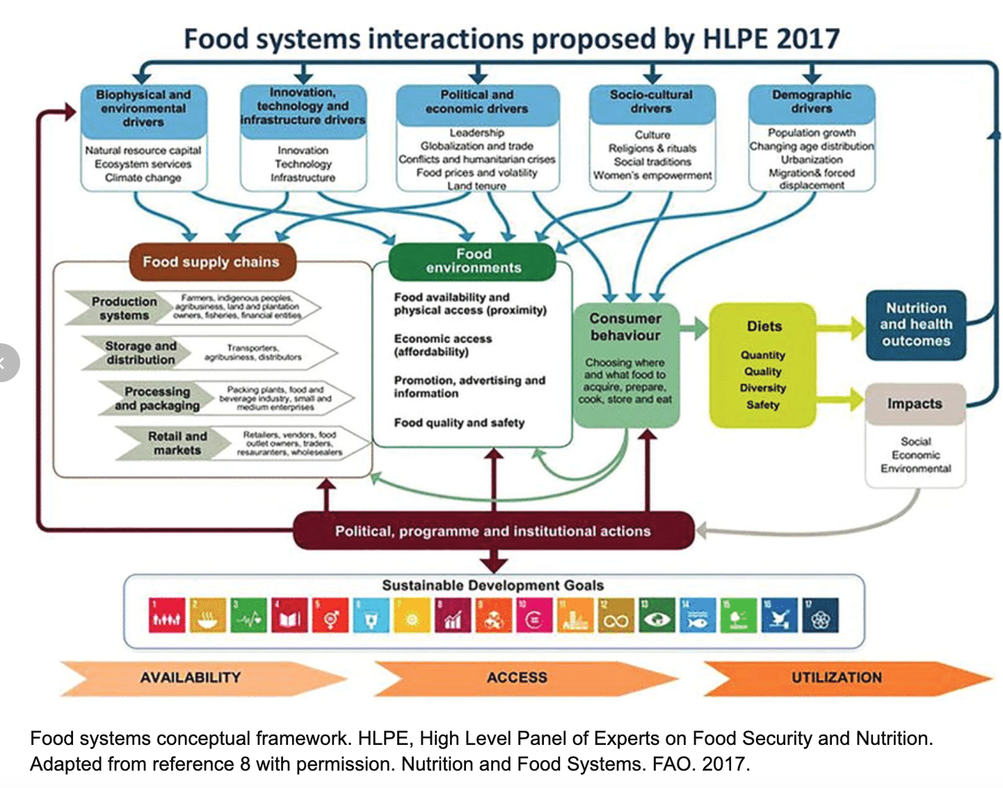

Slide 7
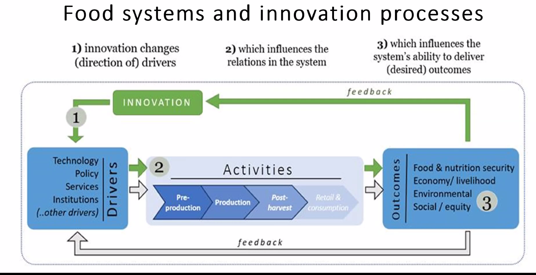

Slide 8
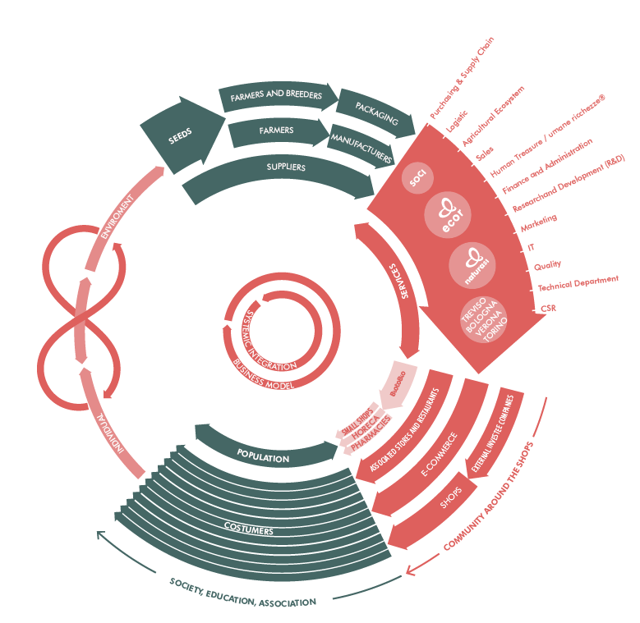
Agri-Food systems
The food system is a complex web of activities involving the production, processing, transport, and consumption. Issues concerning the food system include the governance and economics of food production, its sustainability, the degree to which we waste food, how food production affects the natural environment and the impact of food on individual and population health.
University of Oxford
NaturaSì - Italy

Slide 10
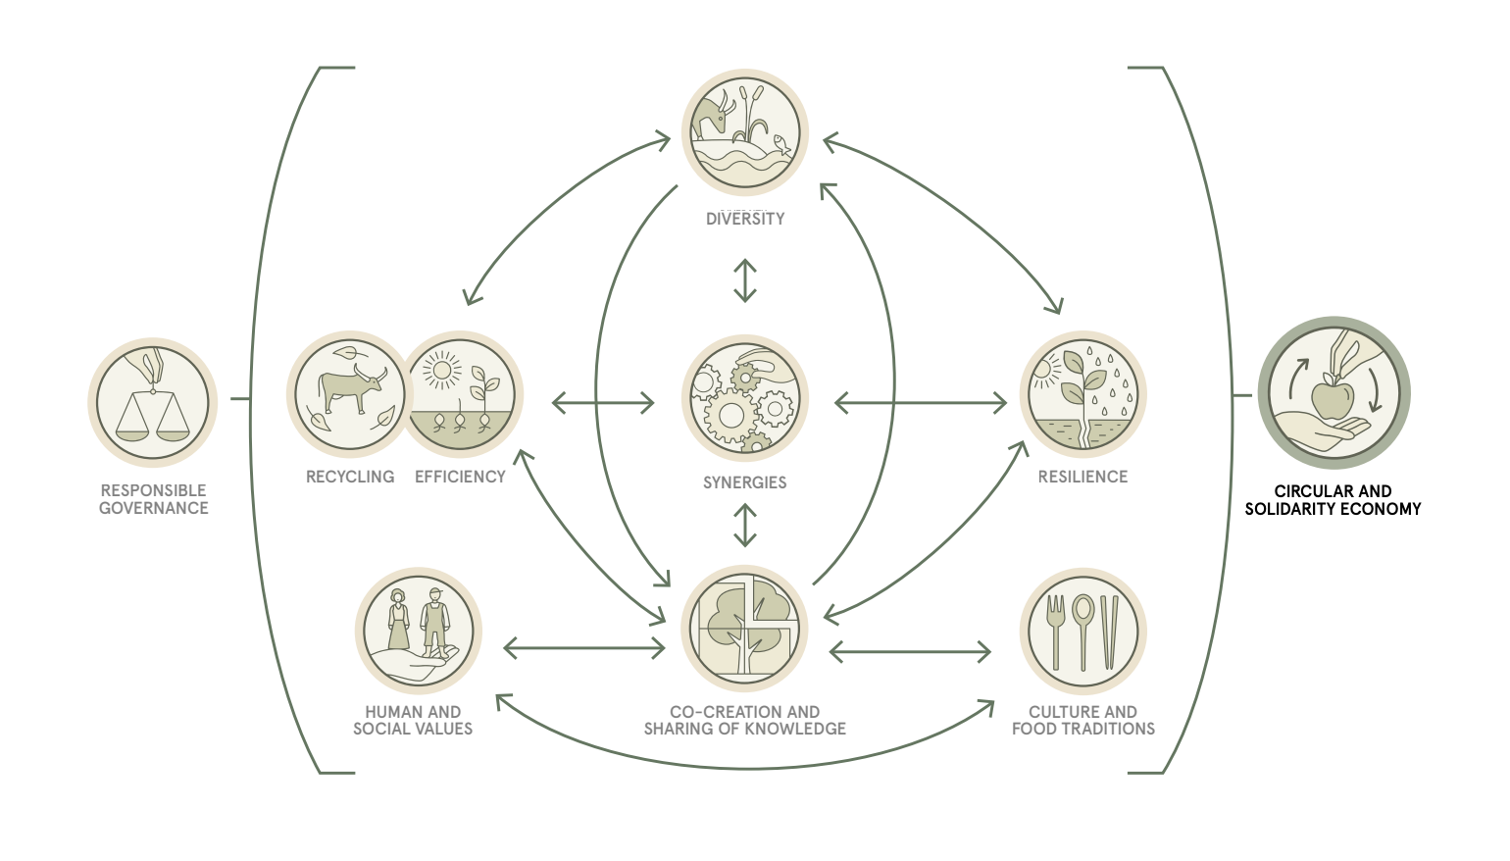
10 elements of Agroecology - TAPE

Slide 11
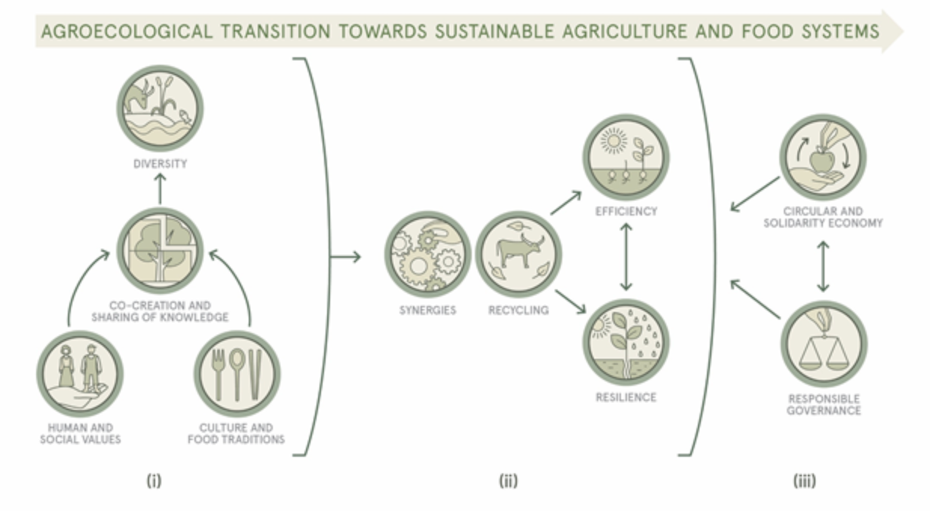
Edmundo Barrios, Barbara Gemmill-Herren, Abram Bicksler, Emma Siliprandi, Ronnie Brathwaite, Soren Moller, Caterina Batello & Pablo Tittonell (2020)

Slide 12
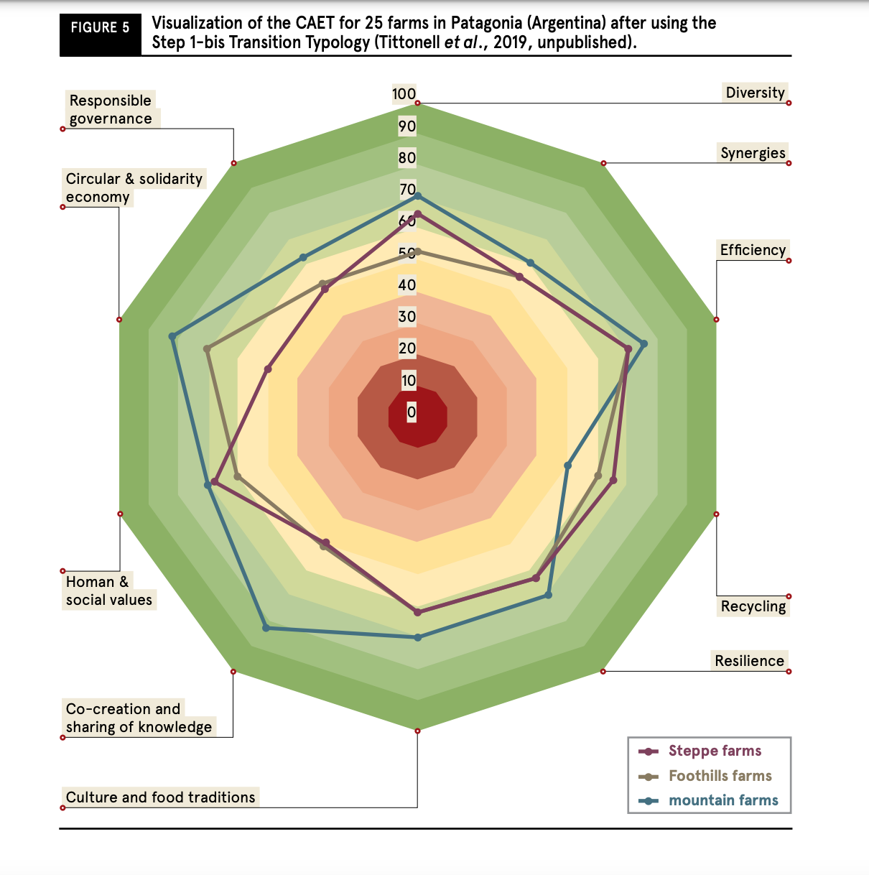

Slide 13
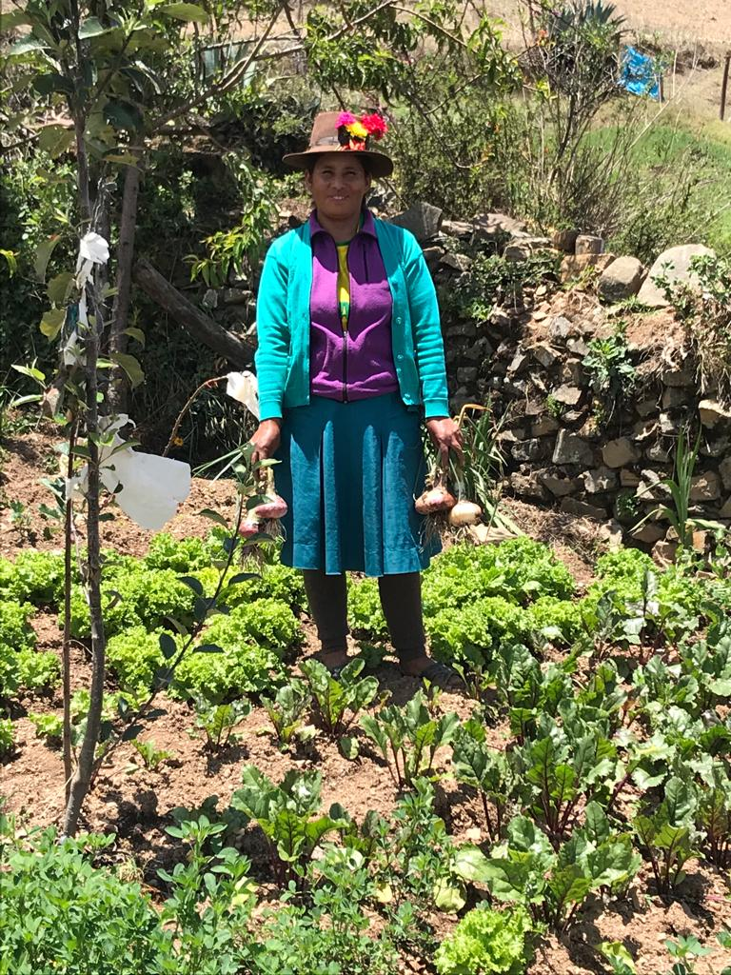
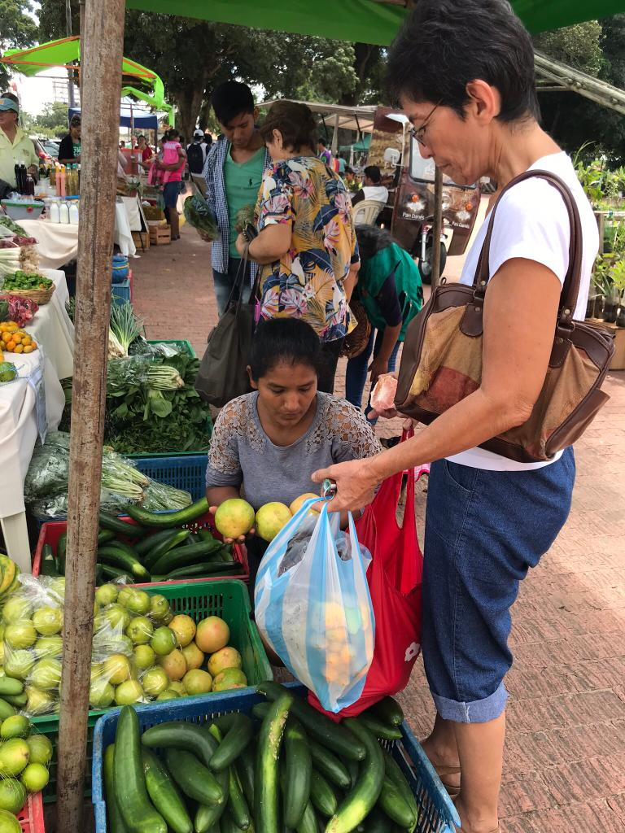
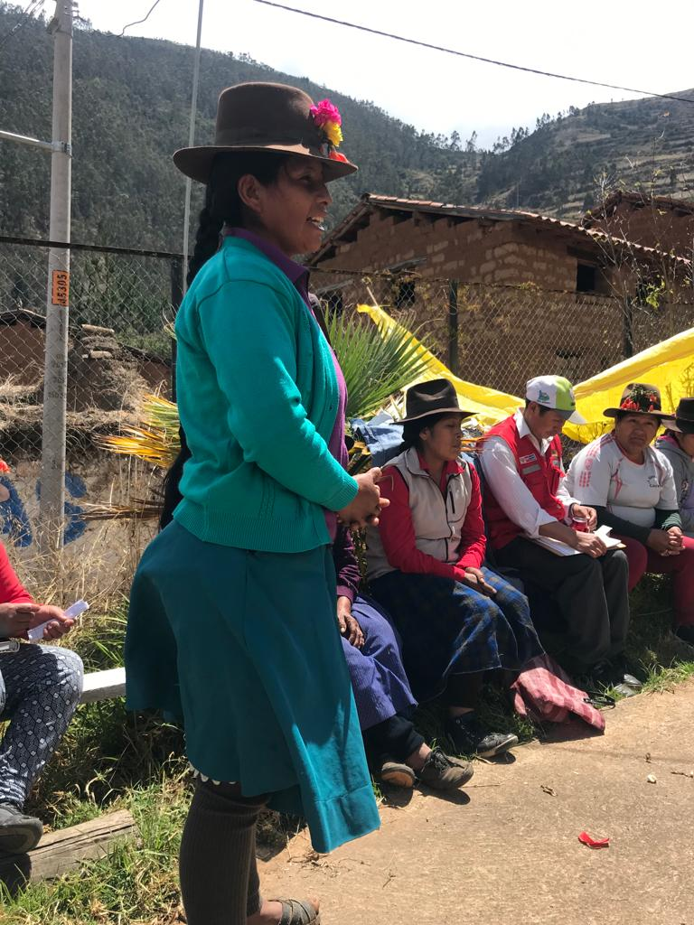
Nutrition Sensitive Agriculture
Empowerment
Production
Income

Slide 14
Diverse diets
accessible and consumed
Impact
RSPs implement NSA Micro-Interventions in mountain regions
Outcome
Nutritious food produced and sold, awareness raised
NSA supportive national policies and action
Global policies strengthen NSA approach
RSP capacities enhanced regionally
Local stakeholders engaged in up-scaling NSA interventions
National stakeholders engaged to up-scale NSA approach
NMA evidence and messages spread globally
Output
MAAN social capital and capacity building program (regional + ToT, with MIs)
Advocacy and knowledge-sharing at global level
Activities
Support SUNSAI*
and
Enhance NSA Public Relations
Advocacy and knowledge-sharing at national and regional level
RSP
Local
National
Global
* Scaling-Up NSA Interventions

Slide 15
Training Teams of Trainers (ToToT)
ToToT
Training of Teams of Trainers
HImalaya
Hindukush
Tien Shan
Andes
ToT
ToT
ToT
ToT
ToT
ToT
ToT
ToT
ToT
ToT
ToT
ToT
CDP
CDP
CDP
CDP
CDP
CDP
CDP
CDP
CDP
CDP
CDP
CDP
CDP
CDP
CDP
CDP
CDP
CDP
CDP
CDP
CDP
CDP
CDP
CDP
3 team of trainers in each region (12 teams in total)
12 teams with 4 trainers in each team (48 trainers)
Each team implemented 2 CDP (funded) in their community
Each CDP has 25 participants implementing a Microintervention
12 x 2 x 25 = 600 MI + 25 in East Africa

Slide 16
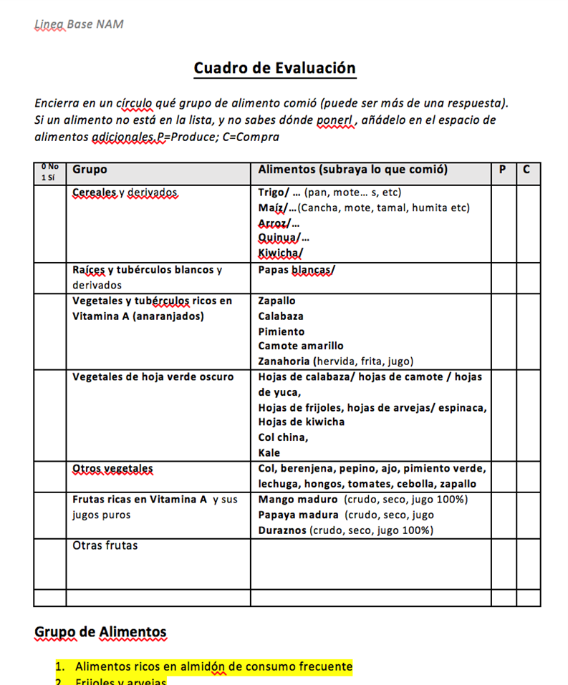
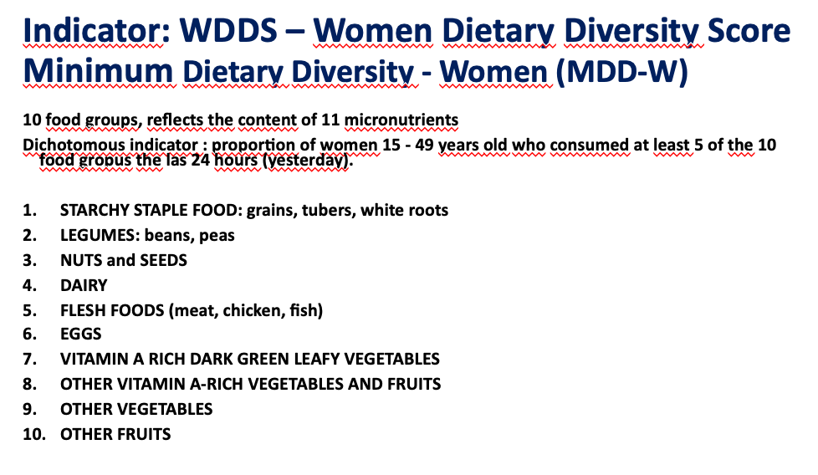
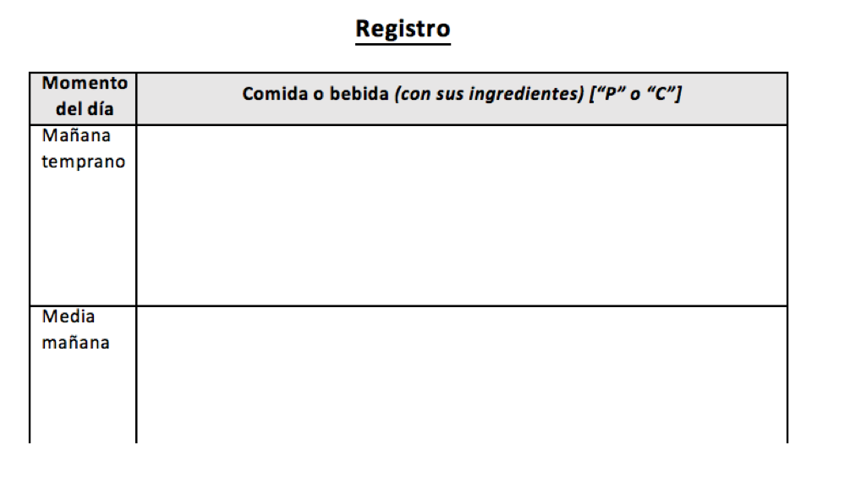
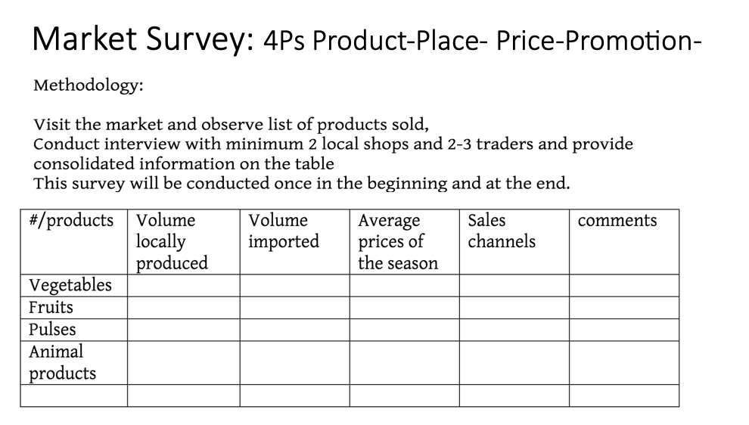

Slide 17
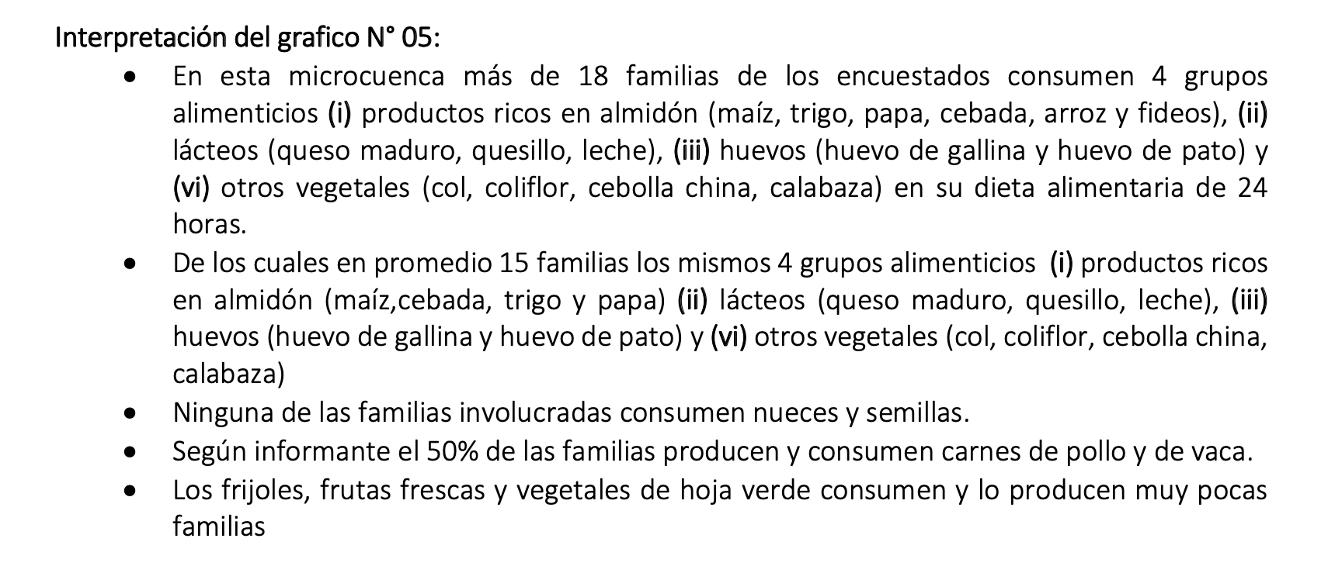
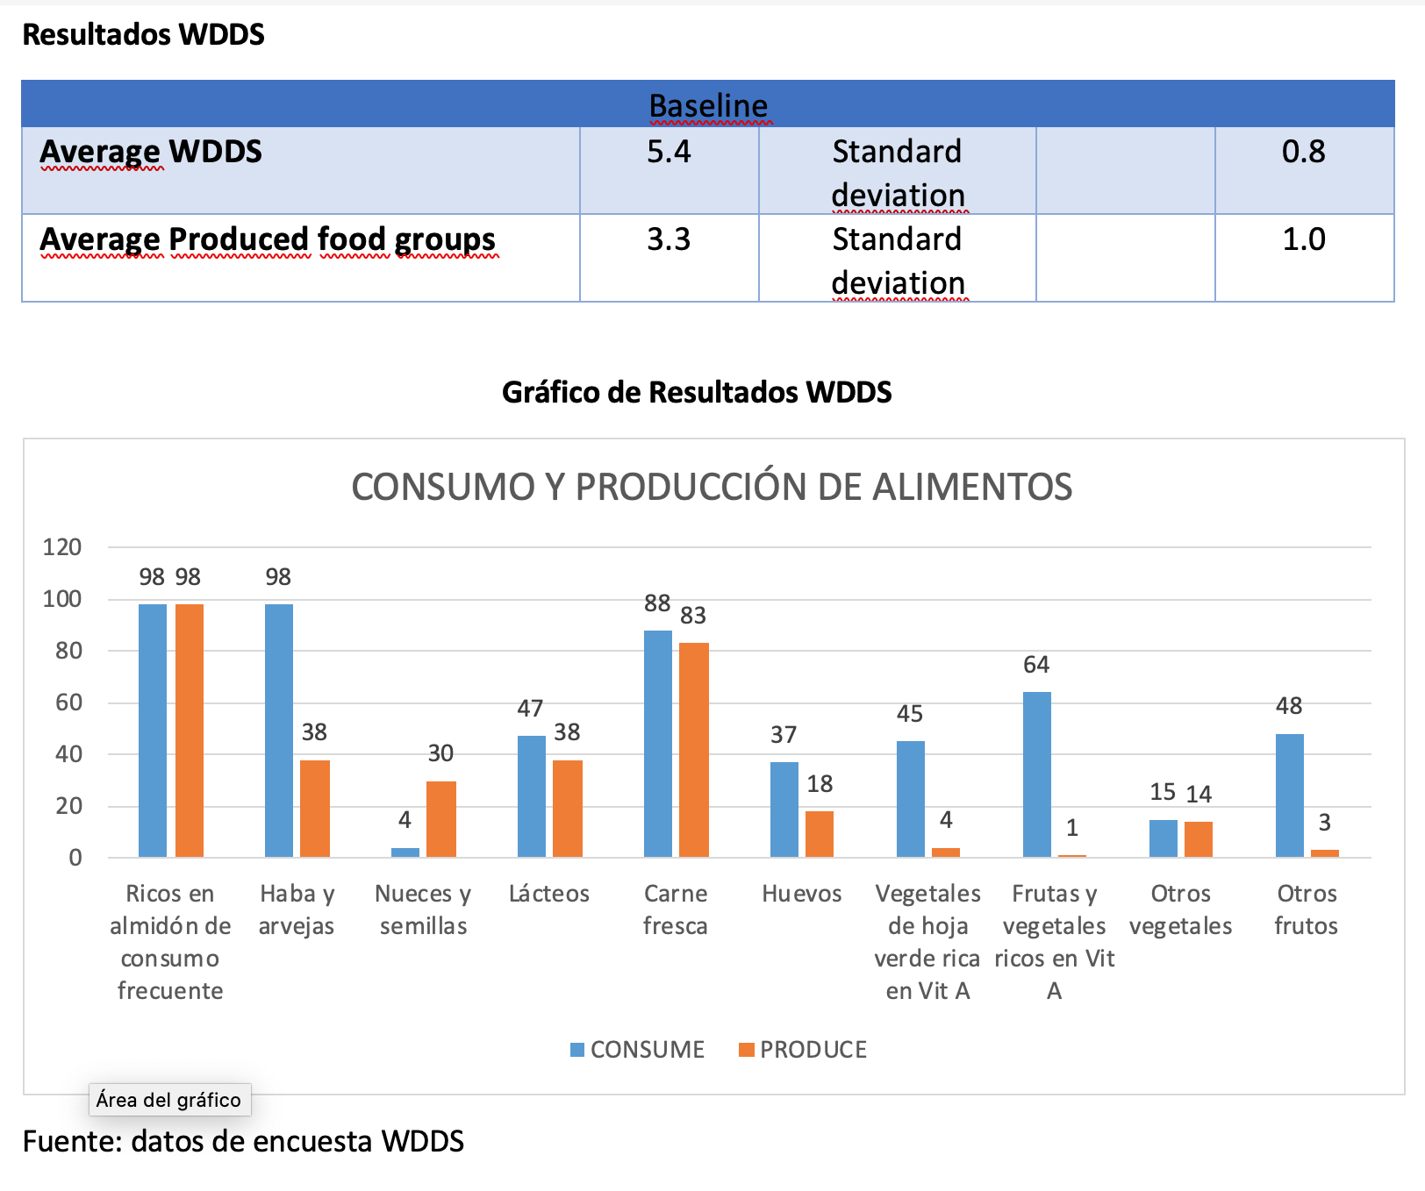
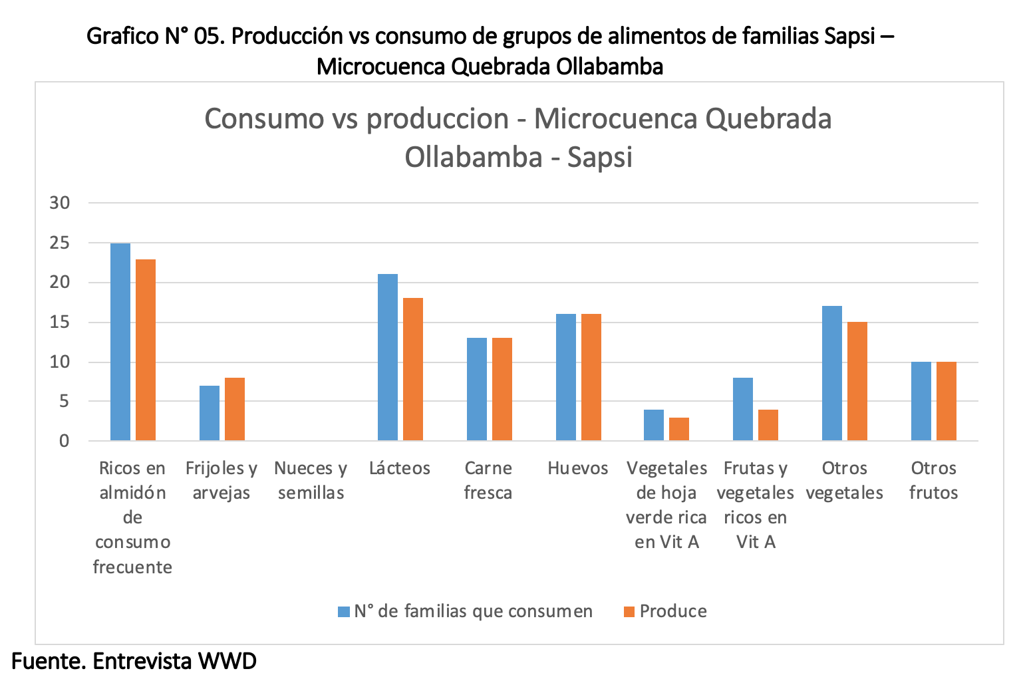
NAM 2, AVANCE LÍNEA DE BASE EN APURÍMAC

Slide 18
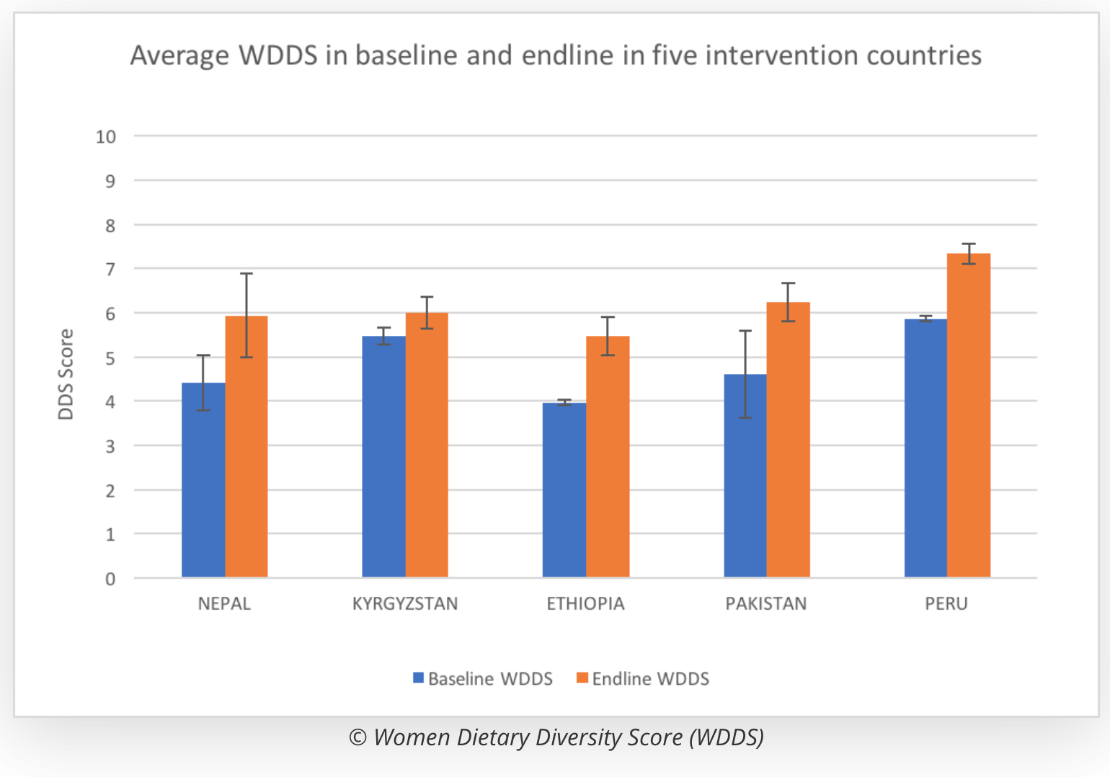
NAM 1

Slide 19
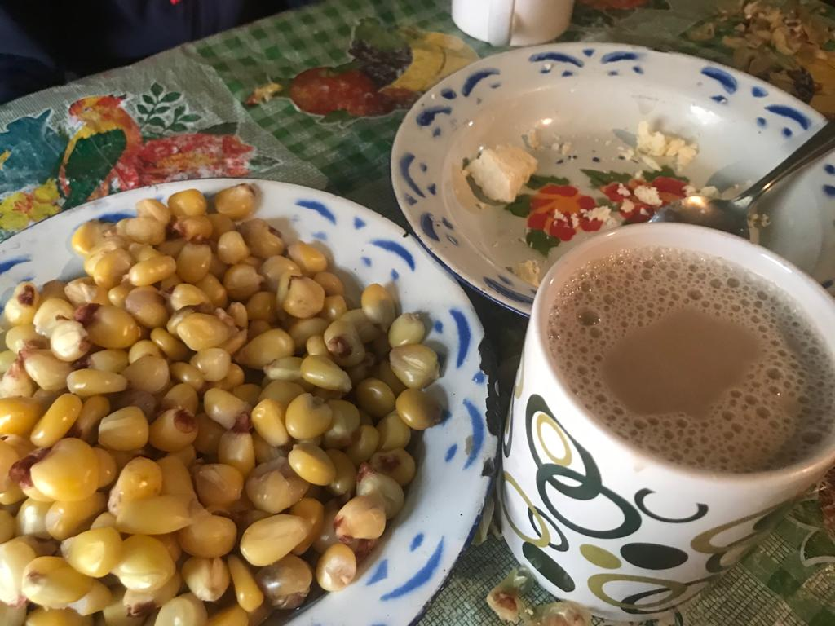
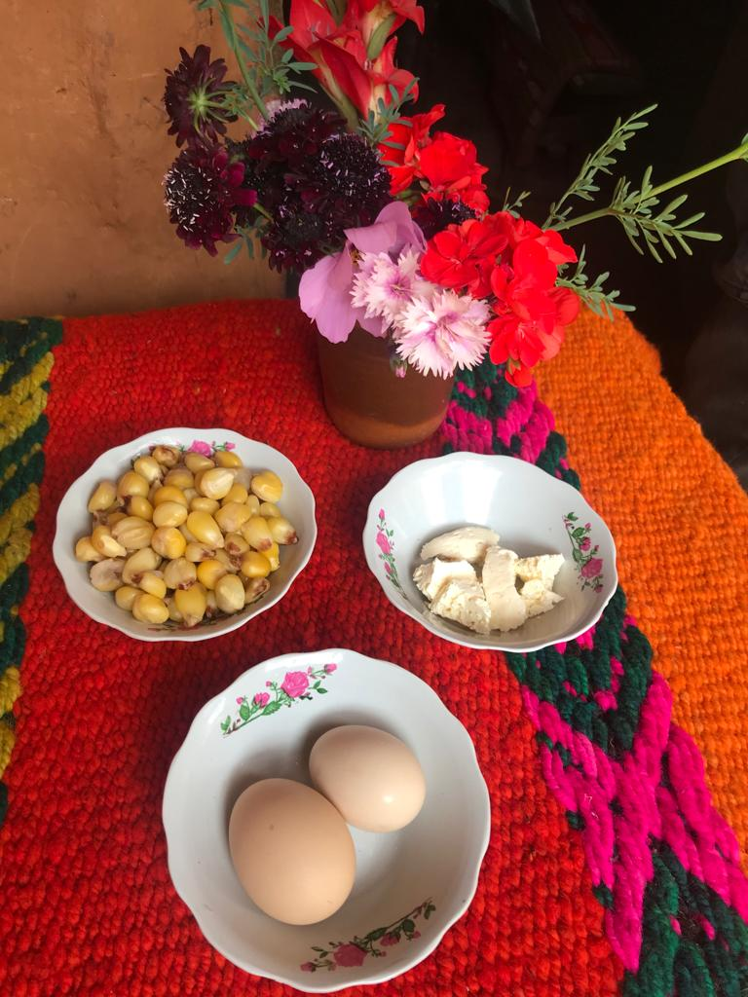
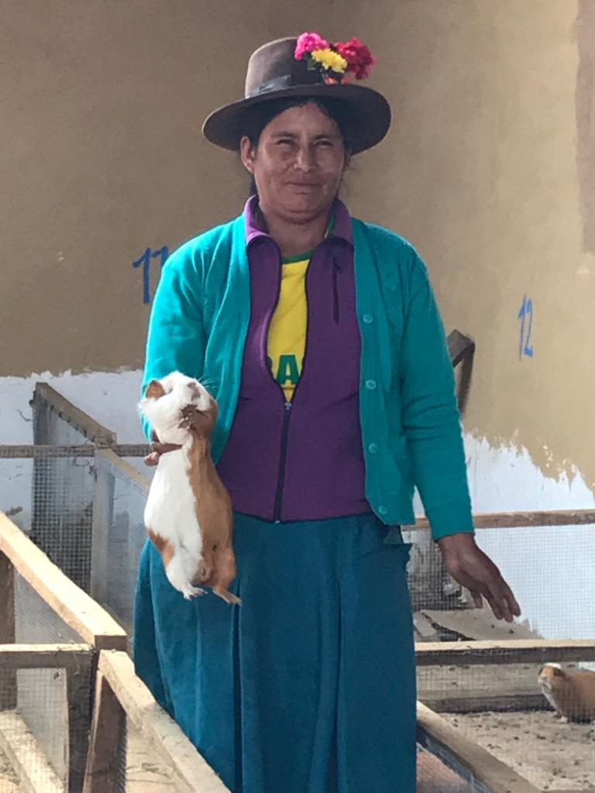
Traditional diets

Slide 20
