Slide 1
2. Pioneers & history of Organic Agriculture:
We stand on the shoulders of giants…

Slide 2
An Organic Timeline:
    The Past
    Visionaries
    Founders
    Disruptors…
c. 1920
Notes:
IFOAM and other sustainability partners spent the last 5 years developing the concept of "Organic 3.0”, which was adopted as a landmark by the movement at our recent General Assembly held in India in 2017
I am not one for labels and boxes, and this term could be understood as another such label, but of we see it is a transformational approach, an evolution of thinking and of production systems towards true sustainability, it makes a lot more sense.
From ca. 1920, the pioneers and visionaries like Steiner, Howard, Fukuoka, Balfour, Bhaskar Save, created a vision based on principles and values – and this is continuing – many of our current initiatives in the organic world is still driven by visionaries and prophets.
In fact, MOST successful initiatives, enterprises and institutions started with dreams and visions, and they still are. Martin Luther King did not have a plan, he had a dream. And so did Mandela, and Ghandhi, and Elon Musk, and so many others.
We cannot and should not dismiss the visions, even if they seem disruptive!
Around the 70s, this visioning was increasingly adopted in the marketplace, and we became codified and regulated while growing Market nearly exponentially
Increasingly, questions were asked about the growth, adoption and sustainability of OA, and the transformation, discussion and think tanking moved towards a sustainability discourse, which is coined as “Organic 3.0”
I added a fourth arrow to “replace” the third – Ture sustainability in Agriculture and food systems – for very obvious reasons.

Slide 3
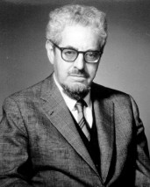
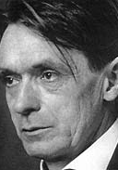
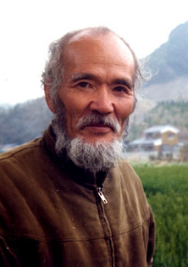
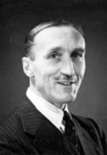
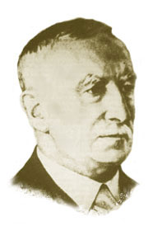
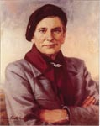
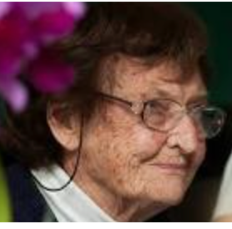
Pioneers,visionaries, disruptors
1924, the pioneers of modern organic agriculture start arguing for an alternative to the simplified views of emerging industrial agriculture.
From Rudolf Steiner and biodynamic agriculture in 1924, to the popularisation of organic in the US by Rodale in the 50s, and the One Straw Revolution of Fukuoka in the 70s, soil fertility and health was – and remains – the basis of organic agriculture practice.
They were driven as much by practice as by principle – farming was not only about production, but also about conviction.
Ana Primavesi. Ecological management of soils.

Slide 4
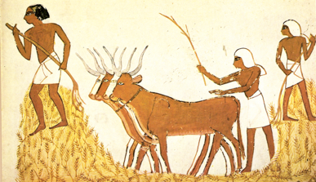
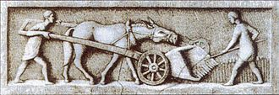
How old is organic agriculture?
Evidence of plant cultivation 23,000 years ago
Animal husbandry 10,000 – 13,000 years ago
Squash grown in Mexico 10,000 years ago
Evidence of the use of manure, compost, ashes 10,000 years ago
Modern industrial agriculture born in the early 20th Century
The “Green Revolution” born in the 1940s
GMO technology approved in 1994
Which should be the “convention”?

Slide 5
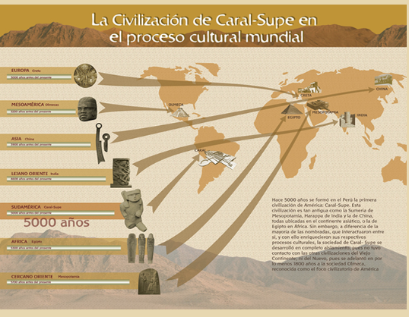
CARAL

Slide 6
An Organic Timeline:
    The Past
    Visionaries
    Founders
    Disruptors…
    The “Present/Current”
    “Niche” market development
    Private Standards & Public Regulations
    Global Recognition/Mainstreaming?
    Reduction of principles?
c. 1920
1970
Notes:
Around the 70s, this visioning was increasingly adopted in the marketplace, and we became codified and regulated while growing Market nearly exponentially
Increasingly, questions were asked about the growth, adoption and sustainability of OA, and the transformation, discussion and think tanking moved towards a sustainability discourse, which is coined as “Organic 3.0”

Slide 7
Locked-ins

Slide 8
An Organic Timeline:
    The Past
    Visionaries
    Founders
    Disruptors…
    The “Present/Current”
    “Niche” market development
    Private Standards & Public Regulations
    Global Recognition/Mainstreaming?
    Reduction of principles?
The Future
Market reinvention
Widespread Conversion
Performance Improvement
Regenerative systems
The Future
TRUE Sustainability in Agriculture and Food Systems
c. 1920
1970
2015
Notes:
Increasingly, questions were asked about the growth, adoption and sustainability of OA, and the transformation, discussion and think tanking moved towards a sustainability and more recently a regenerative discourse, which is coined as “Organic 3.0”
I added a fourth arrow to “replace” the third – Ture sustainability in Agriculture and food systems – for very obvious reasons.
I am not one for labels and boxes, and this term could be understood as another such label, but of we see it is a transformational approach, an evolution of thinking and of production systems towards true sustainability, this all makes a lot more sense.

Slide 9
Three-in-one:
3. The Future
TRUE Sustainability in Agriculture and Food Systems
    2. The “Present/Current”
    “Niche” market development
    Private Standards & Public Regulations
    Global Recognition/Mainstreaming?
    Reduction of principles?
    1. The Past
    Visionaries
    Founders
    Disruptors…
c. 1920
1970
2015
Notes:
Around the 70s, this visioning was increasingly adopted in the marketplace, and we became codified and regulated while growing Market nearly exponentially
Increasingly, questions were asked about the growth, adoption and sustainability of OA, and the transformation, discussion and think tanking moved towards a sustainability discourse, which is coined as “Organic 3.0”

Slide 10
SHORT EXERCISE

Slide 11
3. The WHAT and HOW of Organic Agriculture…

Slide 12
Definitions and Principles

Slide 13
Organic Agriculture definition
Let’s brainstorm - list words/short phrases describing organic.
Speed-date groups: Use the words, and write a definition.

Slide 14
IFOAM OA definition:
Organic Agriculture is a production system that sustains the health of soils, ecosystems and people.
It relies on ecological processes, biodiversity and cycles adapted to local conditions, rather than the use of inputs with adverse effects.
Organic Agriculture combines tradition, innovation and science to benefit the shared environment and promote fair relationships and a good quality of life for all involved.
(IFOAM definition: 2008, GA Vignola)
Notes:
Organic in all languages – let‘s hear each other ☺

Slide 15
FAO
Organic agriculture is a holistic production management system which promotes and enhances agro-ecosystem health, including biodiversity, biological cycles, and soil biological activity.
It emphasises the use of management practices in preference to the use of off-farm inputs, taking into account that regional conditions require locally adapted systems.
This is accomplished by using, where possible, agronomic, biological, and mechanical methods, as opposed to using synthetic materials, to fulfil any specific function within the system.
(FAO/WHO Codex Alimentarius Commission, 1999).

Slide 16
USDA
“Organic farming is a system which avoids or largely excludes the use of synthetic inputs (such as fertilizers, pesticides, hormones, feed additives etc.) and to the maximum extent feasible rely upon crop rotations, crop residues, animal manures, off-farm organic waste, mineral grade rock additives and biological system of nutrient mobilization and plant protection”
(USDA study team)

Slide 17
India
“Organic farming is farming in spirits of organic relationship. In this system everything is connected with everything else.
Since organic farming means placing farming on integral relationship, we should be well aware about the relationship between the soil, water and plants, between soil-soil microbes and waste products, between the vegetable kingdom and the animal kingdom of which the apex animal is the human being, between agriculture and forestry, between soil, water and atmosphere etc.
It is the totality of these relationships that is the bedrock of organic farming.”
(NCOF FAQ website)

Slide 18
YOUR COUNTRY’s DEFINITION

Slide 21

The 4 principles:
The Principle of Health.
Organic Agriculture should sustain and enhance the health of soil, plant, animal, human and planet as one and indivisible.
The Principle of Ecology.
Organic Agriculture should be based on living ecological systems and cycles, work with them, emulate them and help sustain them.
The Principle of Fairness.
Organic Agriculture should build on relationships that ensure fairness with regard to the common environment and life opportunities.
The Principle of Care.
Organic Agriculture should be managed in a precautionary and responsible manner to protect the health and well being of current and future generations and the environment.

Slide 22
The HOW:
Turning a definition into practice…

Slide 23
Tool: The 20 -minute manual:
Same groups
Use your OA definitions
Try and get at least 2 practical examples of each sentence in 15 minutes.
Feedback!

Slide 24
Back to the WHY

Slide 25
Sustainability…
Meeting the needs of the present without compromising the ability of future generations to meet their own needs; conserving an ecological balance by avoiding depletion or destruction of natural resources.

Slide 26
Sustainable Agriculture systems
What is in a name? Let’s consider a few…
Organic
Agroecology
Permaculture
Biodynamic Agriculture
Natural Farming
Traditional Farming
Regenerative Agriculture
Conservation Agriculture…?
Integrated Pest Managemnet (IPM)?
GAP…??
Others...?

Slide 28
SA/OA/AE: What is in, what is out
Sustainable Agriculture
Agroecology
Conservation Agriculture
Organic Agriculture
Permaculture
Regenerative Agriculture
Low external input sustainable agriculture
Biodynamic agriculture
Biointensive Farming
Natural Farming
Traditional Farming

Slide 29
The Triple Bottom Line (ca.2002)
Ecology
Sustainability
Economy
Society

Slide 30
The 4 Principles (2005):
Ecology
Fairness
Organic
Health
Care
Notes:
We opened "society" - we added Health of the systems, and we added the precautionary principles - giving care and taking care.
“Fairness” seen in the realm of economy? I believe that is correct, but only if this “economy” is the broader, inclusive and correctly valued one.
And supported stronlgy by an equal weight and value given to the other petals of this emerging flower.

Slide 31
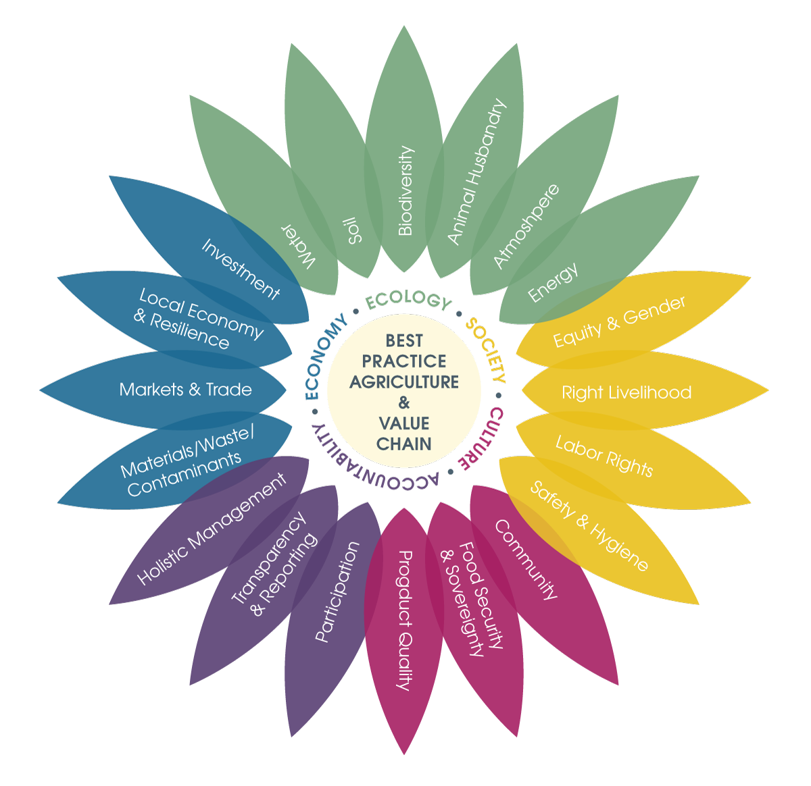
The Sustainability Flower (2012-15)
Notes:
Societal: People live in equality and equity.
Ecological: Common resources are used sustainably.
Economic: Trading leads to prosperity.
Cultural: Inspiration, innovation, leadership, and altruism are enabled. Communities are stable and thrive.
Accountability: People are accountable for their actions; actions are taken in a responsible manner; stakeholders are encouraged to participate.

Slide 32
Sustainability comparisions
“Organic Agriculture in the 21st century” (Reganold and Wachter, 2016)
http://www.nature.com/articles/nplants2015221
Notes:
This meta study published in 2016 shows beautifully how OA addresses a broad spectrum of sustainability issues!
Reganold and Wachter shows how OA outperforms conventional agri on all front but one, and this „one“ has to be redefined – and, in fact already is!
Yield is traditionally measured in very simplistic and narrow ways: Tonnage, Calories, Mono-crop measurements, without taking cognisance of all the other „yield“ that an plot of irganically managed land can offer.
Diverstity of foodstuffs, soil organic matter, ecosystem services and the like.
And, when one start looking at an integrated and holitic food managemnet system, then the yield issue is actually a straw man argument. It is outdated, and overdue for a redefinition.
We need to NOURISH the world, not FEED it. We are already feeding it – badly.

Slide 33
Organic agriculture in the 21st century
Organic farming systems produce lower yields compared with conventional agriculture.
However, they are more profitable and environmentally friendly, and deliver equally or more nutritious foods that contain less (or no) pesticide residues, compared with conventional farming.
Moreover, initial evidence indicates that organic agricultural systems deliver greater ecosystem services and social benefits.
Significant barriers exist to adopting these systems, however, and a diversity of policy instruments will be required to facilitate their development and implementation.
“Organic Agriculture in the 21st century” (Reganold and Wachter, 2016)
http://www.nature.com/articles/nplants2015221

Slide 34
In Conclusion:
Practicing the Principles, or;
Doing the Definition

Slide 35
“A production system, sustaining the health of soils, ecosystems and people”

Slide 36
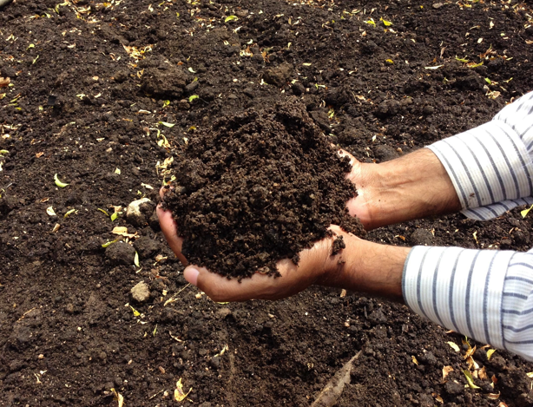
Soils

Slide 37
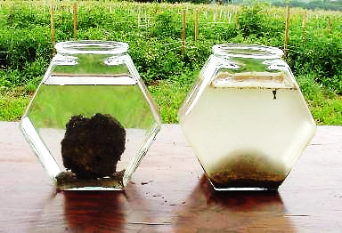
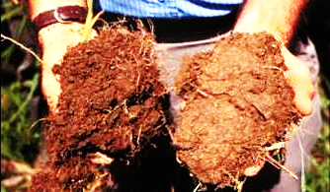
Soils
Higher yields in extreme conditions
Increased soil C and N
Higher water infiltration
Higher water holding capacity
Higher microbial activity
Increased stability

Slide 38
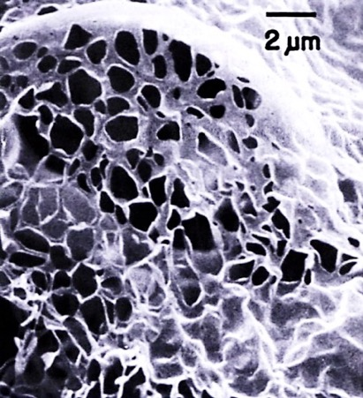
Soils - Humus
Electron micrograph of
soil humus
Holds up to 30x its weight in water
Cements soil particles and reduces soil erosion
Increases nutrient storage & availability
Humus can last 2000 years in the soil

Slide 39
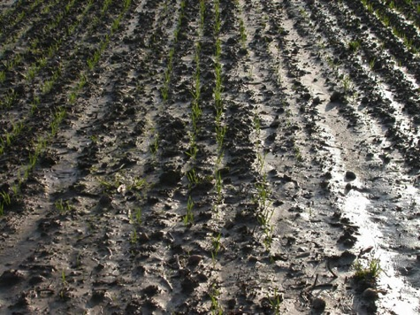
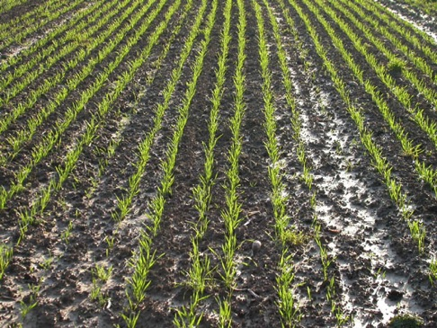
Soils – resilience: Floods, Switzerland
Biodynamic plot
Conventional/IPM plot
Fotos: Fliessbach
Nov. 2002 (DOK Trials)

Slide 40
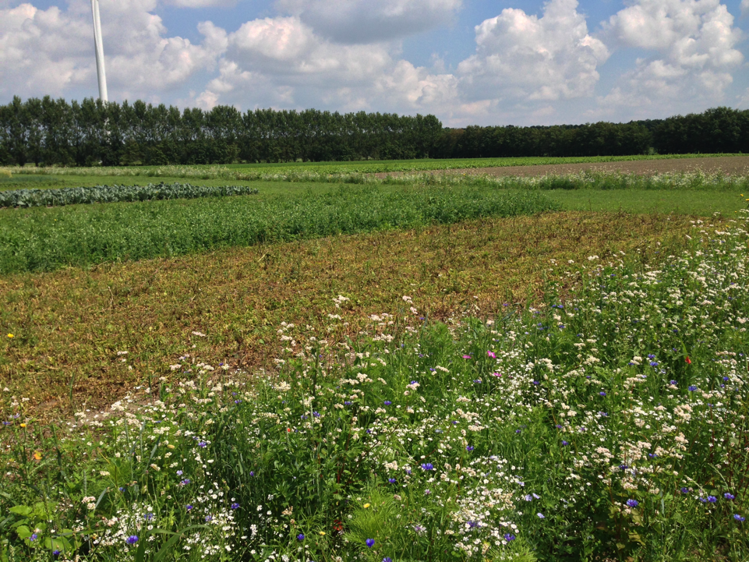
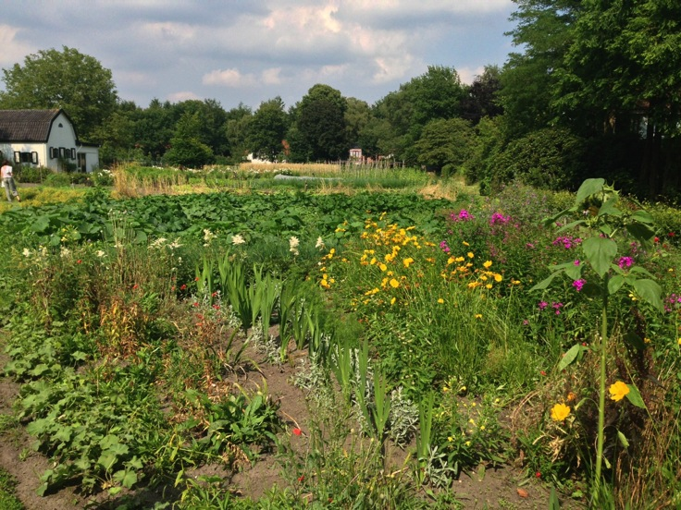
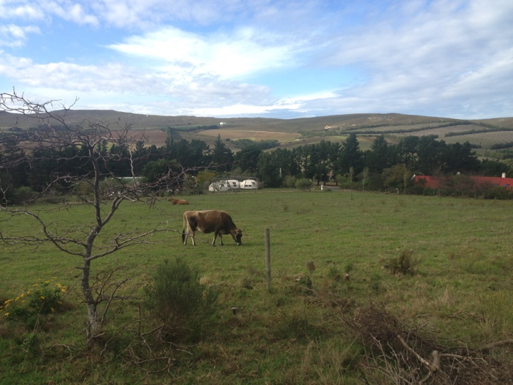
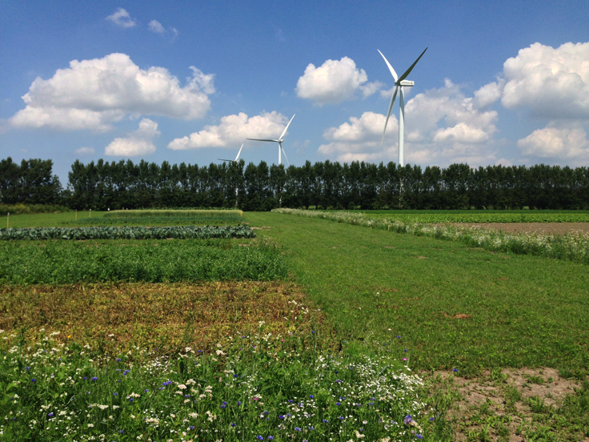
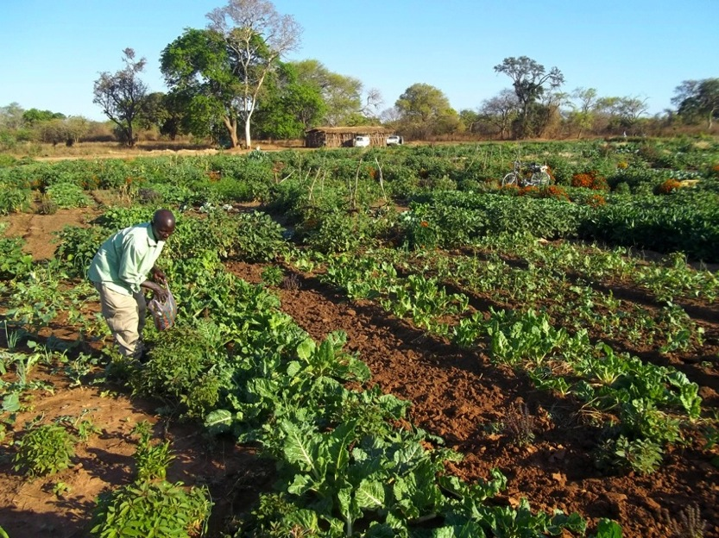
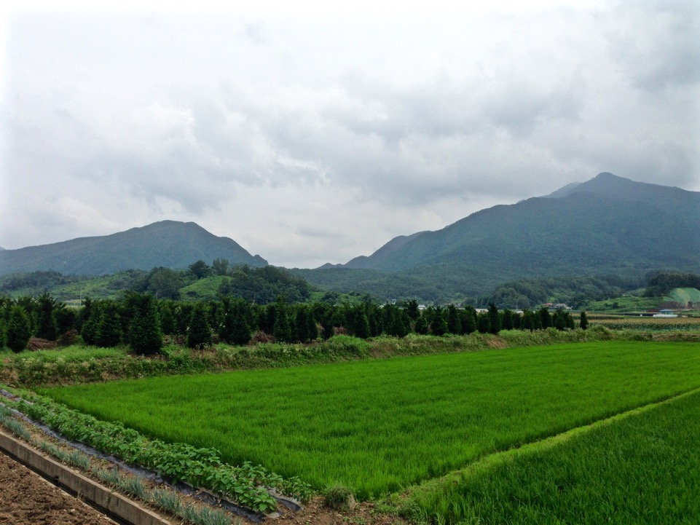
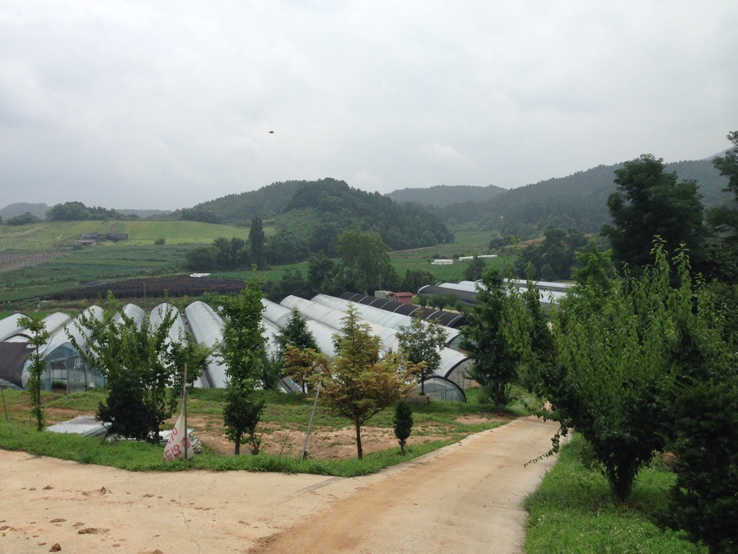
Ecosystems

Slide 41
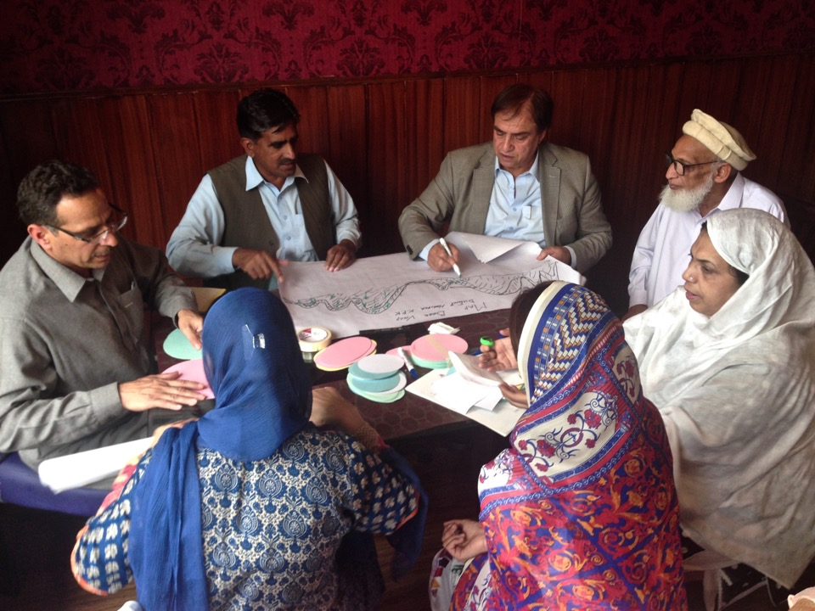
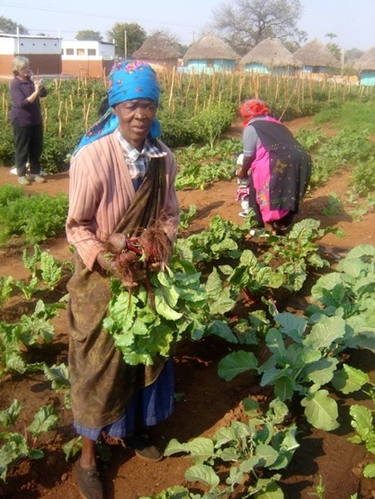
People

Slide 42
“.. relies on ecological processes, biodiversity and cycles adapted to local conditions, rather than the use of inputs with adverse effects.”

Slide 43
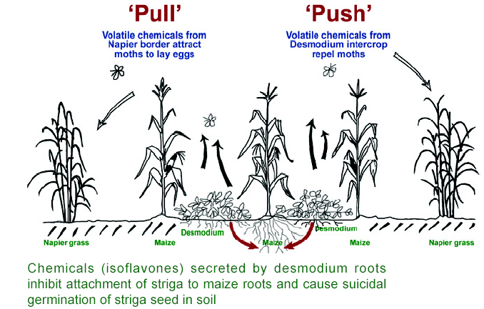
Ecological processes rather than inputs

Slide 44
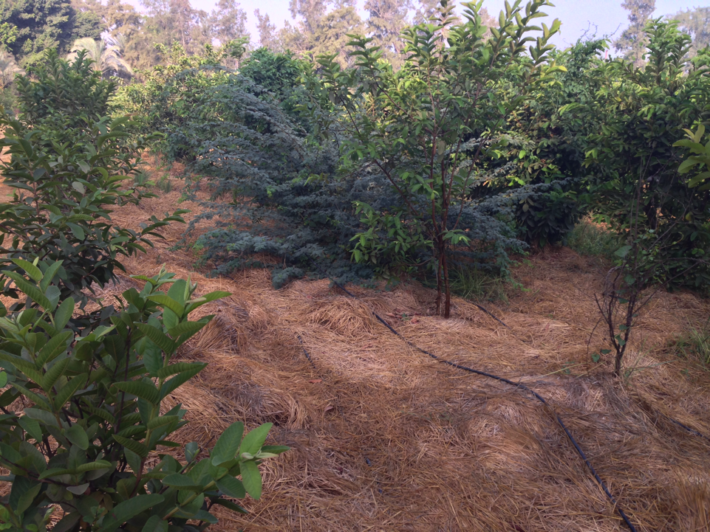
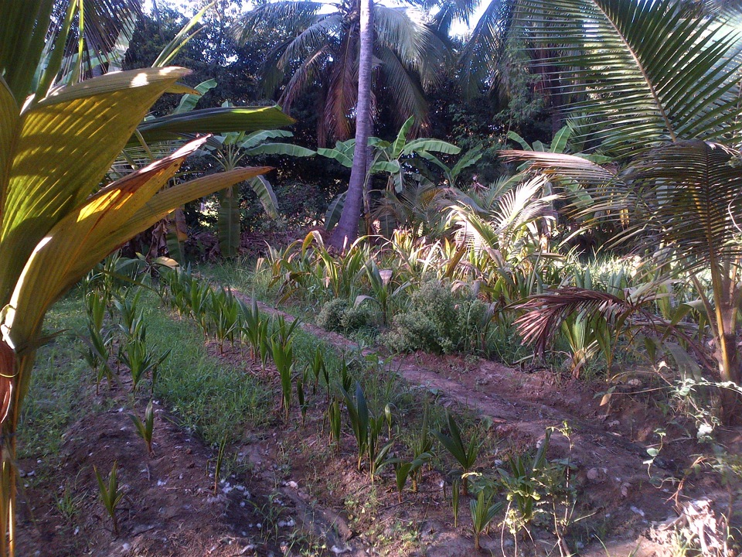
Ecological processes rather than inputs

Slide 45
“combines tradition, innovation and science to benefit the shared environment ....”

Slide 46
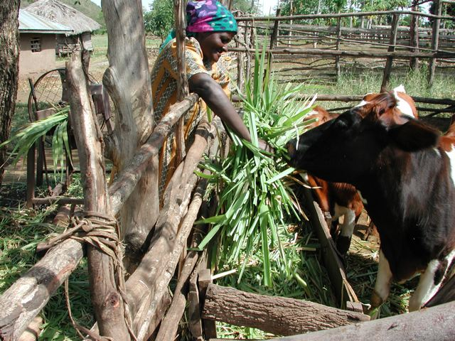
Tradition
Animal husbandry in the crop production system

Slide 47
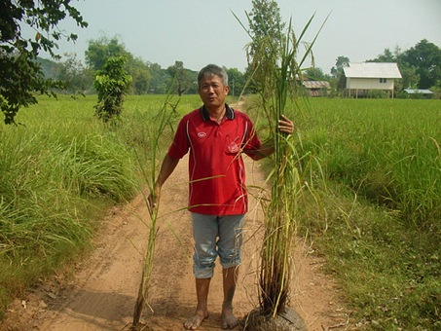
Innovation
System of Rice Intensification (SRI)
In Madagascar, SRI has increased yields from the usual 2-3 tons per hectare to yields of 6,8 - 10 tons per hectare.
Source: Nicolas Parrott, Cardiff University, 'The Real Green Revolution‘

Slide 48
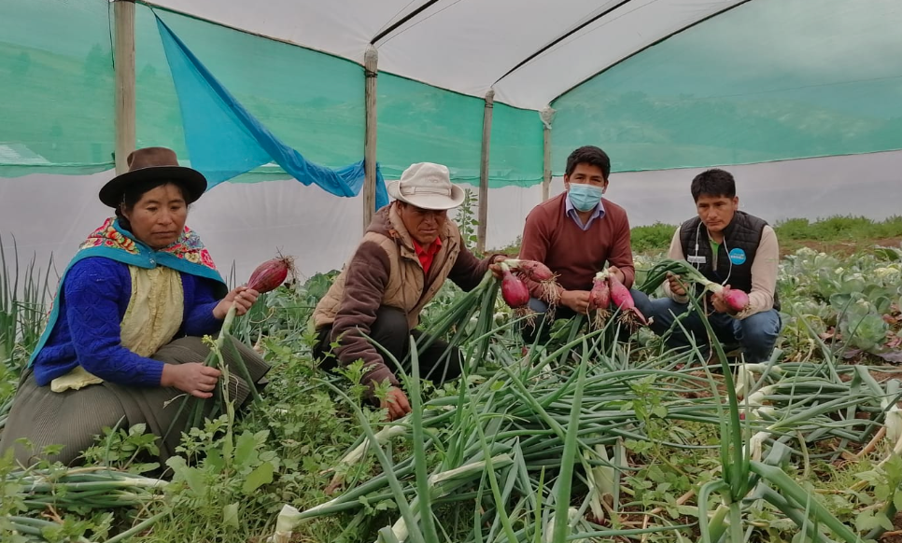
Innovation

Slide 49
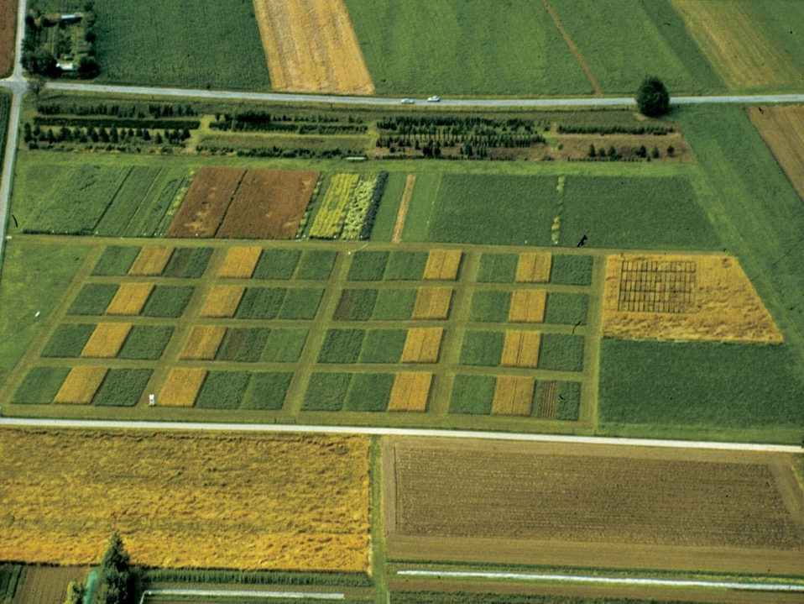
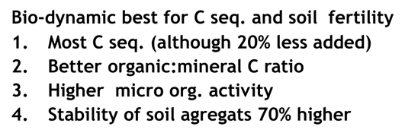
…and science
Integrated
Organic
Bio-dyn.
Control
Bio-dynamic best for C seq. and soil fertility
Most C seq. (although 20% less added)
Better organic:mineral C ratio
Higher micro org. activity
Stability of soil agregats 70% higher

Slide 50
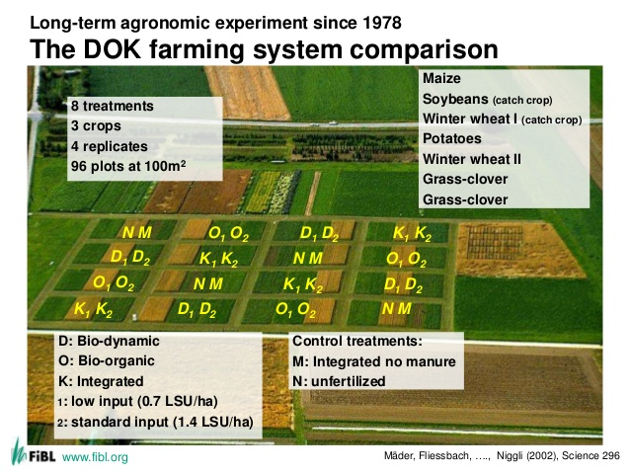
Science
http://www.fibl.org/en/switzerland/research/soil-sciences/bw-projekte/dok-trial.html

Slide 51
“Fair relationships and a good quality of life for all involved.”

Slide 52
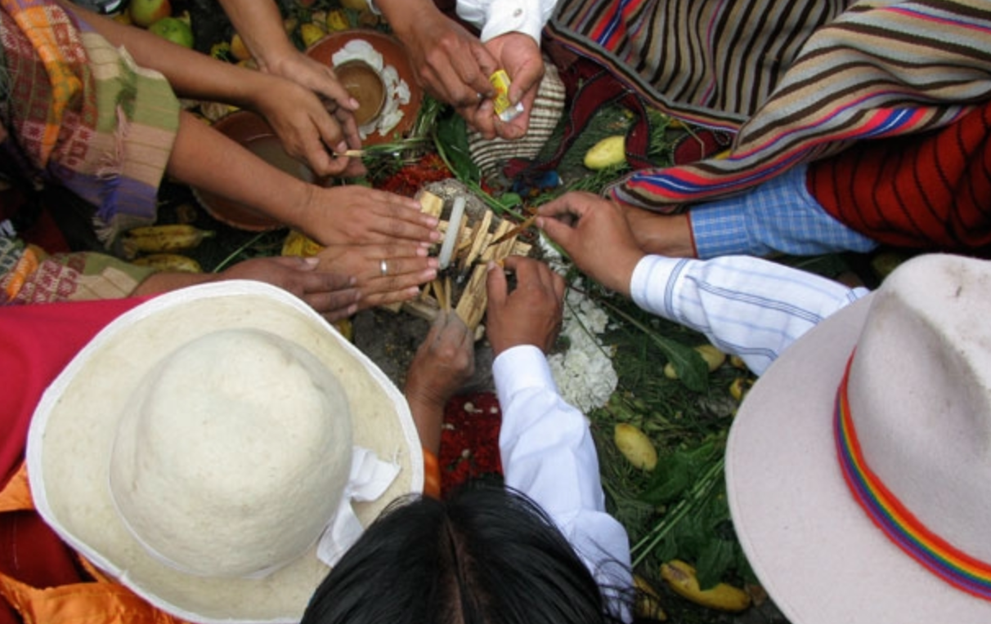
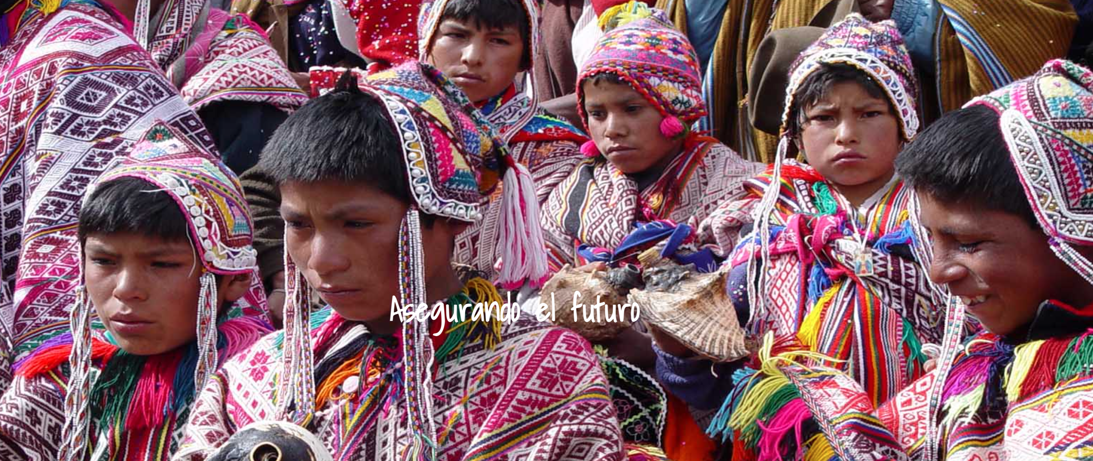
fair relationships and a …

Slide 53
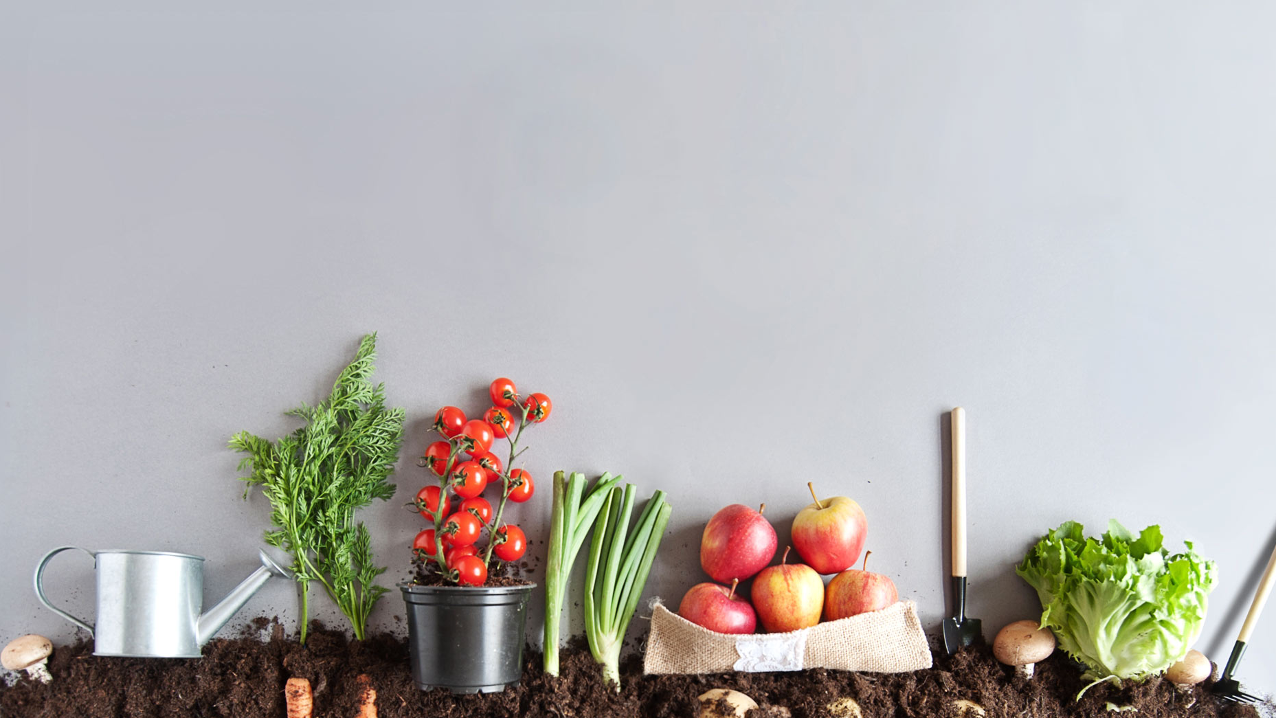
We are leading change, organically!
Together with our members in over 100 countries and territories as well as regional bodies and sector platforms. We inspire change.
Why not join us?
Go to: https://ifo.am/Join
p.flores@ifoam.bio

Slide 54
Thank you…☺

