Slide 1
Getting to know each other
Where do you live?
What languages do you speak?
What is your background?
What do you work on?
LET’S CREATE A PHYSICAL SYSTEM!
Position yourself …
Exercise:
Sociometric / constellations
What we have in common
Where are the stars?

Slide 2
1. The Why

Slide 3
Why are you here? What is your motivation?

Slide 4
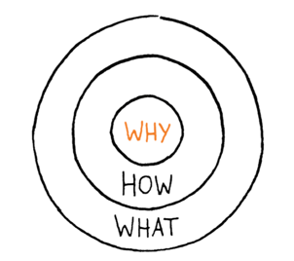
ALWAYS START WITH THE WHY: SIMON SINEK’s “GOLDEN CIRCLE”

Slide 5
#1: Define Your “Why”
Your WHY is your central belief.
In terms of an organization, it’s the reason you’re in business.
The WHY leads to the HOW and the WHAT:
The WHY: This is the vision of your organization/self
It’s the motivation behind your service or product.
It’s the mission that you stand for.
The HOW: The HOW are the practical steps you need to take to achieve your WHY.
The HOW is the practical, operational knowledge that brings the vision to life.
The WHAT: The WHAT is the product or service you are selling or providing.
It’s the tangible part of your company, and it’s also the easiest to identify.

Slide 6
#2 Set the Standard for Your Field
Those who lead aren’t necessarily #1 terms of market share,
but they’re the companies or people who are setting the course for their industries.
Great leaders:
Create a following of loyal people who rally around their WHY.
Inspire people to act because they want to, not because they’re responding to an outside incentive.
Belong to all different sectors.
Great leaders can come from any walk of life or industry.
Have exceptional amounts of influence inside and outside of their industries.

Slide 7
#3: Be Innovative, Not Novel
Novelty — defined as being “new” or “unusual” — is often marketed as “innovation.”
But novelty and innovation are very different from one another.
Novelty is merely introducing something new and will eventually fade into the past.
Innovation is change that is valuable and persists in the sector well into the future.
It is real reinvention, in ways that matter to all in the long-term.

Slide 8
#4: Combine WHY with HOW
Most WHYs need a practical HOW to help translate their vision and passion to the rest of the organization.
WHY types live in the future, and HOWs live in the present.
WHYs are dreamers, while HOWs are practical.
WHY types and HOW types are capable people who can run businesses without the other.
But in order to build a world-changing movement or organization, both need to exist.
Without a strong HOW, inspirational WHY leaders have big ideas but struggle to execute them.

Slide 9
What kind of leader/change agent do you want to be and why?

Slide 10
OLC
Leadership Styles
Autocratic
Democratic
Strategic
Transformational
Team
Cross-cultural
Facilitative
Laissez-faire
Transactional
Coaching
Charismatic
Visionary
Servant
And my personal favourite…
Notes:
1. Autocratic Leadership
Autocratic leadership style is centered on the boss. In this leadership the leader holds all authority and responsibility. In this leadership, leaders make decisions on their own without consulting subordinates.
They reach decisions, communicate them to subordinates and expect prompt implementation. An autocratic work environment normally has little or no flexibility.
In this kind of leadership, guidelines, procedures and policies are all natural additions of an autocratic leader. Statistically, there are very few situations that can actually support autocratic leadership.
Some of the leaders that display this kind of leadership include: Albert J. Dunlap (Sunbeam Corporation) and Donald Trump (Trump Organization), among others.
Steve Jobs is another leader who was famous for using fear to inspire people to get their work done. This leadership style can obviously stifle the leader’s subordinates, but can also be useful in a crisis when important decisions need to be made without delay
2. Democratic Leadership
In this leadership style, subordinates are involved in making decisions. Unlike the autocratic style, this leadership is centered on subordinates’ contributions. The democratic leader holds final responsibility, but he or she is known to delegate authority to other people, who determine work projects.
The most unique feature of this leadership is that communication is active upward and downward. With respect to statistics, democratic leadership is one of the most preferred styles of leadership, and it entails the following: fairness, competence, creativity, courage, intelligence and honesty.
George Washington was a leader who was famous for his democratic focus. Medical and high-tech industries fit well with a democratic leadership style because they require a high amount of collaboration to function.
3. Strategic Leadership Style
Strategic leadership is one that involves a leader who is essentially the head of an organization. The strategic leader is not limited to those at the top of the organization. This style is geared to a wider audience at all levels who want to create a high performance life, team or organization.
The strategic leader fills the gap between the need for new possibility and the need for practicality by providing a prescriptive set of habits. Effective strategic leadership delivers the goods in terms of what an organization naturally expects from its leadership in times of change. 55% of this leadership normally involves strategic thinking.
Sports is clearly an area where we can observe many leadership styles, and one in which strategy is crucial. Hockey player and coach Wayne Gretzky is well-known for his skill in strategizing.
Strategic leaders anticipate future needs and make decisions in the present to meet those needs. Gretzky famously said, “‘I skate to where the puck is going to be, not where it has been.”
4. Transformational Leadership
Unlike other leadership styles, transformational leadership is all about initiating change in organizations, groups, oneself and others.
Transformational leaders motivate others to do more than they originally intended and often even more than they thought possible. They set more challenging expectations and typically achieve a higher performance.
Statistically, transformational leadership tends to have more committed and satisfied followers. This is mainly so because transformational leaders empower followers.
William Edwards Deming, a statistician and engineer, is a leader who saw the best way certain systems could operate and taught those under him how to accomplish these goals.
5. Team Leadership
Team leadership involves the creation of a vivid picture of a team’s future, where it is heading and what it will stand for. The vision inspires and provides a strong sense of purpose and direction.
Team leadership is about working with the hearts and minds of all those involved. It also recognizes that teamwork may not always involve trusting cooperative relationships.
The most challenging aspect of this leadership is whether or not it will succeed. According to Harvard Business Review, team leadership may fail because of poor leadership qualities, as well as other challenges. For example, an airline flight crew would be much more efficient if the team remained consistent.Studies have shown that teams that have worked together for a long period of time are more effective than those that have not. But because keeping a flight crew together would be expensive, crews change their members all the time. Situations such as this are just one example of the challenges teams face.
6. Cross-Cultural Leadership
This form of leadership normally exists where there are various cultures in the society. This leadership has also industrialized as a way to recognize front-runners who work in the contemporary globalized market.
Organizations, particularly international ones, require leaders who can effectively adjust their leadership to work in different environs. Most of the leadership environments in the United States are cross-cultural because of the different cultures that live and work there.
One example of a cross-cultural leader in sports is quarterback and Heisman Trophy winner Mariota Marcus. His Hawaiian background caused him to be an unpretentious player, in contrast to being a more aggressive one, yet he was still successful.
7. Facilitative Leadership
Facilitative leadership is dependent on measurements and outcomes – not a skill, although it takes much skill to master. The effectiveness of a group is directly related to the efficacy of its process. If the group is high functioning, the facilitative leader uses a light hand on the process.
On the other hand, if the group is low functioning, the facilitative leader will be more directive in helping the group run its process. An effective facilitative leadership involves monitoring group dynamics, as well as offering process suggestions and interventions to help the group stay on track.
8. Laissez-faire Leadership
Laissez-faire leadership gives authority to employees. According to azcentral, departments or subordinates are allowed to work as they choose with minimal or no interference. According to research, this kind of leadership has been consistently found to be the least satisfying and least effective management style.
But to a certain extent, delegating is necessary. Famous historical projects led by laissez-faire leaders include the building of the Panama Canal and the Hoover Dam. With both projects, the presidents involved had to delegate many responsibilities in order to succeed.
Completion of Panama Canal in 1904 was a complicated feat. This was only made possible when American President of that time Theodore Roosevelt decided to lead this project. The successful completion of Panama Canal is an engineering marvel, because of its geographical location it came across several road blocks and incidents, but all hurdles were overcome as authority was correctly delegated to professionals.
9. Transactional Leadership
This is a leadership style that maintains or continues the status quo. It is also the leadership that involves an exchange process, whereby followers get immediate, tangible rewards for carrying out the leader’s orders. Transactional leadership can sound rather basic, with its focus on exchange.
Being clear, focusing on expectations, giving feedback are all important leadership skills. Transactional leadership behaviors can include: clarifying what is expected of followers’ performance, explaining how to meet such expectations, and allocating rewards that are contingent on meeting objectives.
10. Coaching Leadership
Coaching leadership involves teaching and supervising followers. A coaching leader is highly operational in settings where results/performance require improvement.
Basically, in this kind of leadership, followers are helped to improve their skills. Coaching leadership does the following: motivates followers, inspires followers and encourages followers.
Some examples of people who have led through coaching are tennis coach Nick Bollettieri and dog behaviorist Cesar Milan.
11. Charismatic Leadership
In this type of leadership, the charismatic leader manifests his or her revolutionary power. Charisma does not mean sheer behavioral change. It actually involves a transformation of followers’ values and beliefs.
Therefore, charismatic leaders are not merely a simply populist leaders who affect attitudes towards specific objects. Rather, these leaders transform the underlying normative orientation that structures specific attitudes.
Charismatic leaders tend to have powerful personalities and attract huge followings. Examples of such leaders are Barack Obama and Oprah Winfrey.
12. Visionary Leadership
This form of leadership involves leaders who recognize that the methods, steps and processes of leadership are all obtained with and through people.
Most great and successful leaders have some sort of vision for where they are going. However, there are those who are highly visionary in their leadership.
Examples of leaders who had powerful and inspirational visions include Nelson Mandela and Dr. Martin Luther King Jr. Outstanding leaders will always transform their visions into realities.

Slide 11
OLC

Slide 12
Change Agent

Slide 13
What is a change agent?
A change agent, or agent of change, is someone who promotes and enables change to happen within any group or organization.
A change agent is an individual who promotes and supports a new way of doing something within the company/organization
Examples: a new process, the adoption of a new management structure or the transformation of an old business model to a new one.

Slide 14
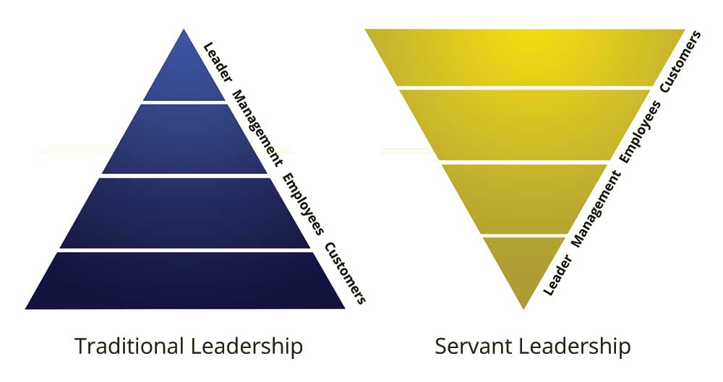

Slide 15
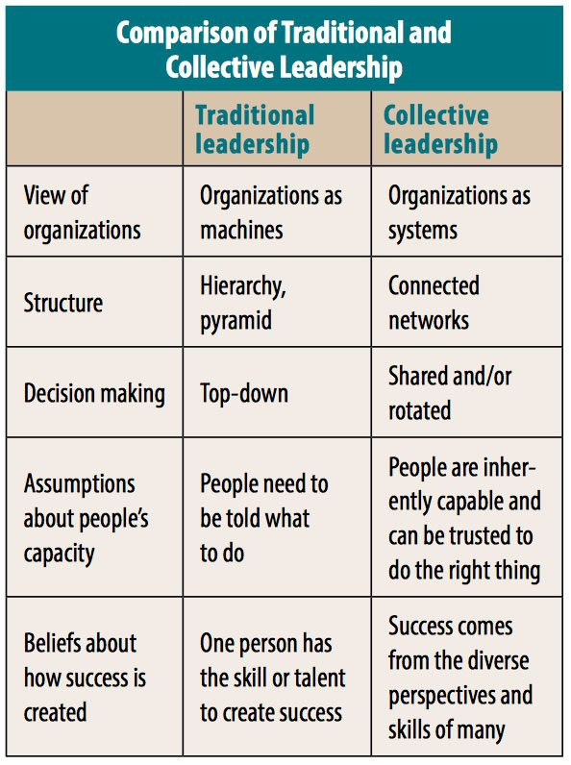
COLLECTIVE
LEADERSHIP
No more heroes,
we need leaders as “hosts”: those who have the skills to promote shared learning, effective group decision making, reflection, visioning and goal setting, and mutual accountability.

Slide 16
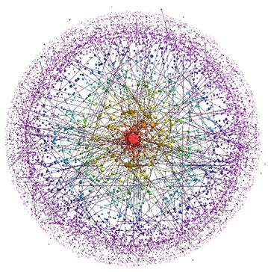
OLC
Changing the Values
If we change the system values, we change the system…

Slide 17
The Theory of U
Otto Scharmer -
Presencing Institute
The success of an intervention depends on the
interior condition of the intervenor. Bill O’Brien
The success of our actions as change-makers does not depend on What we do or How we do it, but on the Inner Place from which we operate (WHY).

Slide 18
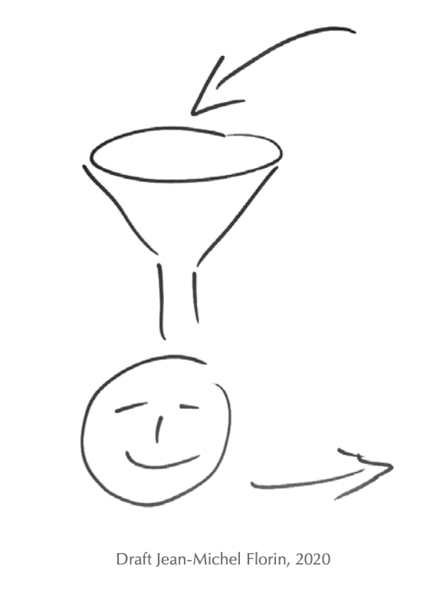
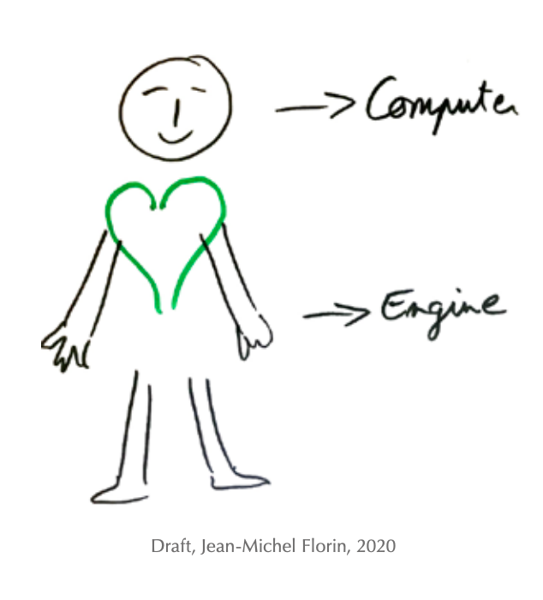
Harmonizing the self
ToToT
Head and intellect = computer and information centre
Hands and will = engine and wheels
Heart quality. This is necessary in order to develop interest and then make a connection to the entity.
Notes:
Learning consists of discovering new things, integrating new things and changing ourselves, or that education is a mixing where two things come together –

Slide 20
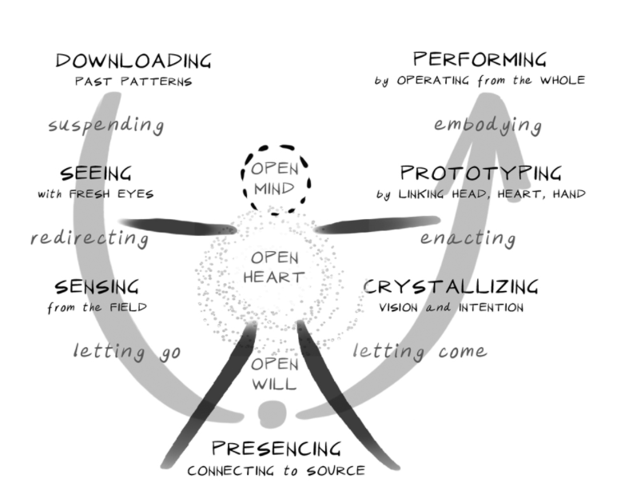
The success of the intervention depends on the interior condition of the agent of change
Build common intent
Stop and listen to others
To what life calls you to do
“What the wind brought me”
Embody the New in Ecosystems
That facilitate seeing and acting from the whole
Protoyype the New
Living examples to explore the future by doing
Observe, observe, observe
Go to the places of most potential
Listen with your mind
hear wide open
Connect to the Source of Inspiration and Will
Go to the place of silence
Allow the inner knowiing to emerge

Slide 22
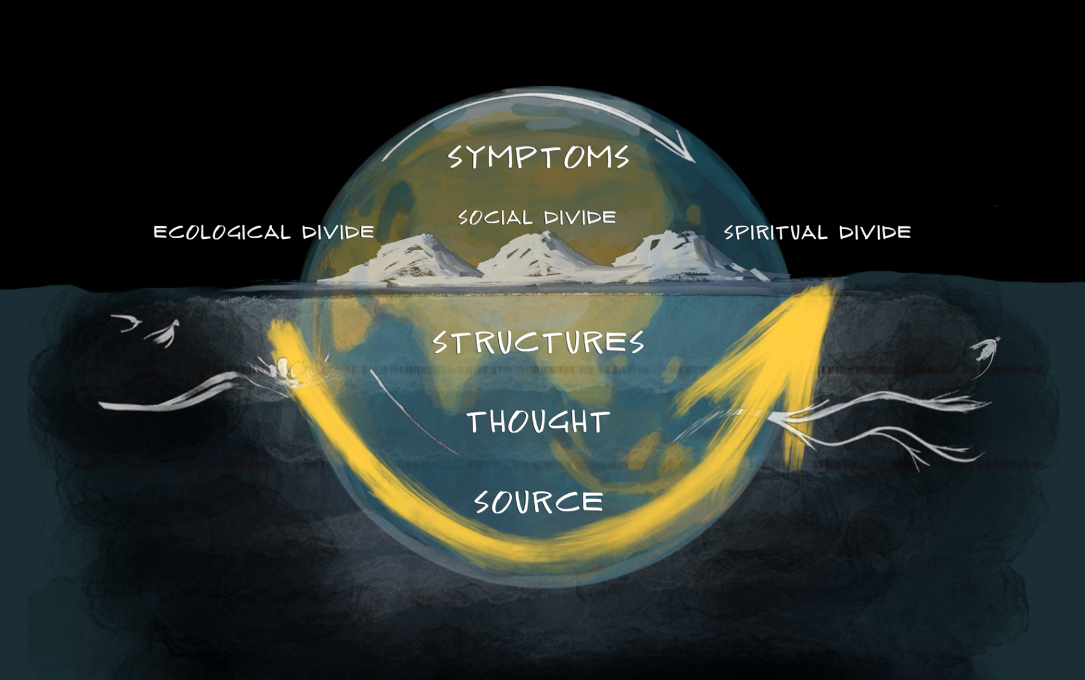

Slide 23
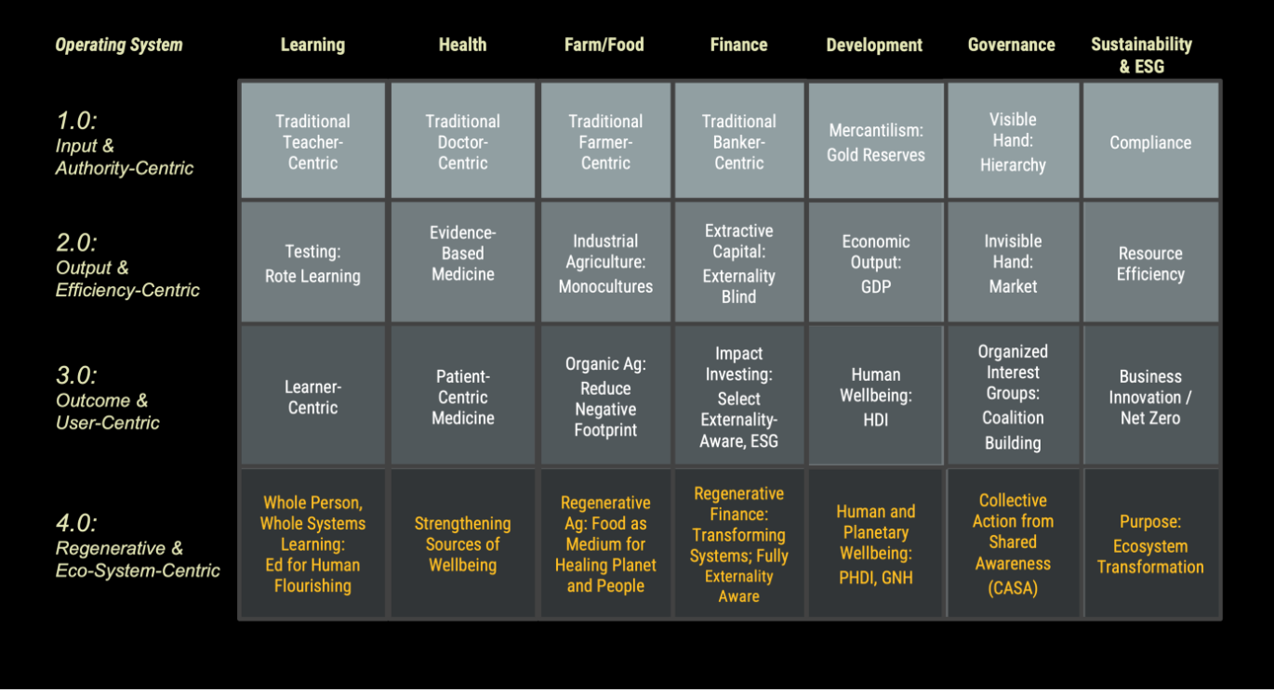

Slide 24
OLC
Leadership in Culture
What does it mean to be a change agent in your own context? In your own culture and paradigm?
How do you influence, convince, inspire?
What are the challenges?
What are the successes?
What did you have to change within yourself?
…

